Slide 1
WEBINAR: Test Automation & Robotic Automation of Dynamics AX with Rapise
October 18th, 2018 – Adam Sandman, @adammarksandman Denis Markovtsev, @dmarkovtsev

Slide 2
WEBINAR: Test Automation & Robotic Automation of Dynamics AX with Rapise
We will be starting the webinar shortly, please stand by…
All phones will be automatically on mute until the Q&A.
October 18th, 2018 – Adam Sandman, @adammarksandman Denis Markovtsev, @dmarkovtsev

Slide 3
Robotic Process Automation - RPA
RPA – is a software for automatic manipulation of PC’s user interface.
RPA software can do what a real user can do and more.

Slide 4
What RPA Can Do
Save time
Repetitive tasks
24/7
Save budget
Work autonomously
Analyze Process
Integrate legacy systems
large volumes of data
for employees

Slide 5
RPA Benefits
Fast & Cheap Implementation
Easy to Support
Local & Remote Scheduled & On Demand Execution
Data Access Control at UI Level
Uses Existing IT Systems

Slide 6
Agenda
Overview of Rapise capabilities
RPA & Test scenarios you can do with Rapise
Demo scenario
Necessary skills
Our offering
Q&A

Slide 7
Rapise Capabilities

Slide 8
Rapise Capabilities
Automation for Desktop, Mobile and Web applications
Independent of screen resolution and coordinates
REST and SOAP calls to third-party systems
Database connection
Email processing
File & Command Line operations
Text manipulation
Full support for Excel spreadsheets
Flexible reporting

Slide 9
Supports Multiple Platforms & Technologies
Web Applications
Mobile Applications
Cross-Platform Technologies
Windows Applications
Desktop Applications
Web Applications
Unit Test Frameworks
Integrations

Slide 10
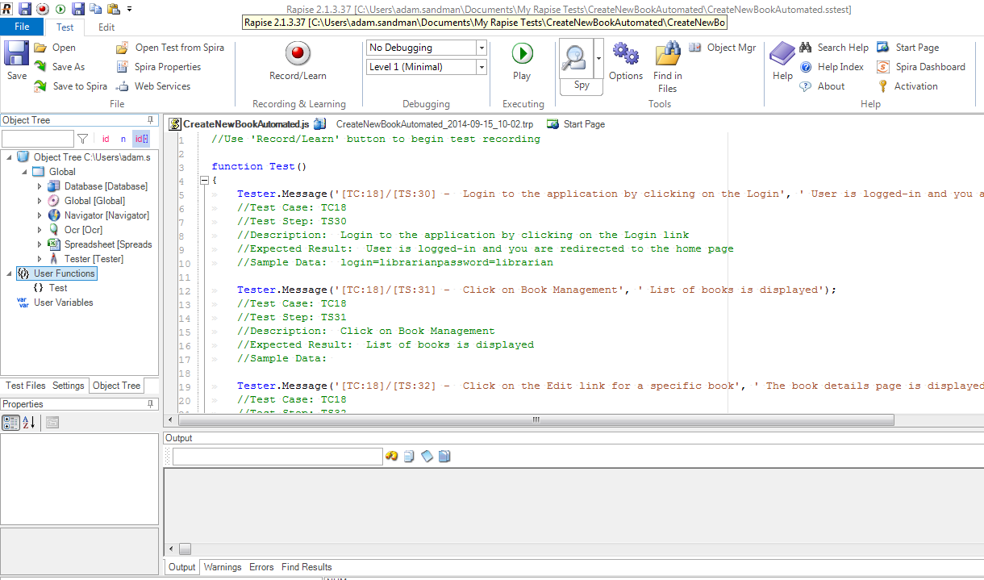
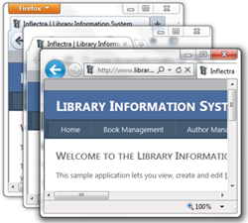
Web Applications
Rapise supports multiple versions of IE, Edge, Firefox Chrome, Safari and Opera.

Slide 11
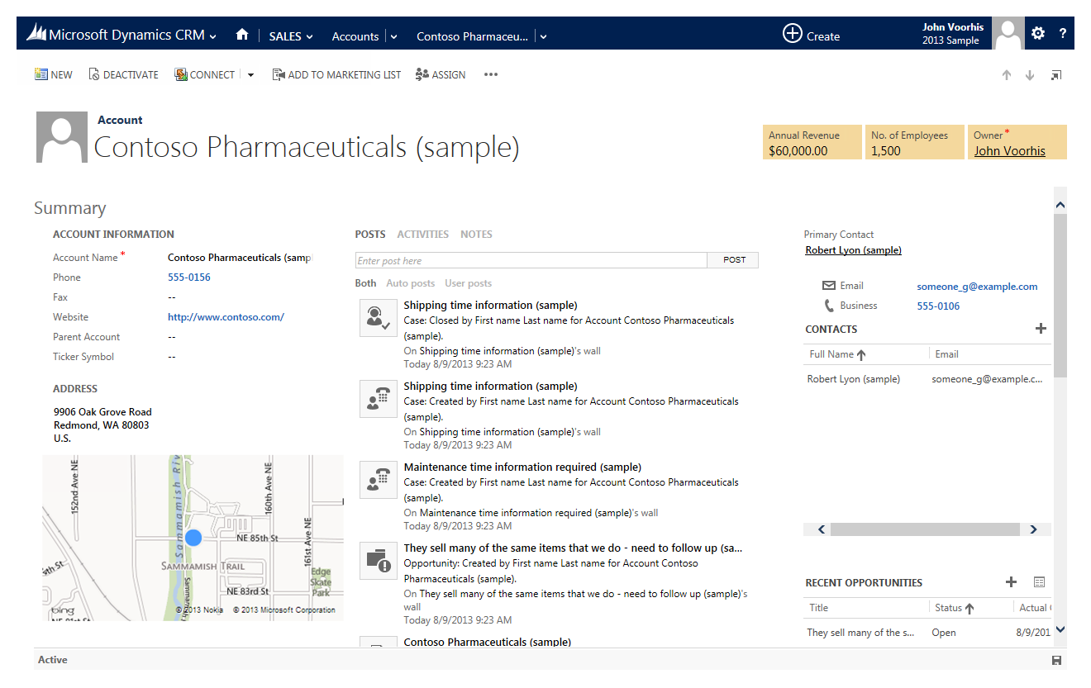
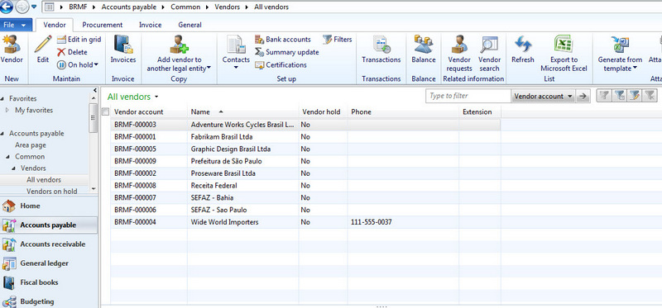
Desktop Applications
Rapise can automate most desktop applications

Slide 12
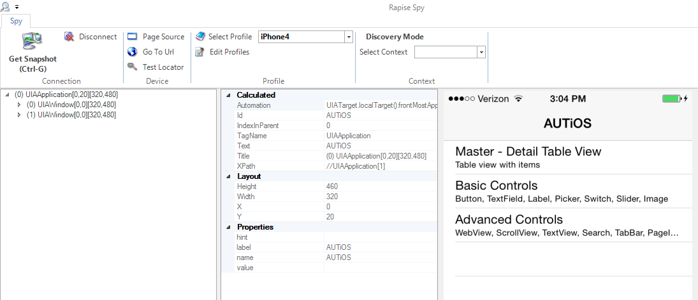
Mobile Apps
Automate Mobile Apps (native, web, iOS, Android)

Slide 13
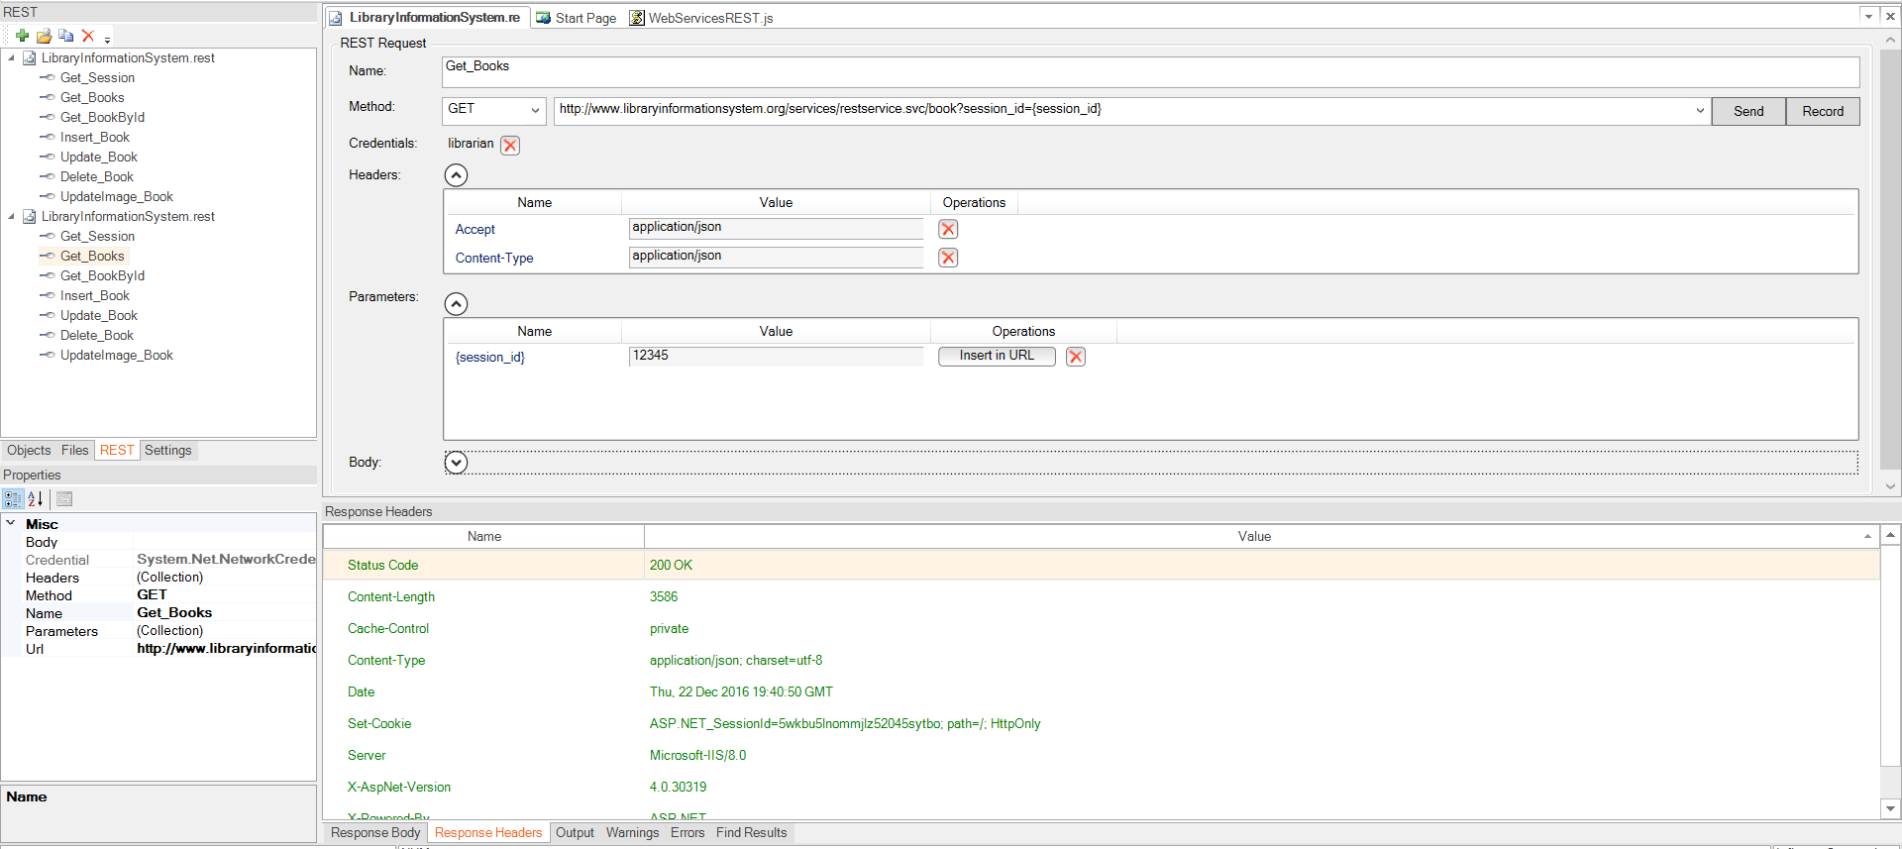
Web Services & APIs
Automate REST and SOAP APIs

Slide 14
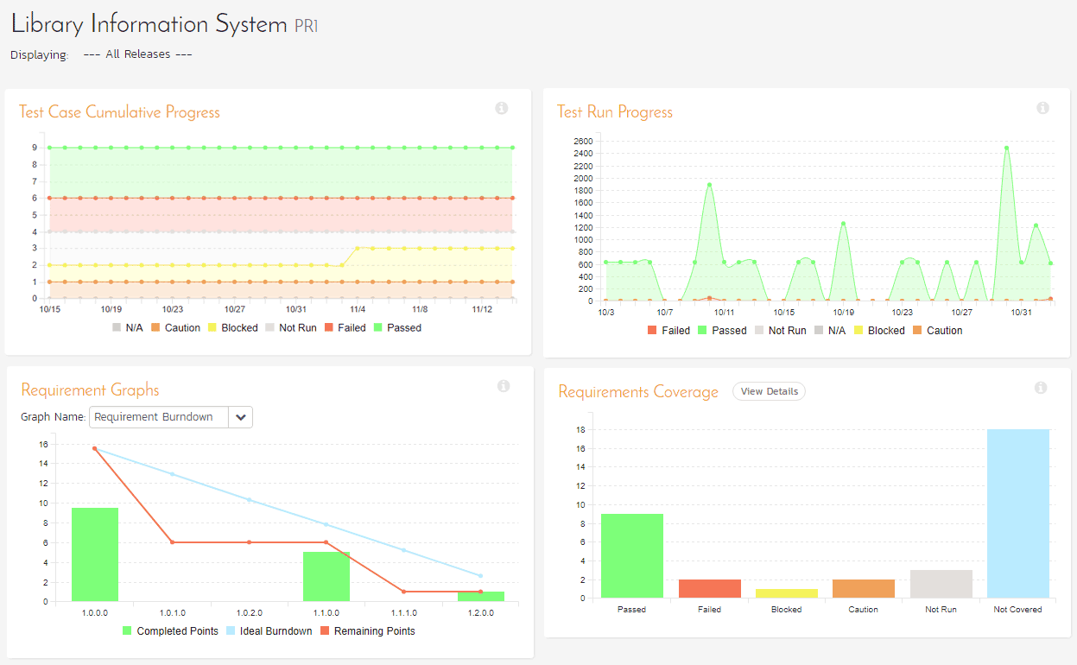
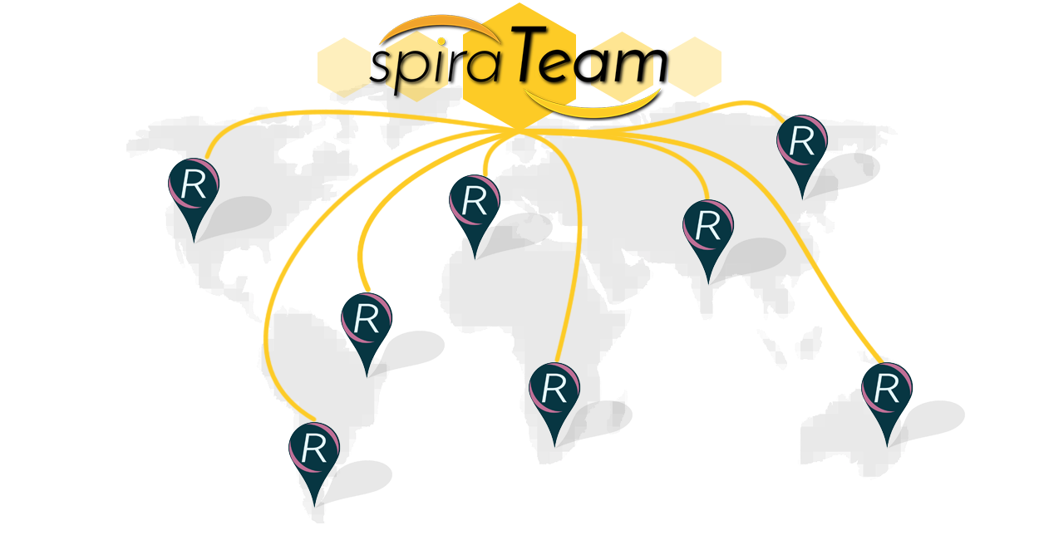
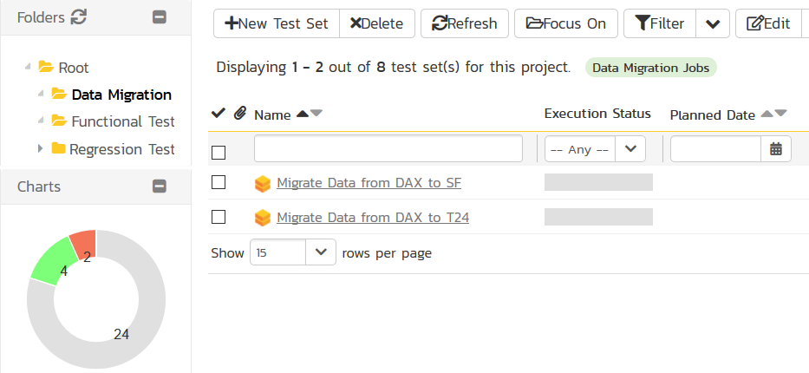
Process Orchestration with SpiraTeam

Slide 15
RPA Scenarios & Tasks
Fill a form based on data in external file
Create a record from incoming email
Import data from a spreadsheet or third-party system
Web scraping
Screen scraping
Terminal automation

Slide 16
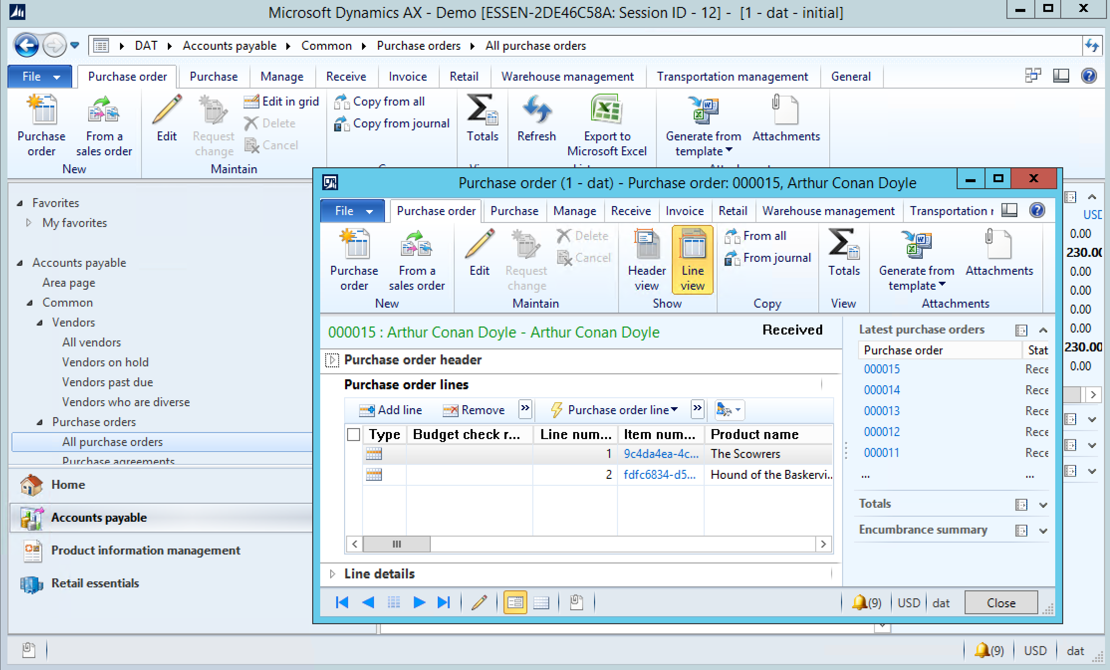
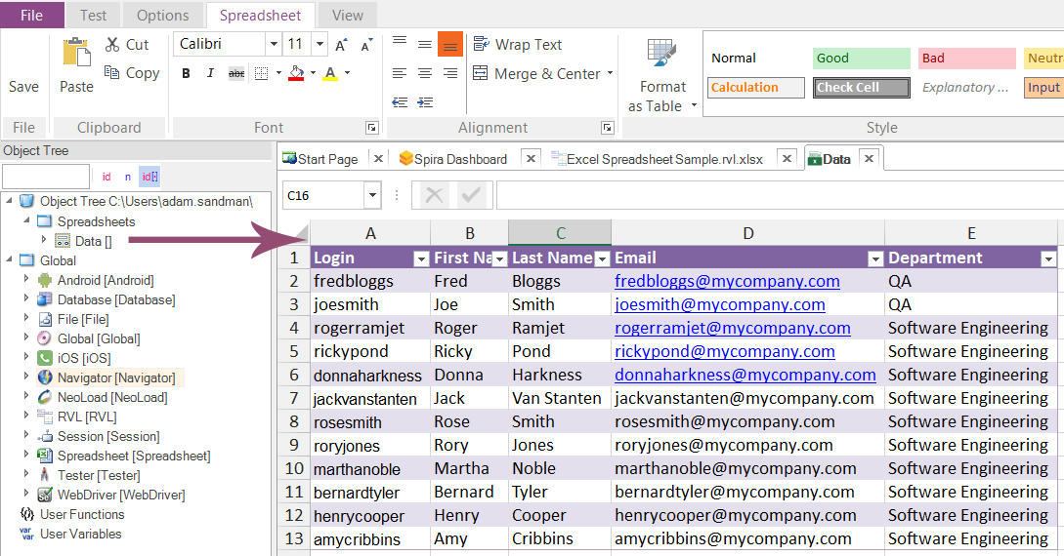
Demo
Importing categories, vendors and products from Excel spreadsheet
Do not create a new record if data already exists
Output important information into the same spreadsheet

Slide 17
Live Demo

Slide 18
Necessary Skills
Knowledge of a programming language is not required for most scenarios
Rapise Visual Language
For advanced scenarios
basic knowledge of JavaScript

Slide 19
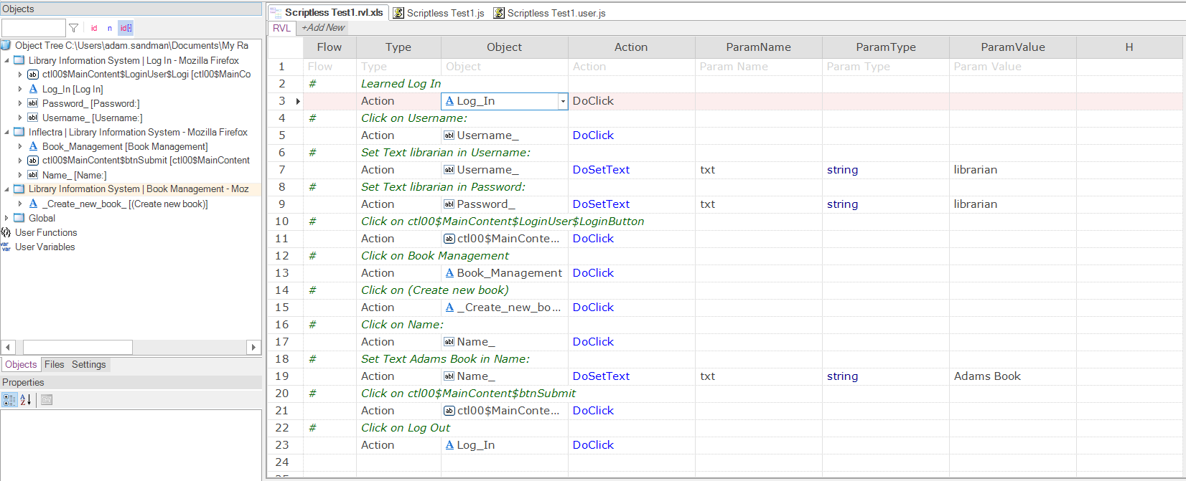
Rapise Visual Language (RVL)
Easier to use, Easier to maintain.

Slide 20
Our Offering
Rapise RPA tool
Training services
Implementation services

Slide 21
Recap – Rapise Automation Capabilities
MS Dynamics – NAV, AX, Business Central, Dynamics 365
WEB – receiving and sending data from/to websites
Databases – sending/receiving data to/from MS SQL, My SQL
MS Office – creating and full manipulation of Excel tables
Email – sending, receiving and manipulation of emails
External data files – CSV, XML, JSON and other – reading and writing
WEB Services – sending and receiving of REST and SOAP requests
Terminals – full manipulation of terminal (Green Screen) based solutions

Slide 22
Next Steps
If you like what you saw today:
Sign Up to Our Partner Program
Reseller and/or
Affiliate
Purchase a heavily discounted partner license
Discounts of 75% if you sign up to be a partner
We are offering free training for a limited time
If you become a partner and purchase partner license,
Certified Partner Program

Slide 23
Questions?
Please Use the Chat Window or Unmute Your Line

