Slide 1

Requirements, Test & Defect Management

Slide 2
Why Inflectra?

Slide 3
When Failure Isn’t An Option. We Help You Deliver. And Prove It.
Inflectra unifies software delivery, quality, compliance, and traceability so you can ship at AI speed, reduce risk, and prove every release is ready.

Slide 4



With Inflectra, Deliver Measurable Quality Fast! Only 16% of software development projects are completed on time and within budget.
PRODUCT MANAGERS
QUALITY ASSURANCE
SOFTWARE TESTING
52%
of time spent on un-planned “fire-fighting” activities
40%
of software budget spent on Quality Assurance
5%
of companies carry out fully automated testing internally
60%
of businesses lack a plan to enhance their PM process
39%
of software projects fail due to poor requirements gathering
24%
of companies saw ROI uplift from automated testing
39%
of managers that worry about missing launch date
67%
of customers cite “bad experience” with products as their churn reason
35%
of companies use non-testers for software testing
Sources: “Software Survival in 2024”, Beta Breakers; “10 QA Statistics”, Testlio; “Product Management Statistics”, UXCam; “Software Testing Statistics – 2024”, TrueList

Slide 5








The Inflectra® Platform
RemoteLaunch®
Test Orchestration
SpiraCapture™
Exploratory Testing
SpiraApps™
Extensibility
SpiraPlan®
Enterprise Software Development Lifecycle Management
SpiraTeam®
Software Development Lifecycle Management for Teams
SpiraTest®
Requirements, Test & Defect Management
Rapise®
UI & API Test Automation
Inflectra.ai
Agentic AI Platform

Slide 6




Spira Platform Snapshot
Capabilities
SpiraTest
SpiraTeam
SpiraPlan
Requirements Management
Test Management & Traceability
Defect & Issue Tracking
Agile Planning Tools
Program & Portfolio Planning

Slide 7
Why SpiraTest?
Test Management With Quality, Agility & Speed

Slide 8











SpiraTest® - Requirements & Test Management
KEY FEATURES & BENEFITS
DIFFERENTIATORS
Centralized management of all factors that impact testing, including requirements, defects, and reporting
1
Modern UI with ease-of-use in mind; quick access to insights and consistent functionality
Easy-to-use, automated bug & issue identification for tracking, prioritization, and resolution of defects before they impact users
2
True “out-of-the-box” platform with a full set of capabilities that can be set up in as little as 10 minutes
Cross-project data storage; simple reporting across projects via pre-built dashboards
3
Streamlined planning, execution, and tracking of testing, including test case management and exploratory testing
Robust set of default workflows for customers in highly regulated industries
4
Extensive and pre-built integration library bolsters in-house capabilities; no need for dedicated admin to manage plug-ins
End-to-end traceability of product releases, tested requirements, and resolved defects, with electronic signature capabilities
5
POPULAR INTEGRATIONS
END USER(S)
95%
40%
30%
Test Managers
QA Managers
Software Testers
Project Managers
Developers
requirements coverage
faster test cycles
cost
reduction
AWS Bedrock

Slide 9

SpiraTest®: Personas
QA ENGINEER
PROJECT MANAGER
DEVOPS SPECIALIST
PRODUCT OWNER
Demographics:
Age: 30-45
Job Title: QA Engineer
Experience: 5-15 years
Goals:
Reduce manual testing time
Centralize test management across teams
Seamless integration with CI/CD pipelines
Pain Points:
Tedious data entry for test cases;
Struggles with tools that don't scale with team size
Difficulties tracking test case execution progress
Demographics:
Age: 35-50
Job Title: Project Manager
Experience: 8-20 years
Goals:
Improve project timelines
Minimize risks of undetected issues in production
Foster collaboration between QA, Dev, and Product teams
Pain Points:
Limited visibility into the QA process
Difficulty aligning testing goals with business outcomes
Delays caused by poor communication
Demographics:
Age: 25-40
Job Title: DevOps Engineer
Experience: 5-10 years
Goals:
Ensure testing aligns with CI/CD
Reduce downtime due to integration challenges
Automate repetitive testing tasks
Pain Points:
Manual handovers between QA and DevOps teams
Non-integrated tools leading to bottlenecks
Lack of real-time synchronization between environments
Demographics:
Age: 28-45
Job Title: Product Owner
Experience: 4-10 years
Goals:
Align product requirements with testing
Monitor product readiness pre-release
Ensure all user stories meet acceptance criteria
Pain Points:
Fragmented tools for managing requirements and test cases
Lack of clarity on defect origins
Challenges in tracking which features are ready for release

Slide 10

SpiraTest®: User Benefits
DEPLOYMENT FLEXIBILITY
DEPLOYMENT
FLEXIBILITY
COST-EFFECTIVE
SCALABLE
REAL-TIME INSIGHTS
Offers cloud-hosted and on-premise deployment options to fit diverse IT environments
Allows flexible user licensing, optimizing cost efficiency for teams of varying sizes.
Supports projects from small teams to enterprise-level initiatives without performance loss.
Provides dashboards and customizable reports for precise tracking and analysis.
EFFICIENT REGRESSION TESTING
INTEGRATION-FRIENDLY
AGILE/DEVOPS COMPATIBILITY
USER-FRIENDLY UI
Enables test case reuse and maintenance for iterative releases.
Connects seamlessly with JIRA, Jenkins, Git, and DevOps toolchains.
Aligns with iterative development and continuous integration practices.
Offers an intuitive interface that reduces onboarding time for teams

Slide 11




Add-On Products
Extends Spira® Platform (SpiraTest, SpiraTeam, SpiraPlan) with customizable features to meet specific industry needs and compliance requirements.
Offers modular SpiraApps to dynamically adapt workflows, optimize SDLC processes, and maximize ROI.
Integrates with AI solutions like ChatGPT, Azure OpenAI, and AWS Bedrock for automated test generation, risk analysis, and streamlined project management.
Quick installation with support for integrations like GitHub, GitLab, AWS Bedrock, and CircleCI for a unified workflow experience.
Supports third-party development and monetization of SpiraApps, expanding functionality and fostering innovation.
DataSync is a data synchronization tool designed to automate and streamline integrations between Spira and external platforms, ensuring real-time updates and consistent data across systems.
Automatically reflects changes across all connected tools, reducing
manual work and ensuring teams stay aligned.
Adapts to any operational need with cloud, on-premise, and hybrid deployment models, making it ideal for businesses of all sizes and industries.
Comprehensive and developer-friendly, DataSync offers advanced data mapping, multi-instance support, and a centralized dashboard for easy management and troubleshooting.
Ensures data integrity with robust security features and scales effortlessly to handle growing business requirements, including complex hybrid environments.

Slide 12




Add-On Products
Browser-based testing capture tool that enables secure recording of exploratory testing sessions
Automated tracking of clicks & keystrokes on each tab being recorded
Logging of steps for each testing session and notes for specific issues encountered
Delivered as “freemium” product; viewed as additional lever of future product-led growth for the Spira suite
Extension of the Spira suite that enables orchestration of automated regression testing (manual & automated)
Open architecture to allow for use in tandem with SpiraTest or other test automation tools, whether commercial (HP Unified Functional Testing, TestComplete) or open source (Selenium, Playright)
Facilitates scheduling, execution, and management of automated test scripts, allowing for full oversight of distributed test labs from a central SpiraTest server
Flexible deployment (cloud, on-premise, hybrid) to suit the needs of all end users
Real-time and detailed reporting delivers a holistic view of manual & automated testing with screenshots, log files, and QA metrics
Primary target users are automation engineers, but also test managers and QA managers

Slide 13





Customer Onboarding & Self-Guided Enablement
1
2
3
4
5
Getting Started Videos
Introduces our products and walks you through your first 10 days.
Inflectra Campus
Online Training
Includes free introductory courses followed by paid advanced modules and certificates
Live Webinars
& Q&A
Regular webinars on key product releases, customer roundtables, and other interactive sessions
YouTube
Channel
Recordings of our webinars, advanced product insights and other key Inflectra information
InflectraCon360
Thought leadership content from industry leaders, Inflectra customers and partners
Learn more
Learn more
Learn more
Learn more
Learn more

Slide 14





Technical Support & Customer Success
1
2
3
4
Live Tech Support
Legendary technical support via email, phone, forums. Free standard support with every purchase.
Knowledge Base
A repository of expert-written articles covering product troubleshooting, best practices, and tips & tricks.
Documentation
Quick-start guides, in-depth manuals, and integration instructions for smooth deployment & optimal performance.
Account Managers
Experienced account executives providing strategic guidance from pre-sales consultations through the entire lifecycle.
Premium Support
Combined advanced customer success and tailored technical support delivered by highly skilled professionals.

Slide 15
How SpiraTest Works For You
Features for different industries and methodologies

Slide 16


Healthcare, Life Sciences & Bio-Tech
Electronic signatures for FDA 21 Part 11 compliance
Secure hosting with support for HIPAA BAA agreements
End to end traceability of requirements, tests, and code
Validated platform where you control update cadence
Learn more

Slide 17

Financial Services & Insurance
Secure cloud platform (SOC2) or on-premise deployment
Integrated enterprise risk management
Integration with automated testing and compliance tools
End-to-end traceability and auditability of testing
Helps You Manage Compliance: DORA, SOX, BASEL III
Learn more

Slide 18

Energy, Industrial & Automotive
Testing for public safety with world class test management
Define requirements and test for compliance
Integrate standards and regulations into your test plans
Understand and manage risk of critical systems
Support for Failure Mode & Effects Analysis (FMEA)
Learn more

Slide 19

Defense, Government & Aerospace
Manage programs and portfolios across platforms
Test step level traceability for mission systems
Automate testing and compliance with RemoteLaunch
Orchestrate System of Systems (SoS) development
Security and privacy with on-premise and AWS GovCloud
Learn more

Slide 20


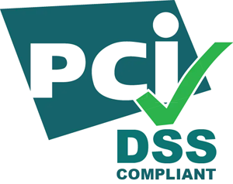
Security & Compliance
Our cloud platform is SOC2 Type II certified
Our website and payment systems are PCI-DSS certified
Data encrypted in transit and at rest using strong ciphers
Multi-factor authentication (MFA) and Single Sign On (SSO)
Physical infrastructure provided by Amazon Web Services.
Learn more

Slide 21














Compliance with International Standards
Guidance on Data Integrity
EudraLex Volume 4 Part I & II

Slide 22
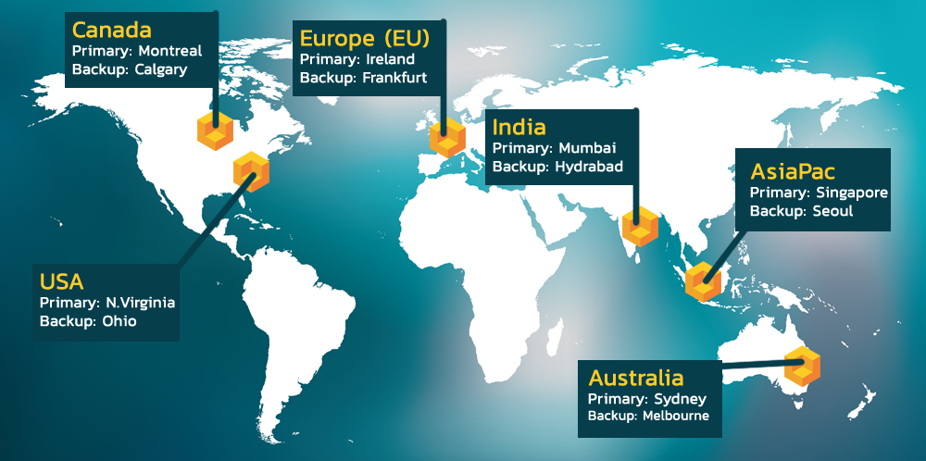
Hosting: Data Privacy and Sovereignty Built In

Slide 23
































Representative Customers
Energy, Industrial & Transport
Financial & Business Services
Media & Telecom
Government & Defense
Healthcare & Bio-Technology

Slide 24























Global Partnership Ecosystem
SOLUTION PARTNERS
TECHNOLOGY PARTNERS
TIERS
# PARTNERS
AREAS OF FOCUS:
Artificial Intelligence (AI)
DevOps & CI/CD
Test Automation
Device Management
Modeling Tools
Platinum
9
Modernization
Agile Transformation
Implementation Services
Training
Load Testing
Gold
10
Silver
31
Blue
69

Slide 25
Customer Testimonials
“
Working with enterprise software in the Finance/Accounting area, I open many support tickets for issues. This time, it's different. I just had to let your team know what a great product SpiraTest is. We mostly need to perform manual tests of key system controls during the SaaS provider's upgrades throughout the year. I'm still learning the product. But, *every single time* I've thought "gee, I bet it doesn't do [fill in blank]," I'm proven wrong. Not only have I not experienced any pain points, but it's almost fun to use such a well-designed product that lets me get to work and get my job done efficiently. So, thank you.
- Michael Aust, Plenty Unlimited Inc.
“
I looked at more than a dozen products and the bottom line is that SpiraTest is hugely superior in value over everything I evaluated. The staff was a tremendous help and a big part of our decision. We are able to train quickly and let people take over as their own project owners in many cases and just stay in touch and help them along the way.
- Chris Deaton, Arizona State University
“

Slide 26
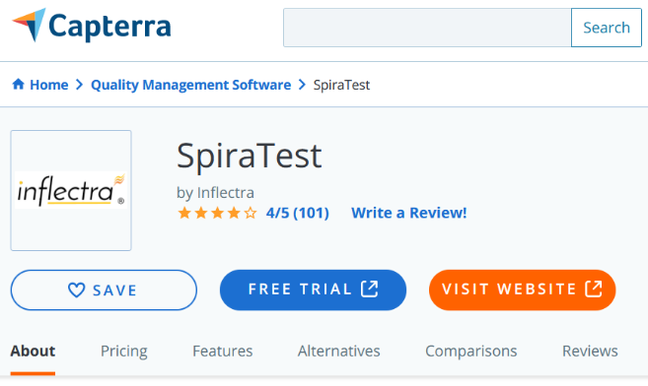
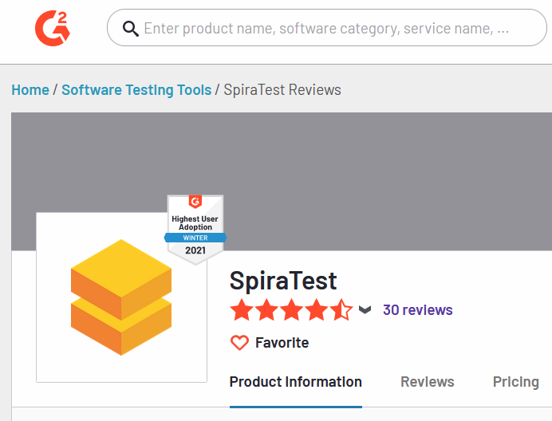
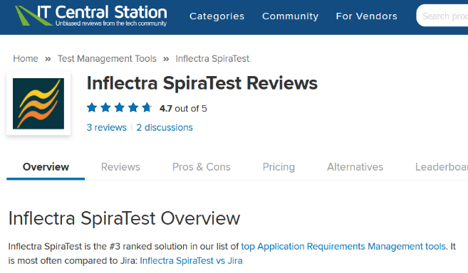
Awards and Recognition*
*IT Central Station, G2 Crowd, Capterra

Slide 27
Feature Overview
Let's Look at the Key Features in SpiraTest

Slide 28
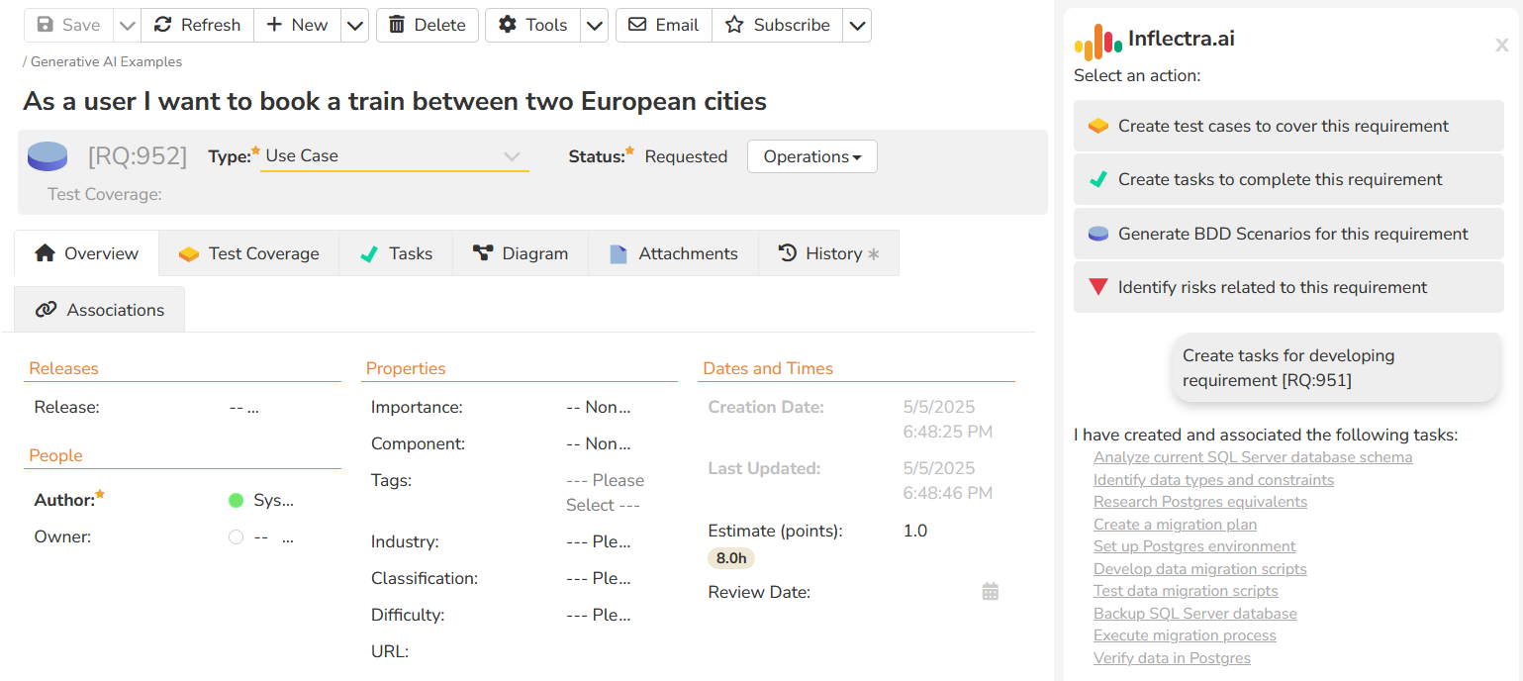
AI Supercharged Test Management
SpiraTest's artificial intelligence functionality lets you generate test cases, BDD scenarios and other artifacts from requirements. The AI functionality increases test management productivity by 40%.

Slide 29
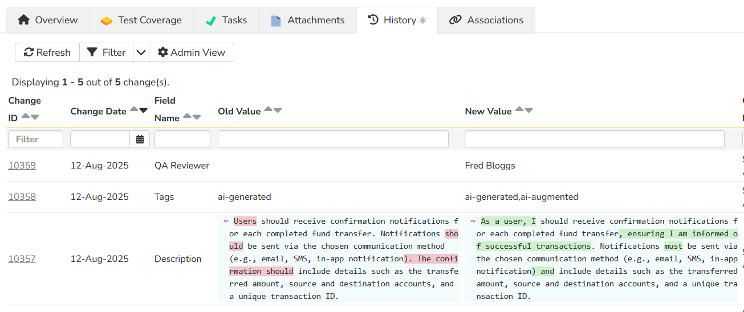
Improve Quality With Requirements Analysis
SpiraTest’s embedded AI engine helps you improve quality right from the start of the process. It will review your requirements, provide an assessment and suggestions, and even rewrite it for you.

Slide 30
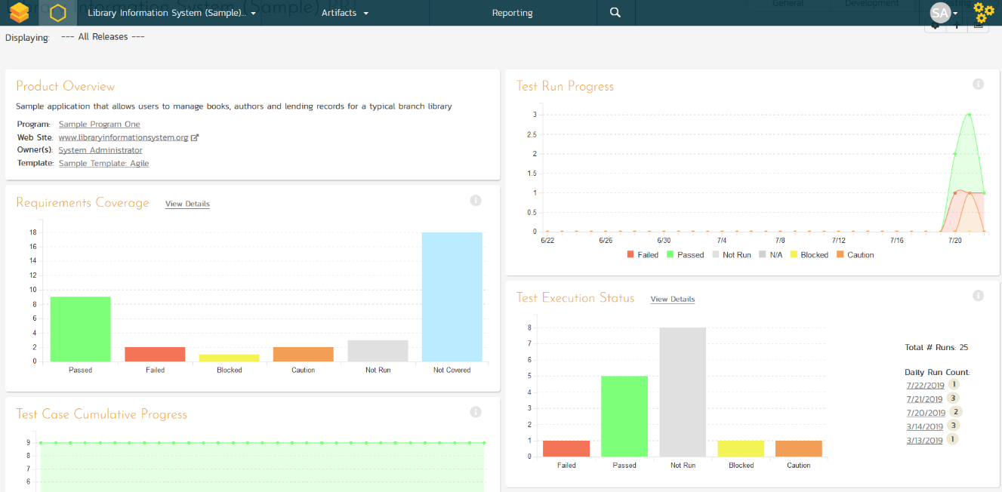
Integrated QA Dashboards
Customizable reporting dashboards at the product, project, release and sprint levels, giving a “single pane of glass”.

Slide 31
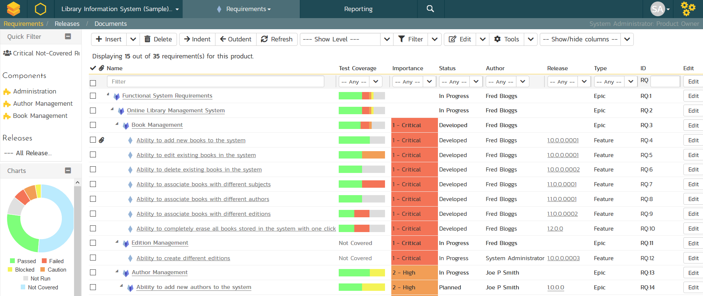
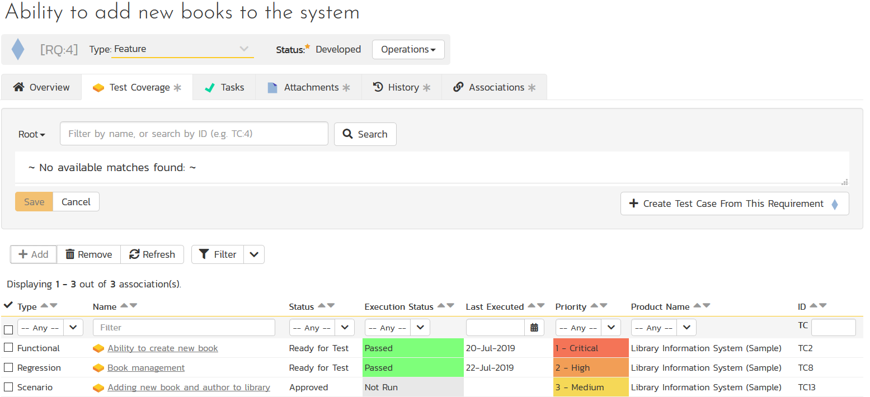
Requirements Management
Requirements management with test & defect traceability

Slide 32
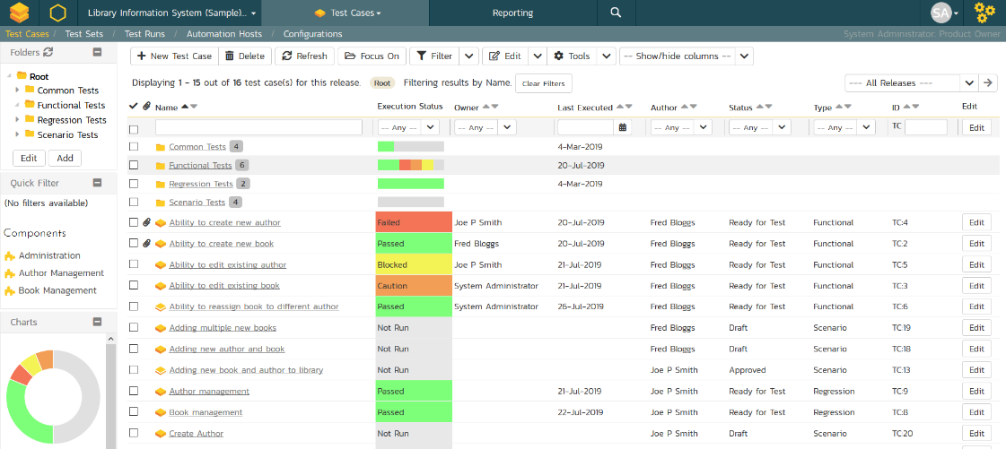
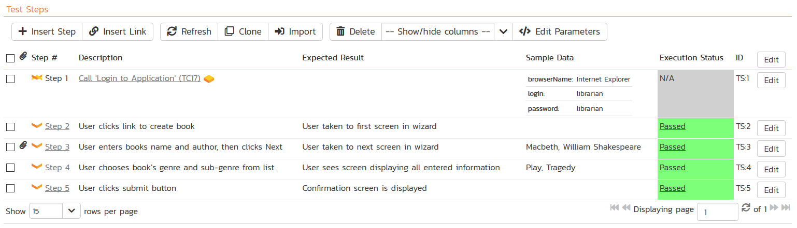
Test Management & QA
Manage your automated and manual test cases, test suites and testing artifacts in a central repository.

Slide 33
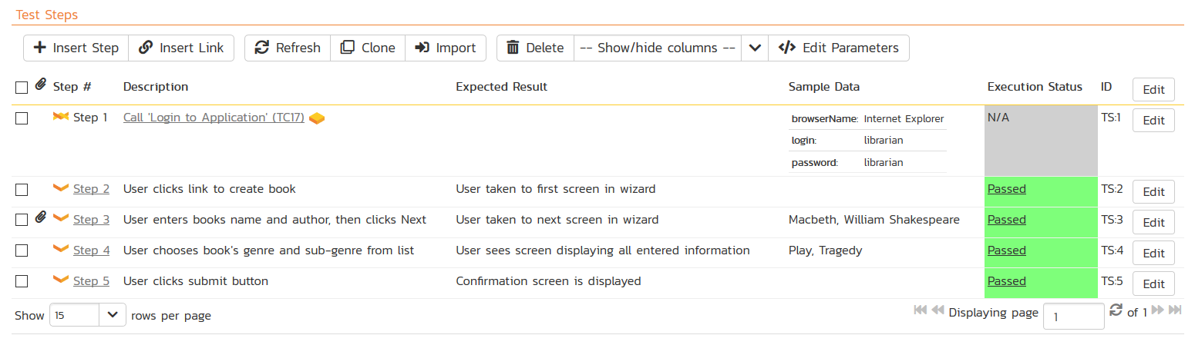
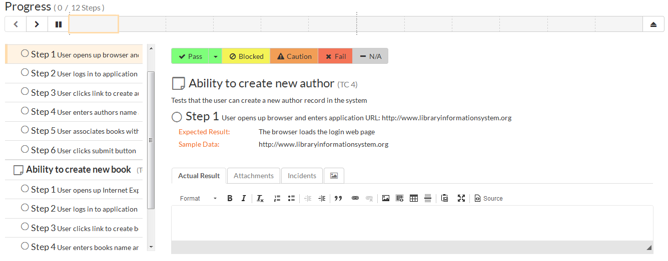
Manual Testing
SpiraTest lets you easily author test cases and test steps with a built in test execution wizard that makes running tests easy.

Slide 34
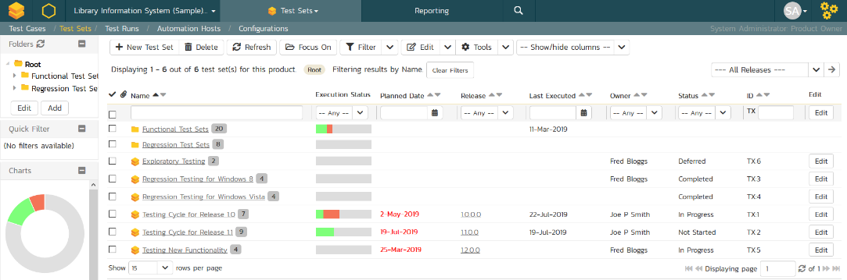
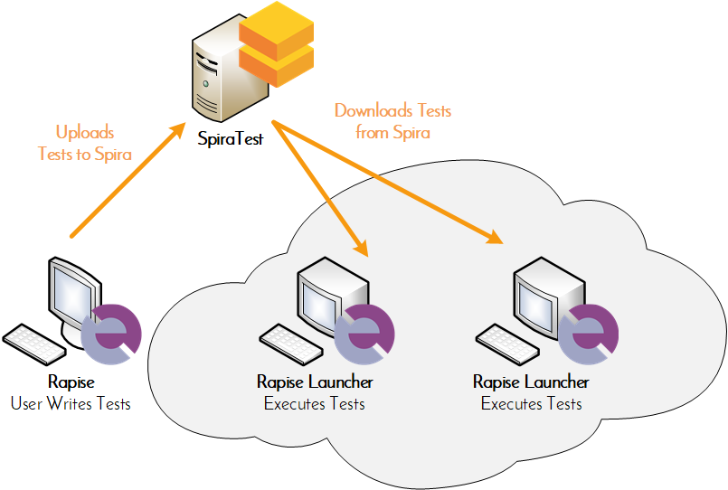
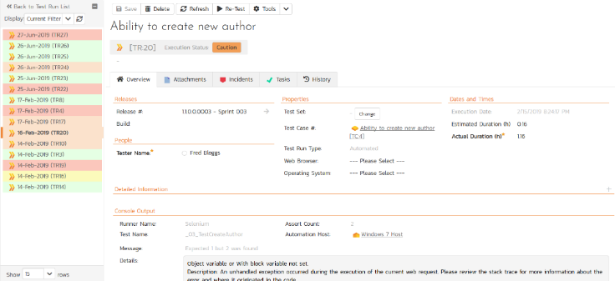
Automated Testing
Orchestrate your automated tests by linking Rapise® from Inflectra with SpiraTest, with integrated test lab management.

Slide 35
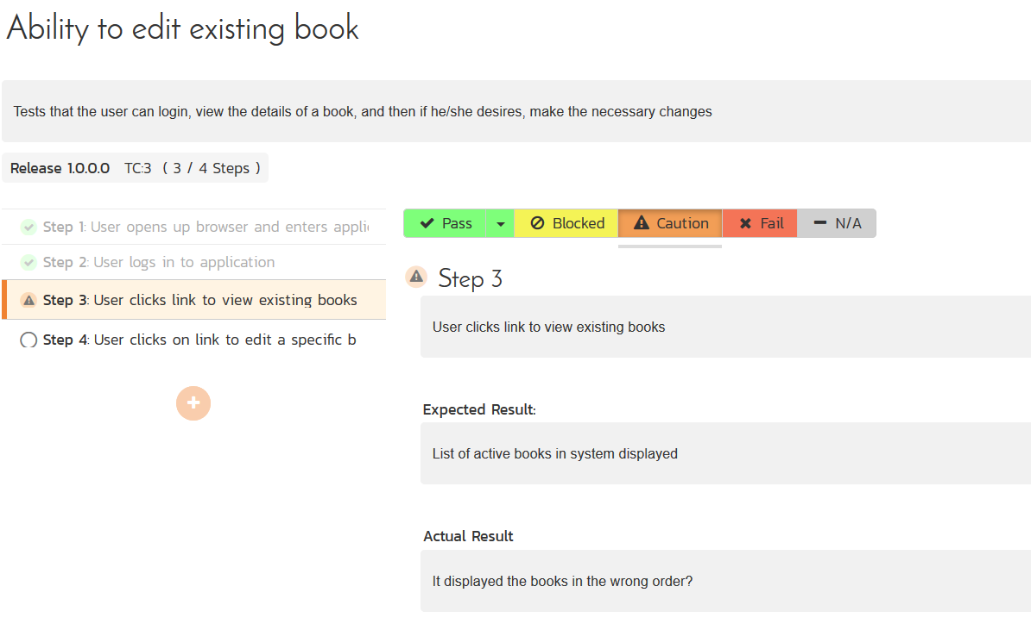
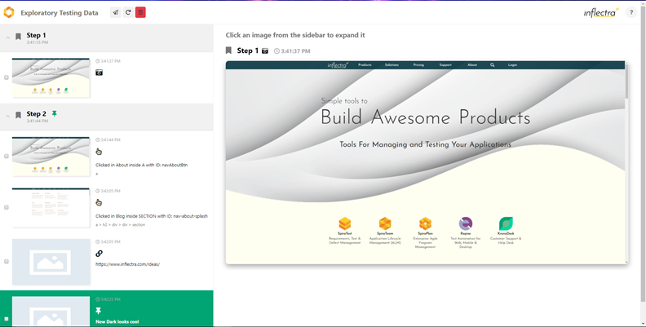
Exploratory & Session-Based Testing
SpiraTest provides an easy to use testing wizard for session and exploratory tests, with SpiraCapture™ for automated capture.

Slide 36
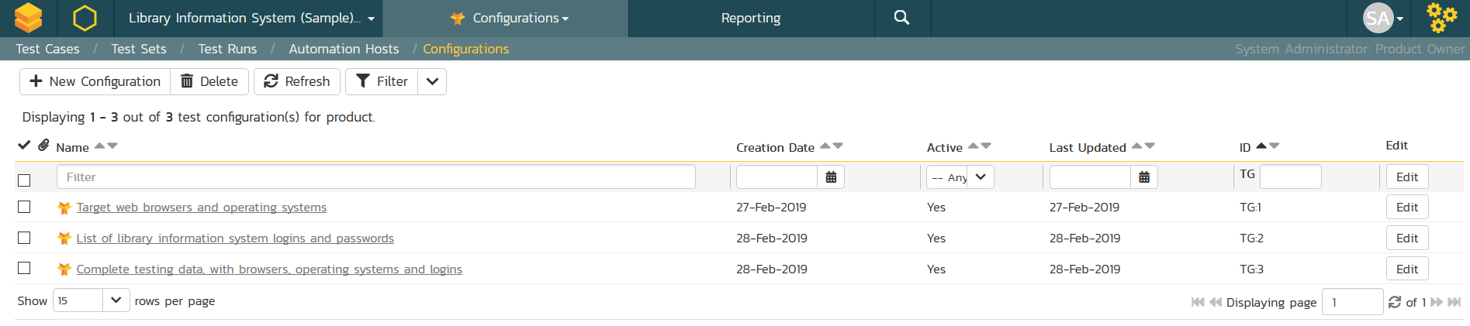
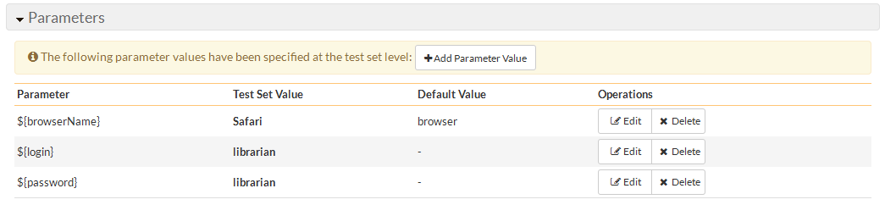
Data-Driven Testing
SpiraTest lets you parameterize your test cases and execute them using different data combinations for full coverage.

Slide 37
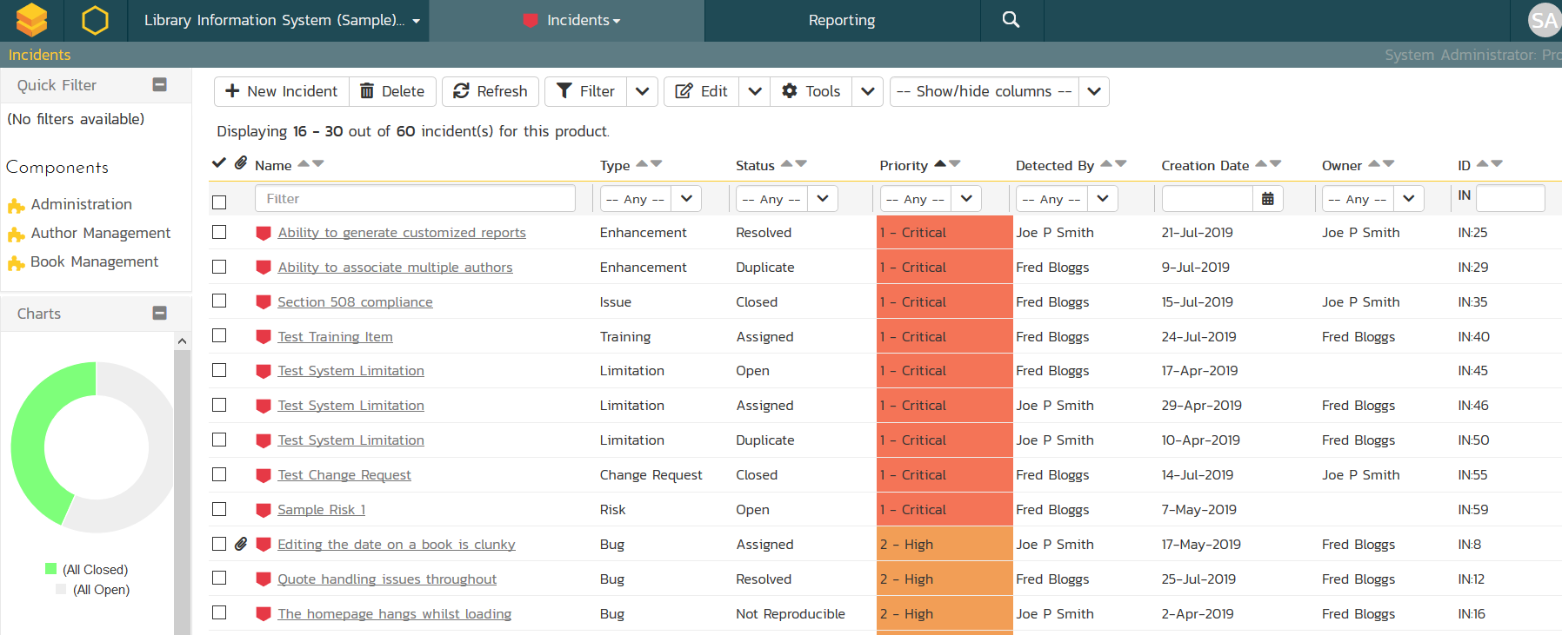
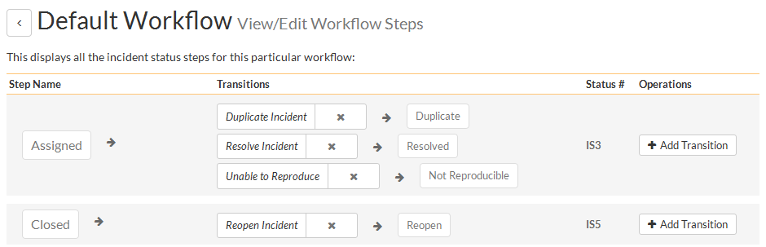
Issue & Defect Tracking
SpiraTest includes a flexible bug and issue tracker with requirements traceability, and integrated workflow engine.

Slide 38
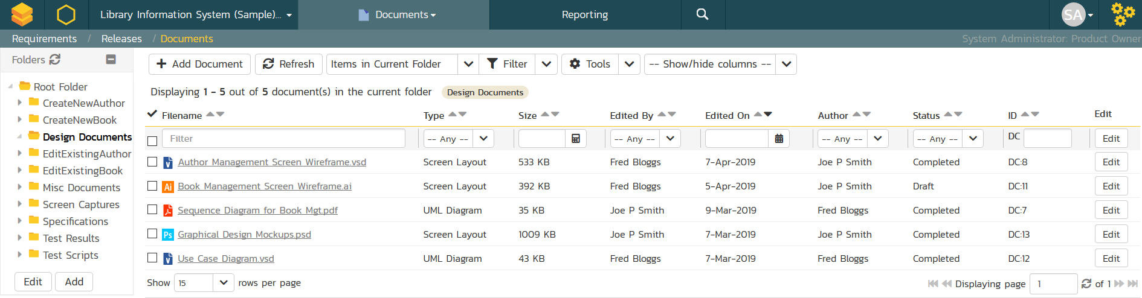
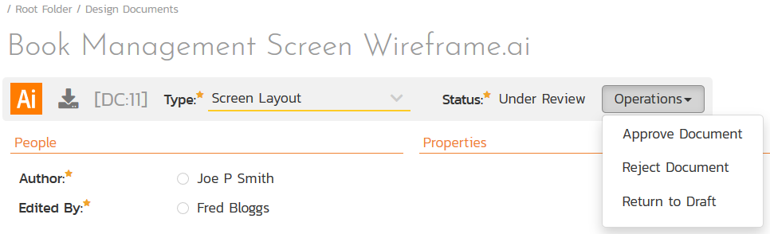
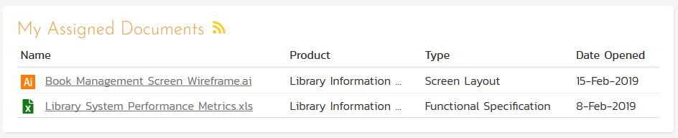
Document Management
Complete integrated document management system with versioning, check-in/out and approval workflows.

Slide 39
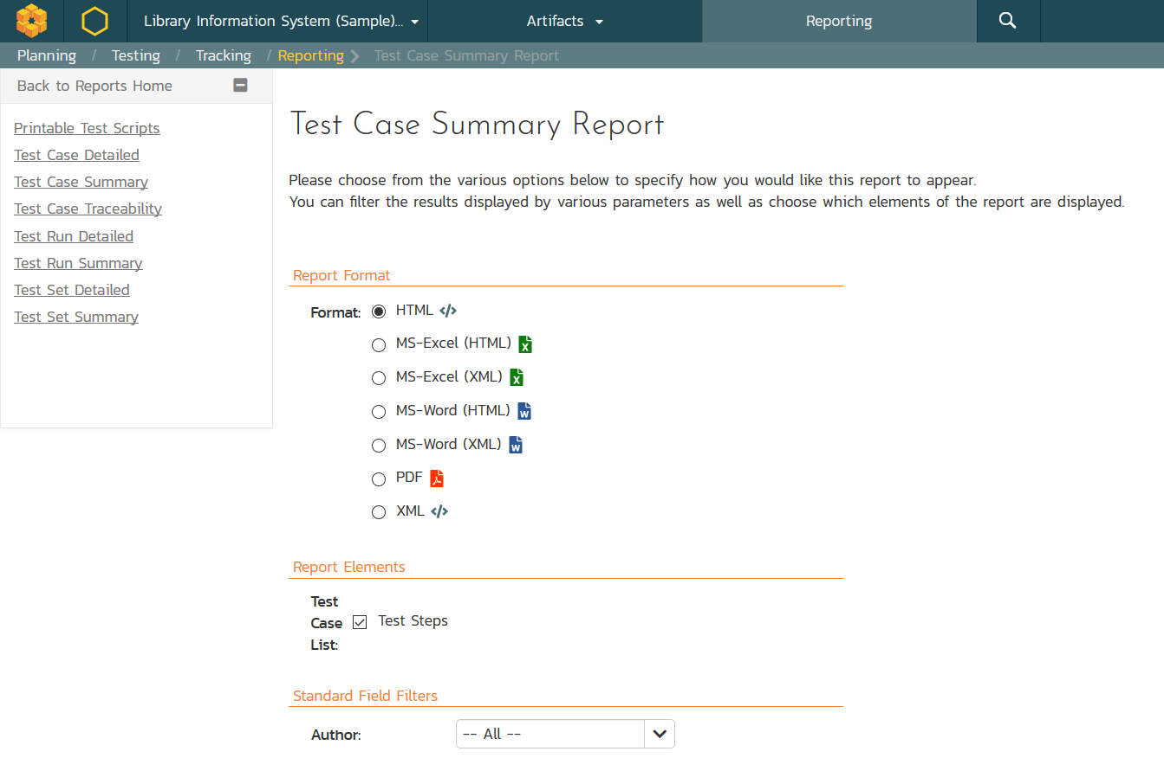
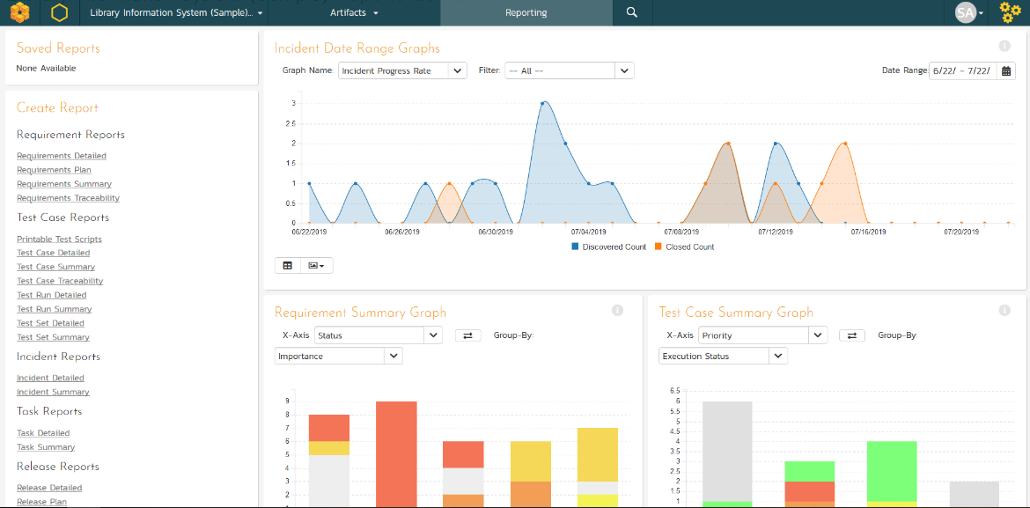
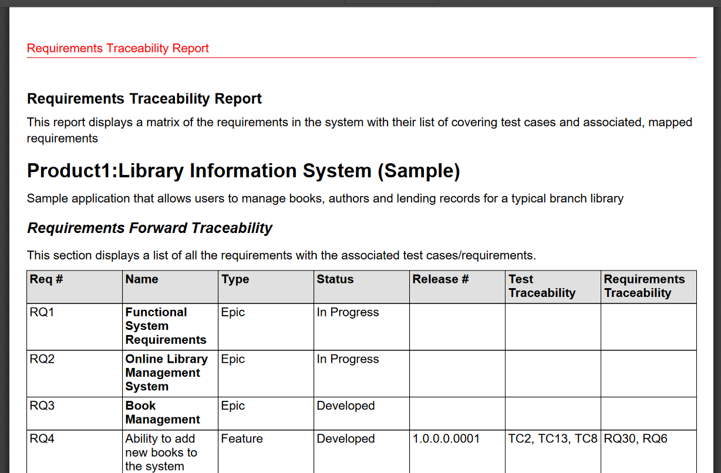
Customizable Reporting
Library of standard and custom reports, export in various formats including Word, PDF, Excel and PDF

Slide 40
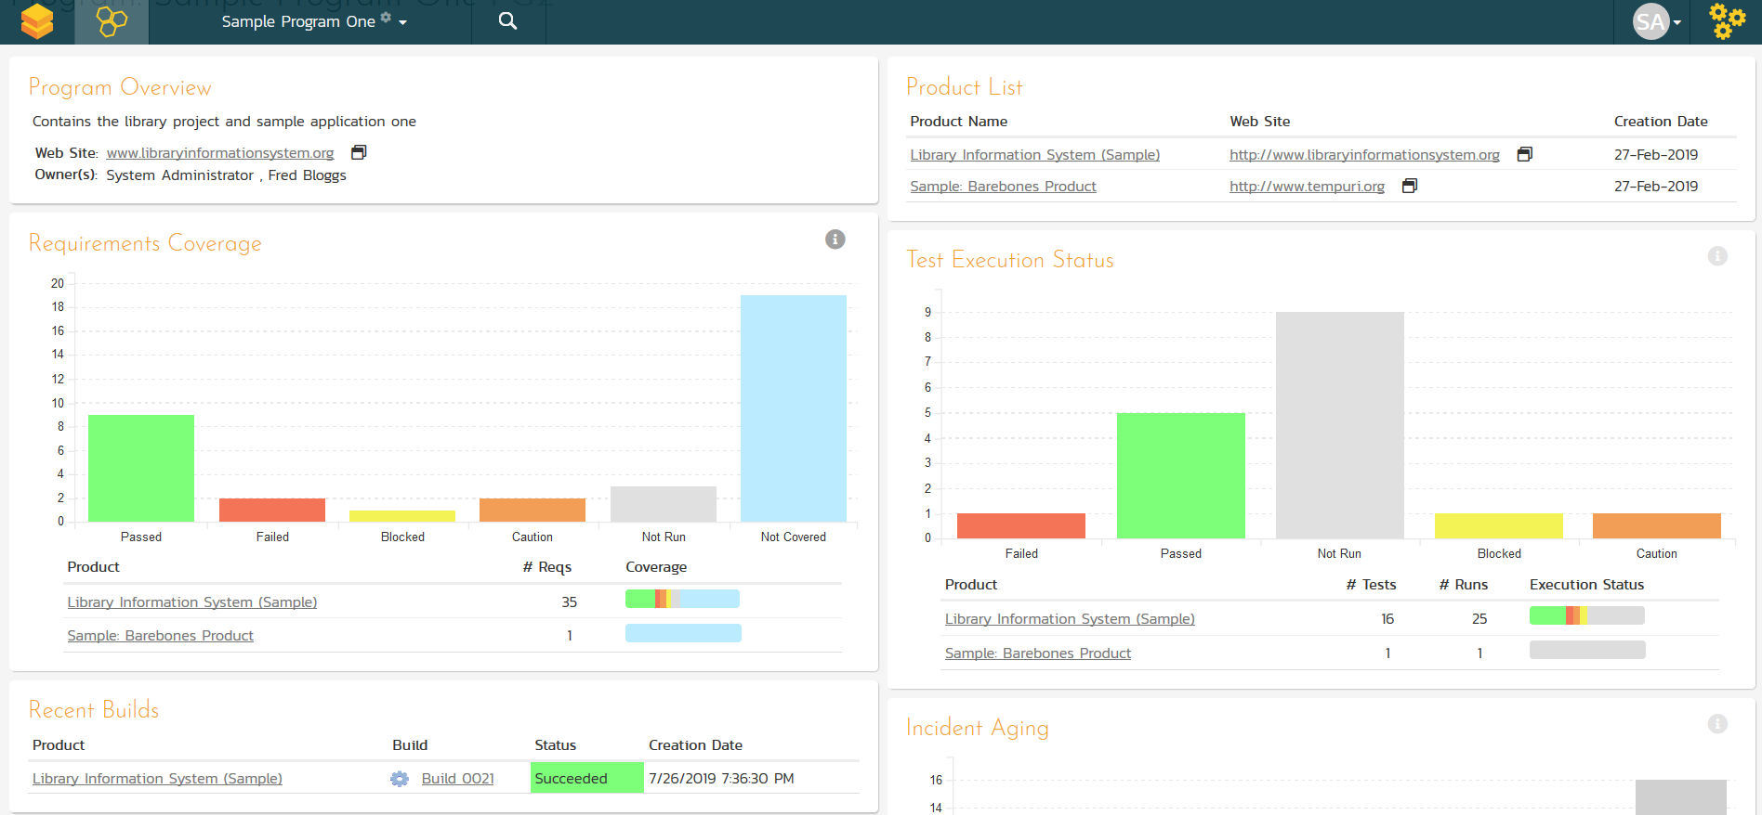
Cross Project Reporting
Dashboards and reports let you see the health of your different projects, grouped by program.

Slide 41

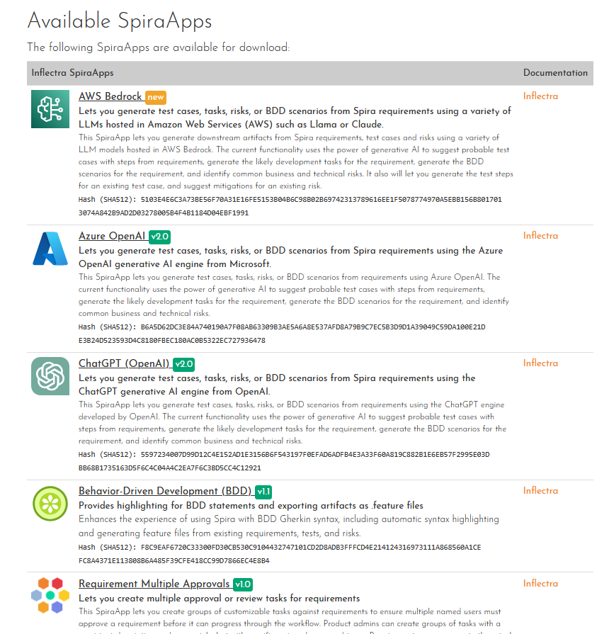
Extensibility with SpiraApps™
SpiraApps are powerful add-ons that unlock the full potential of SpiraTest by extending its core functionality to precisely match your specific requirements.
They empower allow you to optimize SpiraTest to support your software development lifecycle and quality engineering practices.

Slide 42
Integration Options
SpiraTest Fits into Your Ecosystem Seamlessly

Slide 43






















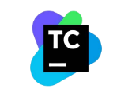




Extensive Integrations & Migrations
80+ INTEGRATIONS
35+ BUILT-IN MIGRATIONS

Slide 44
RemoteLaunch® - Automation Integration
Host #1
Windows 2008
IE 8.0
Manual
Tester #1
RemoteLaunch®
Host #2
Windows Vista
Mozilla Firefox
SpiraTest®
Repository
Manual
Tester #2
RemoteLaunch®
Host #3
Ubuntu Linux
Google Chrome
Manual
Tester #3
RemoteLaunchX®
RemoteLaunch lets you integrate other automated testing tools with SpiraTest in addition to Rapise

Slide 45
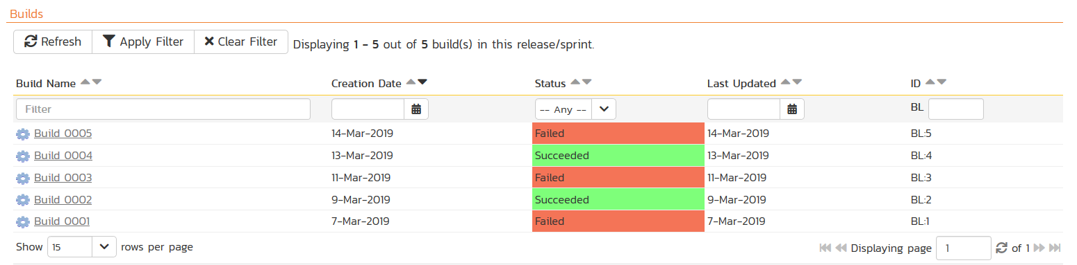
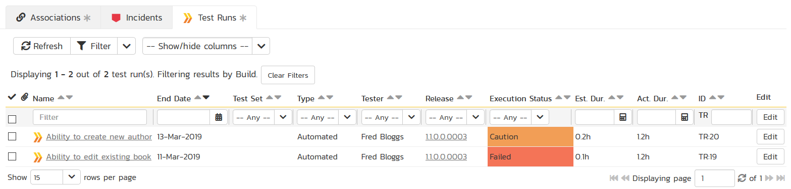
Build Integrated with CI / CD Tools
Build Management in SpiraTest lets you integrate with continuous integration build servers with full traceability for each build

Slide 46
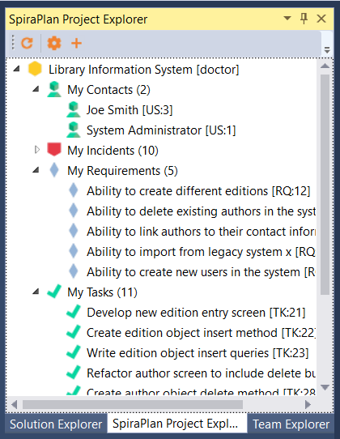
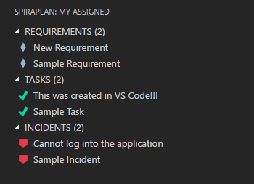
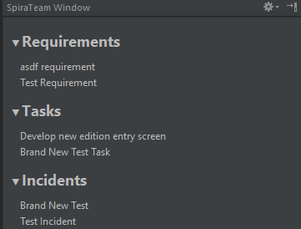



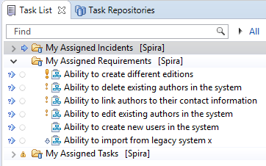

Integration with your Favorite IDEs

Slide 47




































Integration Options
Over 80 integrations and connectors, here’s some of the more popular ones:
Developer IDEs
Unit Test Frameworks
CI / Build Servers
Bug-Tracking Tools
Modelling Tools
Functional Testing Tools
CRM & Service Management
Performance Testing Tools

Slide 48
Case Studies

Slide 49

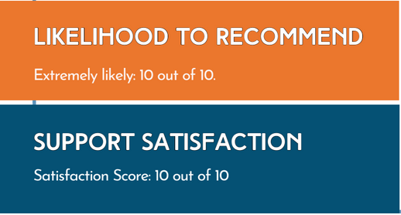
Mastek (IT & Healthcare)
The Challenge
In a highly regulated and competitive market, Mastek needed to enhance their testing processes to achieve comprehensive test coverage, reduce time to market, and efficiently manage multiple projects while maintaining regulatory compliance.
The Solution
Mastek selected Inflectra products due to their favorable pricing, licensing options, and advanced project management and QA functionalities. SpiraTest was implemented to enhance project monitoring, streamline team collaboration, and improve compliance.
Existing Tools in Place
Jira lacked comprehensive test management that could ensure full traceability from requirements to defects. Difficulties in automating test maintenance within Jira's ecosystem, led to greater manual work.
“Inflectra's suite of products has transformed the way we manage our projects and testing processes. With tools like SpiraTest we have achieved unprecedented levels of efficiency, compliance, and quality. The seamless integration and robust features have enabled us to deliver projects faster and with greater accuracy, ensuring our competitive edge in the industry. “-- Kanchan R, Mastek

Slide 50

80% Improvement of Test Coverage
The Challenge
Telstra International faced growing demands for an advanced test automation for its Salesforce platform. The strict security standards, however, required full security review and approval of any automation solution, adding complexity to the selection process.
LIKELIHOOD TO RECOMMEND
Extremely likely: 10 out of 10
SUPPORT SATISFACTION
Satisfaction Score: 8 out of 10
The Solution
SpiraTest and Rapise were deployed to build a comprehensive and reliable regression test suite for Salesforce. Rapise’s flexibility enabled Telstra to automate repetitive and complex tasks within the Salesforce environment, such as regression and daily sanity testing. Furthermore, the team utilized SpiraTest to effectively manage and document their testing processes, ensuring full coverage.
Key Results & Metrics
Test coverage improved by 80%
Regression testing 100% automated
Reduced reliance on manual testing, boosted overall testing efficiency, reducing human error, and improving project agility.
” We have found Rapise to be a great automation tool, enabling us to complete regression and daily sanity testing efficiently. In the future, we plan to update the Rapise scripts to include downstream systems”….. – Nicholas B.

Slide 51

Oney Bank (Banking & Finance)
The Challenge
Oney wanted a single, integrated platform to manage requirements, create and reference test cases, run
test campaigns, log and track test runs, create tasks and log defects.
Key Outcomes and KPIs
Ability to automatically generate QA metrics for the first time.
One centralized system for standardized QA processes.
Replaced multiple obsolete tools with a single modern solution.
Consolidated testers, developers and designers on one tool.
Increased productivity using native tool
features unavailable with previous solution.
The Solution
Oney Bank conducted thorough market research and determined that only SpiraTest could provide the features and quality they sought in a single tool. SpiraTest also proved to be the best value.
“SpiraTest…is the best tool in terms of quality and value compared to the other competing programs available on the market.. the time, productivity and cost savings are transparent”
-- Benjamin-Michel G., Technical Test Analyst
Existing Tools in Place
Prior to using SpiraTest, Oney employed Microsoft Excel to manage projects, test documentation and defect tracking and Microsoft Word to handle any screenshots.

Slide 52
Questions?

