Slide 1

Software Development Lifecycle Management for Teams

Slide 2
Why Inflectra?

Slide 3
When Failure Isn’t An Option. We Help You Deliver. And Prove It.
Inflectra unifies software delivery, quality, compliance, and traceability so you can ship at AI speed, reduce risk, and prove every release is ready.

Slide 4



With Inflectra, Deliver Measurable Quality Fast! Only 16% of software development projects are completed on time and within budget.
PRODUCT MANAGERS
QUALITY ASSURANCE
SOFTWARE TESTING
52%
of time spent on un-planned “fire-fighting” activities
40%
of software budget spent on Quality Assurance
5%
of companies carry out fully automated testing internally
60%
of businesses lack a plan to enhance their PM process
39%
of software projects fail due to poor requirements gathering
24%
of companies saw ROI uplift from automated testing
39%
of managers that worry about missing launch date
67%
of customers cite “bad experience” with products as their churn reason
35%
of companies use non-testers for software testing
Sources: “Software Survival in 2024”, Beta Breakers; “10 QA Statistics”, Testlio; “Product Management Statistics”, UXCam; “Software Testing Statistics – 2024”, TrueList

Slide 5








The Inflectra® Platform
RemoteLaunch®
Test Orchestration
SpiraCapture™
Exploratory Testing
SpiraApps™
Extensibility
SpiraPlan®
Enterprise Software Development Lifecycle Management
SpiraTeam®
Software Development Lifecycle Management for Teams
SpiraTest®
Requirements, Test & Defect Management
Rapise®
UI & API Test Automation
Inflectra.ai
Agentic AI Platform

Slide 6




Spira Platform Snapshot
Capabilities
SpiraTest
SpiraTeam
SpiraPlan
Requirements Management
Test Management & Traceability
Defect & Issue Tracking
Agile Planning Tools
Program & Portfolio Planning

Slide 7
Why SpiraTeam?

Slide 8










SpiraTeam®- Application Lifecycle Management
KEY FEATURES & BENEFITS
DIFFERENTIATORS
Fully integrated project / requirements management and an extensive integration library to eliminate inefficiencies from overlapping tools
1
Robust data roll-up capabilities across all dimensions – product, component, requirements, release, and team
2
Extensive built-in integration library for easy connections to all solutions with zero limitations
Quality assurance (QA), risk management, and collaboration capabilities to ensure visibility into all aspects of the software development lifecycle
3
Pre-existing niche artifact types to address specific use cases and ensure adherence to best practices
Specialized artifact types, built-in workflows, and advanced dashboards to provide an “out-of-the-box” experience for any team
4
Various project planning views for different roles within the team that can handle both planned and adaptive lifecycles
5
Operates in both cloud and on-premise hosting environments
Complete support of all development methodologies, whether Agile, Waterfall, or hybrid
POPULAR INTEGRATIONS
END USER(S)
Project Managers
QA Managers
Business Analysts
Software Testers
Developers
Chief Information Officer (CIO)
40%
30%
35%
cost
reduction
faster time
to market
better
productivity

Slide 9

SpiraTeam®: Personas
AGILE ADVOCATE
QA ENGINEER
BA ANALIST
CIO
Demographics:
Age: 35
Role: Agile Project Lead
Experience: 10-15 years
Goals:
Ensure all team members have clear tasks & deadlines.
Deliver projects on time without compromising quality.
Foster collaboration between cross-functional teams.
Pain Points:
Limited real-time visibility into team progress.
Over-reliance on multiple, disconnected tools for tracking & communication.
Difficulty aligning sprints with business priorities.
Demographics:
Age: 28-40
Job Title: Test Manager
Experience: 5-12 years
Goals:
Streamline test case creation & execution workflows.
Maintain full traceability from requirements to defects.
Deliver actionable quality assurance reports.
Pain Points:
Lack of automation & inefficiencies in manual test tracking.
Disconnected workflows between QA & Dev teams.
Frequent last-minute defect discoveries slowing down production.
Demographics:
Age: 30-40
Job Title: Business Analyst
Experience: 5-10 years
Goals:
Clearly document and communicate requirements to tech teams.
Ensure alignment b/w business goals & project deliverables.
Proactively track changes & their downstream impact
Pain Points:
Frequent miscommunication b/t business & technical teams.
Difficulty reconciling feedback from multiple stakeholders.
Lack of tools to manage rapidly evolving project requirements.
Demographics:
Age: 45-55
Job Title: CIO
Experience: 15-25 years
Goals:
Align IT projects with overarching business objectives.
Minimize operational costs by unifying disparate tools.
Maintain compliance and governance for internal and external audits.
Pain Points:
Limited visibility into project health across multiple teams.
Inefficiency and cost burden from maintaining redundant tools.
Challenges ensuring consistent project tracking & governance.

Slide 10
SpiraTeam®: User Benefits
INTEGRATED AGILE LIFECYCLE MANAGEMENT
CROSS-FUNCTIONAL ALIGNMENT
DYNAMIC REQUIREMENT MANAGEMENT
ENTERPRISE-GRADE COMPLIANCE TOOLS
Centralized tools for sprint planning, backlog prioritization, and progress tracking eliminate the need for multiple platforms, ensuring streamlined workflows.
Facilitates collaboration across development, QA, and product teams with shared workflows and automated updates, reducing communication overhead.
Enables real-time documentation, versioning, and tracking of requirements to minimize errors and ensure alignment with project goals.
Configurable workflows and reporting ensure adherence to governance standards and regulatory requirements across all projects.
UNIFIED TOOL ECOSYSTEM
SCALABLE PROJECT MANAGEMENT
FULL TRACEABILITY ACROSS TESTING PHASES
AI-POWERED RISK MITIGATION
Replace multiple disconnected tools with a centralized platform for project, requirement, and test management, reducing costs and complexity
Support enterprise growth with a scalable platform designed to manage portfolios, resources, and large teams effectively.
Ensures complete linkage between requirements, test cases, execution results, and defects, improving quality assurance accuracy and accountability.
Leverage AI to assess project data and flag potential compliance or operational risks before they escalate.

Slide 11




Add-On Products
Extends Spira® Platform (SpiraTest, SpiraTeam, SpiraPlan) with customizable features to meet specific industry needs and compliance requirements.
Offers modular SpiraApps to dynamically adapt workflows, optimize SDLC processes, and maximize ROI.
Integrates with AI solutions like ChatGPT, Azure OpenAI, and AWS Bedrock for automated test generation, risk analysis, and streamlined project management.
Quick installation with support for integrations like GitHub, GitLab, AWS Bedrock, and CircleCI for a unified workflow experience.
Supports third-party development and monetization of SpiraApps, expanding functionality and fostering innovation.
DataSync is a data synchronization tool designed to automate and streamline integrations between Spira and external platforms, ensuring real-time updates and consistent data across systems.
Automatically reflects changes across all connected tools, reducing
manual work and ensuring teams stay aligned.
Adapts to any operational need with cloud, on-premise, and hybrid deployment models, making it ideal for businesses of all sizes and industries.
Comprehensive and developer-friendly, DataSync offers advanced data mapping, multi-instance support, and a centralized dashboard for easy management and troubleshooting.
Ensures data integrity with robust security features and scales effortlessly to handle growing business requirements, including complex hybrid environments.

Slide 12




Add-On Products
Browser-based testing capture tool that enables secure recording of exploratory testing sessions
Automated tracking of clicks & keystrokes on each tab being recorded
Logging of steps for each testing session and notes for specific issues encountered
Delivered as “freemium” product; viewed as additional lever of future product-led growth for the Spira suite
B2B service desk solution for cloud & on-premise installations that integrates tightly with all Spira products to keep product teams informed
Built-in knowledge base, help desk, and forums capabilities with a powerful ticketing system that facilitates communication with the end customer and enables prioritization
Centralization of all customer communications enables a streamlined approach to customer support
Complete configurability allows for adaptability to any customer support workflow
Quick set-up and easy-to-use ticket creation & management, with an existing email integration
Robust and customizable reports for effective visualization of the entire customer support engine with easy KPI tracking (e.g., ticket volume, resolution times, customer satisfaction, etc.)

Slide 13


Add-On Products
Accelerators
Extension of the Spira suite that enables orchestration of automated regression testing (manual & automated)
Open architecture to allow for use in tandem with SpiraTest or other test automation tools, whether commercial (HP Unified Functional Testing, TestComplete) or open source (Selenium, Playright)
Facilitates scheduling, execution, and management of automated test scripts, allowing for full oversight of distributed test labs from a central SpiraTest server
Flexible deployment (cloud, on-premise, hybrid) to suit the needs of all end users
Real-time and detailed reporting delivers a holistic view of manual & automated testing with screenshots, log files, and QA metrics
Primary target users are automation engineers, but also test managers and QA managers
Pre-defined packages of professional services for specific customer objectives
Each package is associated with specific outcomes & deliverables, offered at a fixed price vs. hourly
Provides smaller organizations & teams access to the expertise of Inflectra’s global solution partner network
Offerings are incremental to Inflectra’s existing customer support and other services

Slide 14





A Complete, Out of The Box Solution
Test
Management
3
Requirements Management
Program
Management
Automated
Testing
Risk Management
AI-Powered Functionality

Slide 15





Customer Onboarding & Self-Guided Enablement
1
2
3
4
5
Getting Started Videos
Introduces our products and walks you through your first 10 days.
Inflectra Campus
Online Training
Includes free introductory courses followed by paid advanced modules and certificates
Live Webinars
& Q&A
Regular webinars on key product releases, customer roundtables, and other interactive sessions
YouTube
Channel
Recordings of our webinars, advanced product insights and other key Inflectra information
InflectraCon360
Thought leadership content from industry leaders, Inflectra customers and partners
Learn more
Learn more
Learn more
Learn more
Learn more

Slide 16





Technical Support & Customer Success
1
2
3
4
Live Tech Support
Legendary technical support via email, phone, forums. Free standard support with every purchase.
Knowledge Base
A repository of expert-written articles covering product troubleshooting, best practices, and tips & tricks.
Documentation
Quick-start guides, in-depth manuals, and integration instructions for smooth deployment & optimal performance.
Account Managers
Experienced account executives providing strategic guidance from pre-sales consultations through the entire lifecycle.
Premium Support
Combined advanced customer success and tailored technical support delivered by highly skilled professionals.

Slide 17
How SpiraTeam Works For You
Features for different industries and methodologies

Slide 18

Bridging Between Agile and Compliance
Regulated Industries
Modern, Agile Processes
Baselining
Risk Management
Electronic Signatures
Data Privacy
Compliance
Workflow
Requirements Mgt
On-Premise
CI / CD
Scrum
Kanban
Scaled Agile
DevOps
Distributed Teams
Remote Working
Cloud-Based
98% customer satisfaction rating

Slide 19


Healthcare, Life Sciences & Bio-Tech
Electronic signatures for FDA 21 Part 11 compliance
Secure hosting with support for HIPAA BAA agreements
End to end traceability of requirements, tests, and code
Validated platform where you control update cadence
Learn more

Slide 20

Financial Services & Insurance
Secure cloud platform (SOC2) or on-premise deployment
Integrated enterprise risk management
Integration with automated testing and compliance tools
End-to-end traceability and auditability of testing
Helps You Manage Compliance: DORA, SOX, BASEL III
Learn more

Slide 21

Energy, Industrial & Automotive
Testing for public safety with world class test management
Define requirements and test for compliance
Integrate standards and regulations into your test plans
Understand and manage risk of critical systems
Support for Failure Mode & Effects Analysis (FMEA)
Learn more

Slide 22

Defense, Government & Aerospace
Manage programs and portfolios across platforms
Test step level traceability for mission systems
Automate testing and compliance with RemoteLaunch
Orchestrate System of Systems (SoS) development
Security and privacy with on-premise and AWS GovCloud
Learn more

Slide 23
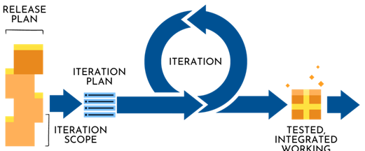
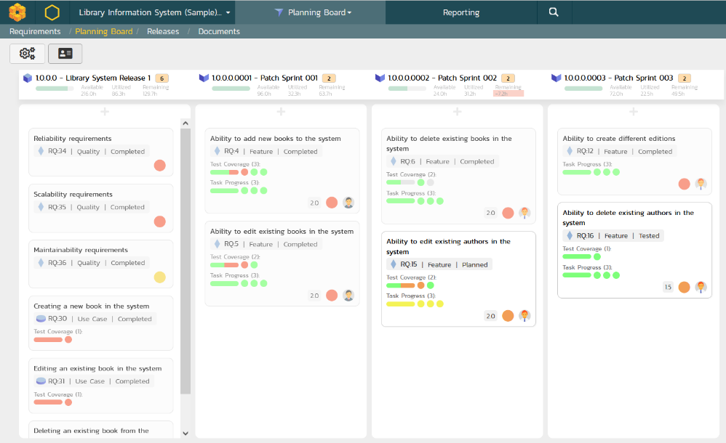
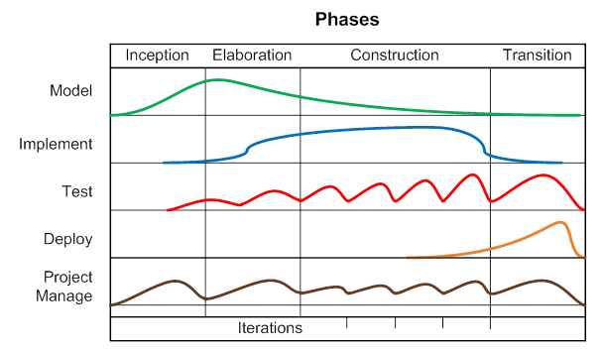
Support for Agile Methodologies
SpiraTeam has been specifically designed to handle all the most popular agile methodologies including Scrum, Kanban, AUP and DAD.

Slide 24
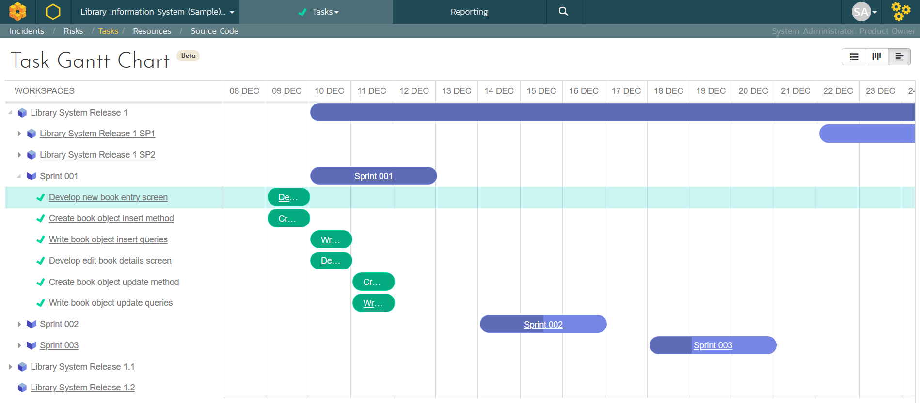
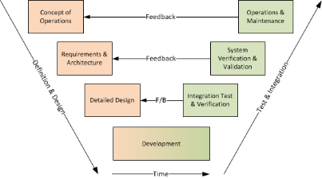
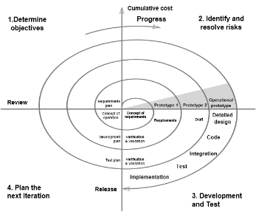
Support for Predictive Methodologies
SpiraTeam has been specifically designed to handle all the most popular predictive methodologies such as waterfall, hybrid and V-model.

Slide 25
Features for Regulated Industries
Auditability and end-to-end traceability
Data Privacy, Security baked in
Generation of Compliance Documentation
Workflows & Electronic Signatures
Integrated Risk Analysis and Management

Slide 26



Security & Compliance
Our cloud platform is SOC2 Type II certified
Our website and payment systems are PCI-DSS certified
Data encrypted in transit and at rest using strong ciphers
Multi-factor authentication (MFA) and Single Sign On (SSO)
Physical infrastructure provided by Amazon Web Services.
Learn more

Slide 27














Compliance with International Standards
Guidance on Data Integrity
EudraLex Volume 4 Part I & II

Slide 28
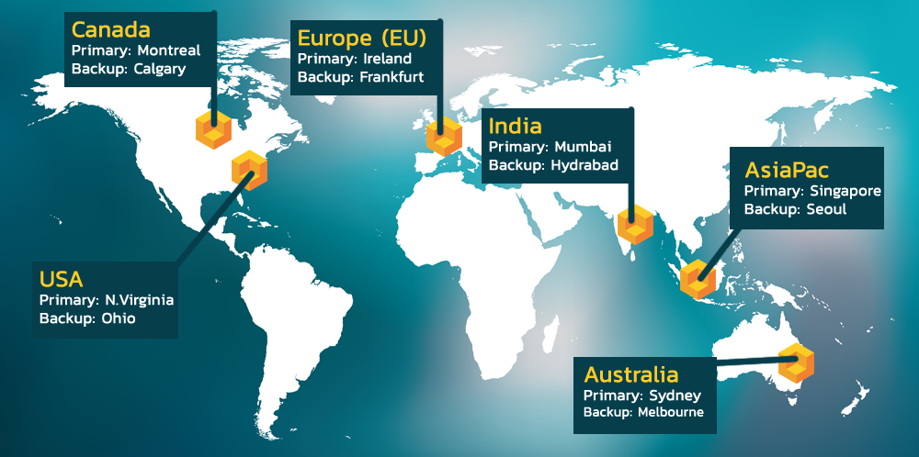
Hosting: Data Privacy and Sovereignty Built In

Slide 29
































Representative Customers
Energy, Industrial & Transport
Financial & Business Services
Media & Telecom
Government & Defense
Healthcare & Bio-Technology

Slide 30























Global Partnership Ecosystem
SOLUTION PARTNERS
TECHNOLOGY PARTNERS
TIERS
# PARTNERS
AREAS OF FOCUS:
Artificial Intelligence (AI)
DevOps & CI/CD
Test Automation
Device Management
Modeling Tools
Platinum
9
Modernization
Agile Transformation
Implementation Services
Training
Load Testing
Gold
10
Silver
31
Blue
69

Slide 31
Customer Testimonials
“
Great product for managing your software development projects. When evaluating solutions, it became clear to me that the choice would be SpiraTeam. For the price to feature ratio, it could do everything and more than we would need. With the ability to just add additional licenses as our team grew it provided the flexibility we needed. The support team at Inflectra is also top notch. Any time I had a question/issue, they were there to help in a quick and friendly manner.
- Brian Kratsch, Tolko Industries Ltd.
“
Inflectra’s SpiraTeam is disrupting this market. And deservedly so. If you’re in the market for an ALM tool, I recommend you put SpiraTeam at the top of your shortlist. This is a great suite for managing the application development life cycle. Very competitive in features and functions.
- Jim Reardan, Process1st Consulting
“

Slide 32
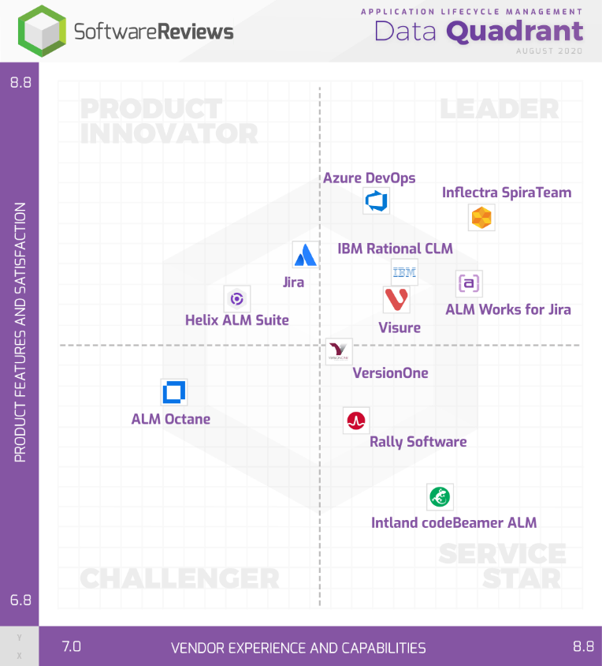
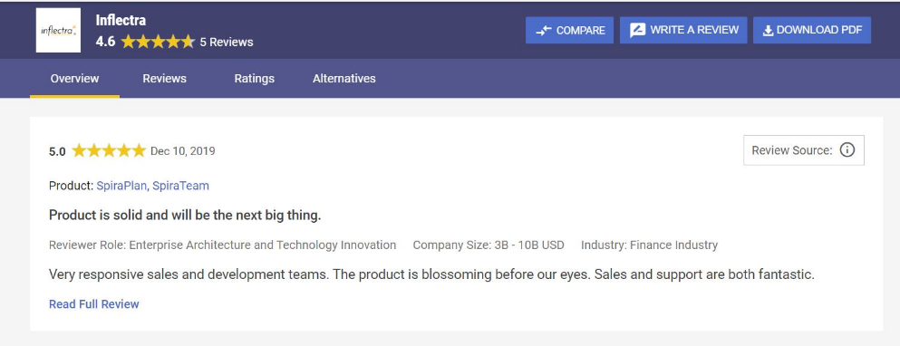
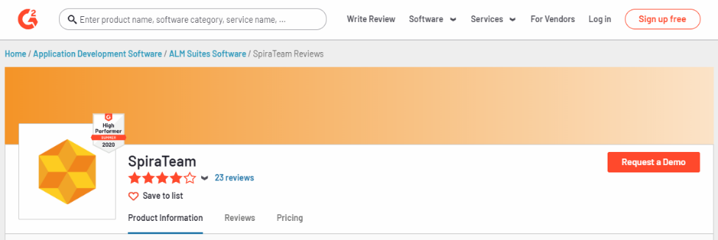
Awards and Recognition*
*Gartner, G2 Crowd, InfoTech

Slide 33
AI in the Software Lifecycle
How AI is Transforming the Software Development Lifecycle

Slide 34
Agentic AI: Adoption in the Enterprise
Phase 1: Digital Intern
Phase 2: Digital Employee
Phase 3: Digital Team
AI agents working together, AI “middleware”, A2A, MCP & ACP protocols. Era of true #AgenticAI
Workflow automation, autonomous agents, vibe coding, IT modernization, synthetic data generation
Coding Assistants, Digital Marketing, Internal / External Chat-bots. Era of #GenerativeAI

Slide 35


Slide 36
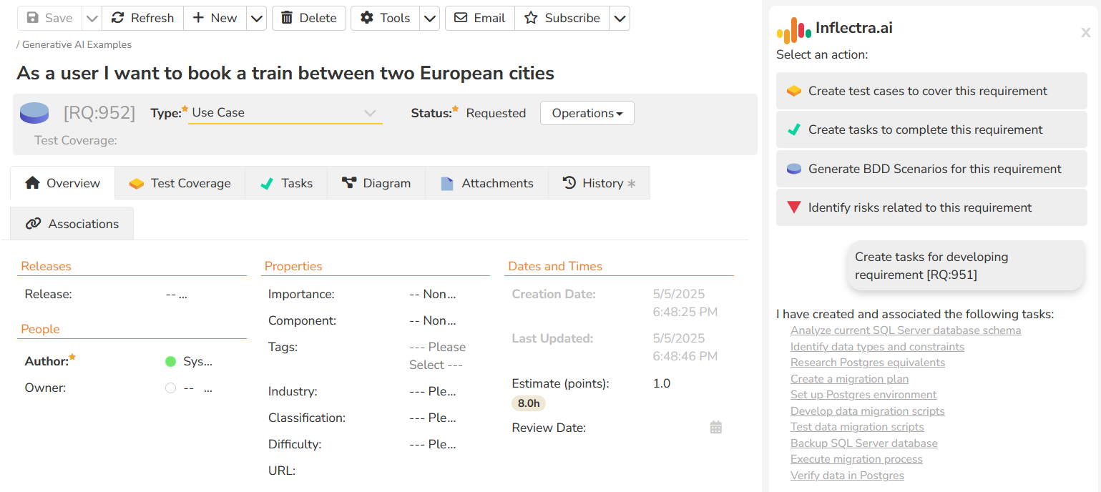
AI Supercharged Lifecycle Management
SpiraTeam's artificial intelligence functionality lets you generate project artifacts such as requirements, test cases, tasks, code, risks and deliverables. The AI functionality increases productivity by 40%.

Slide 37
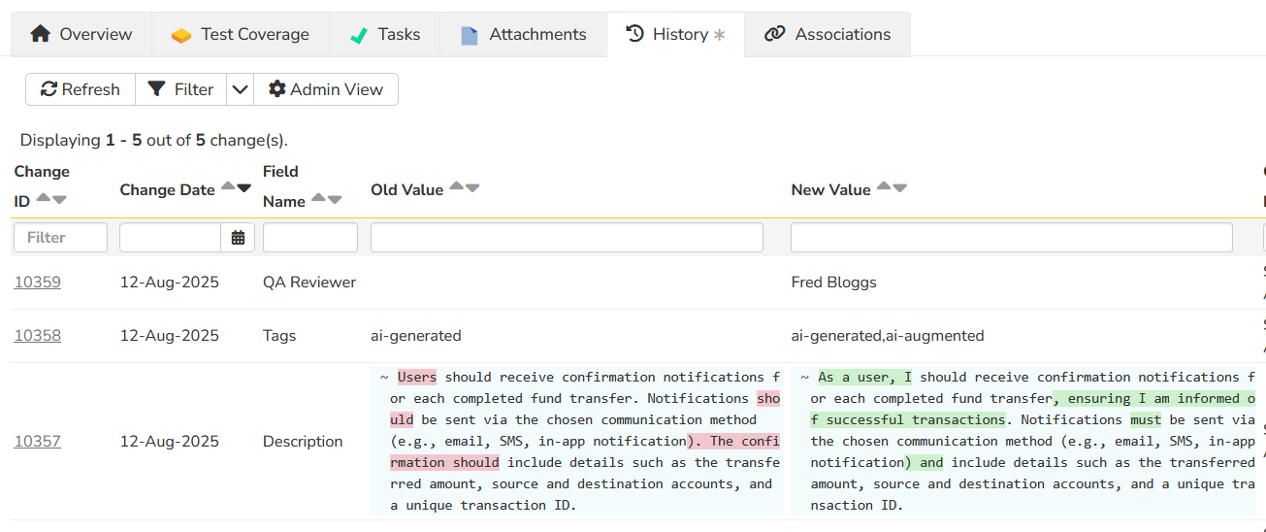
Improve Quality With Requirements Analysis
SpiraTeam’s embedded AI engine helps you improve quality right from the start of the process. It will review your requirements, provide an assessment and suggestions, and even rewrite it for you.

Slide 38
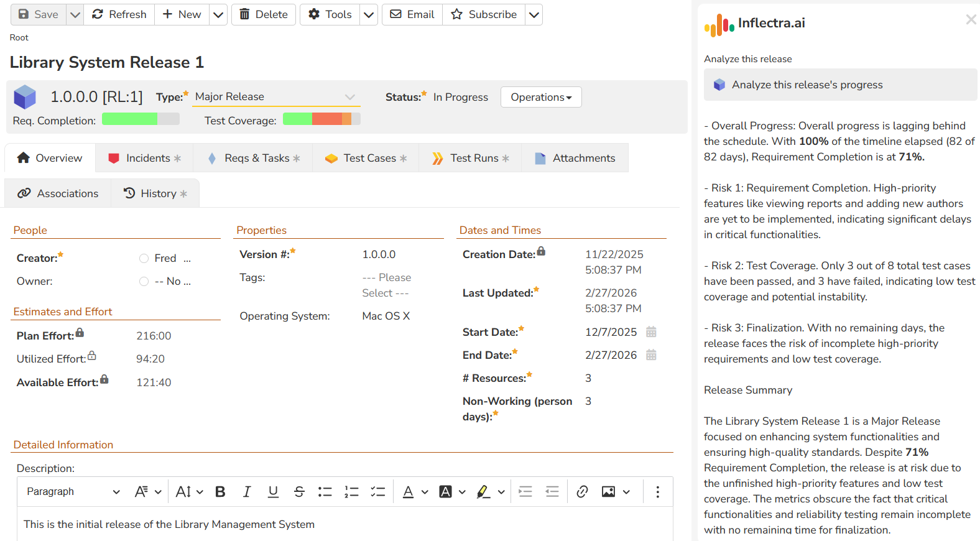
Real-Time Insights on Project Progress
With Inflectra.ai, SpiraTeam lets you analyze the progress of a Release or Sprint, gain insights into the possible risks, and get recommendations on how to mitigate before they happen.

Slide 39



Integrating Inflectra.ai with MCP
Our products have MCP Servers and integrate with agentic coding agents like Claude, Kiro, Anti Gravity, Codex for spec-based development:
Spira MCP Server
Web
APIs
Spira REST API
Agentic Coding
Agents
MCP
Protocol
Rapise MCP Server
Test Execution CLI
GitHub MCP Server
Web
APIs
GitHub REST API
LLM Models

Slide 40



From System of Record to Action
Understanding what matters, what changed, and what’s at risk in real time as software is built faster with AI.
Together, SpiraTeam and Rapise form a closed-loop system that delivers traceability from intent to execution to evidence automatically, continuously, and at scale.
REQUIREMENTS & PLANNING
AI CODE GENERATION
TESTING & QA
INTEGRATION & CI/CI
DEPLOYMENT & MONITORING
SpiraTeam
Kiro/Claude
Rapise
GitLab/Hub
AWS/Azure

Slide 41
SpiraTeam Differentiators in the Age of AI
Integrated end-to-end traceability
Strong support for auditability and compliance
Existing AI platform that lets us add use cases easily, and pull large amounts of existing data that we have inside our platform from our existing integrations
Experience with large-scale, complex applications, understanding scaling AI-SDLC beyond simple demo apps
Ability to be deployed in public, private clouds, on-prem unlike Atlassian and other vendors going 100% SaaS

Slide 42
Core Features
Let’s Look at the Key Features in SpiraTeam

Slide 43
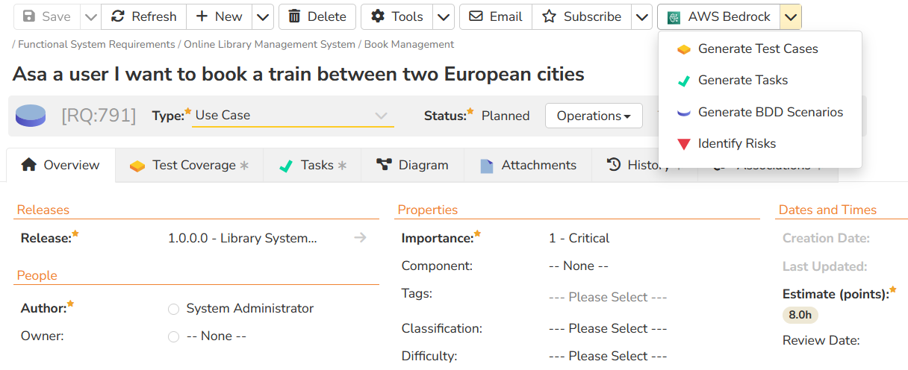
AI Supercharged Lifecycle Management
SpiraTeam's artificial intelligence functionality lets you generate project artifacts such as requirements, test cases, tasks, code, risks and deliverables. The AI functionality increases productivity by 40%.

Slide 44
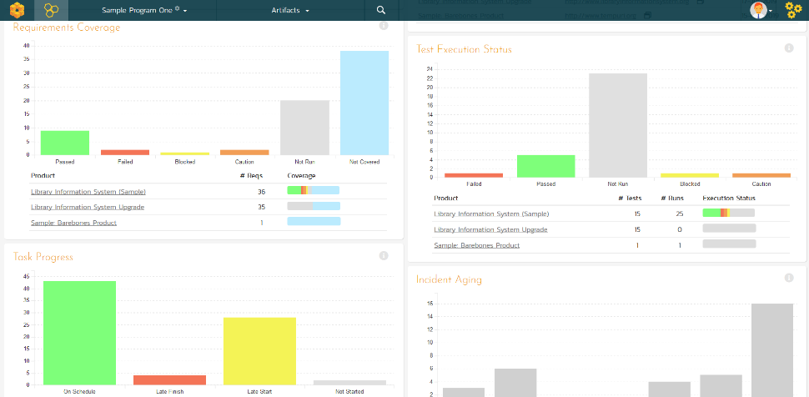
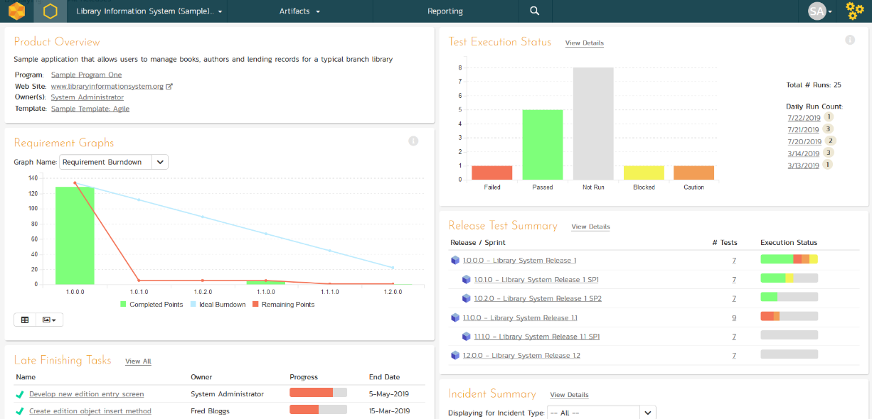
Integrated Program & Project Dashboards
Customizable reporting dashboards at the program, product, project, release and sprint levels, giving a “single pane of glass”

Slide 45
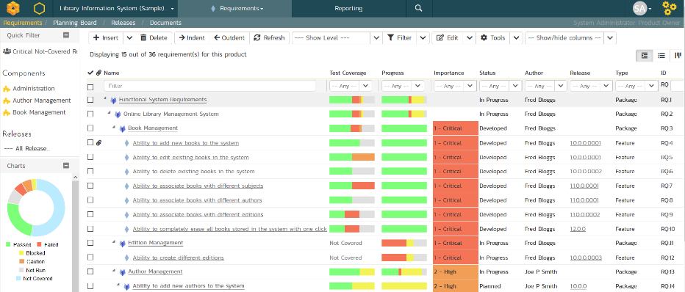
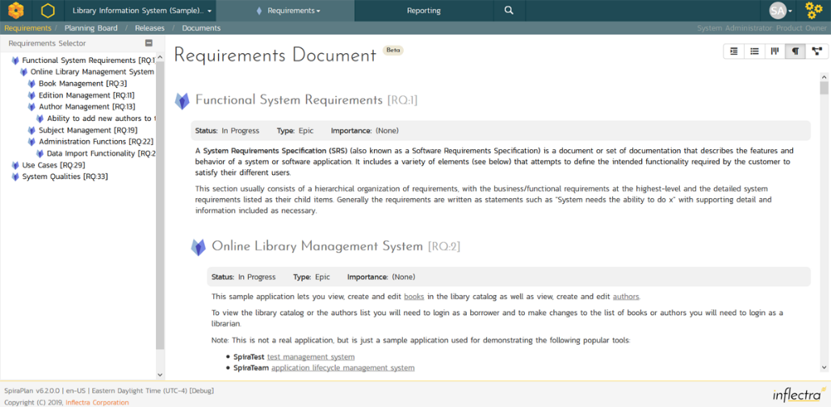
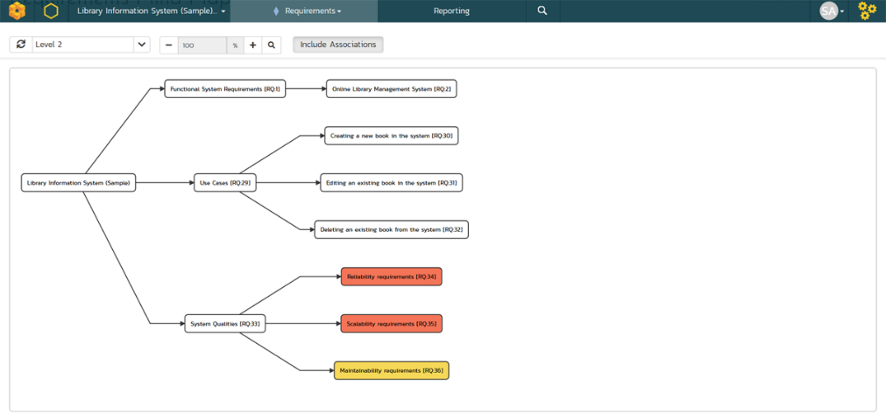
Requirements Management
Requirements management with end-to-end traceability, multiple views and powerful change tracking.

Slide 46
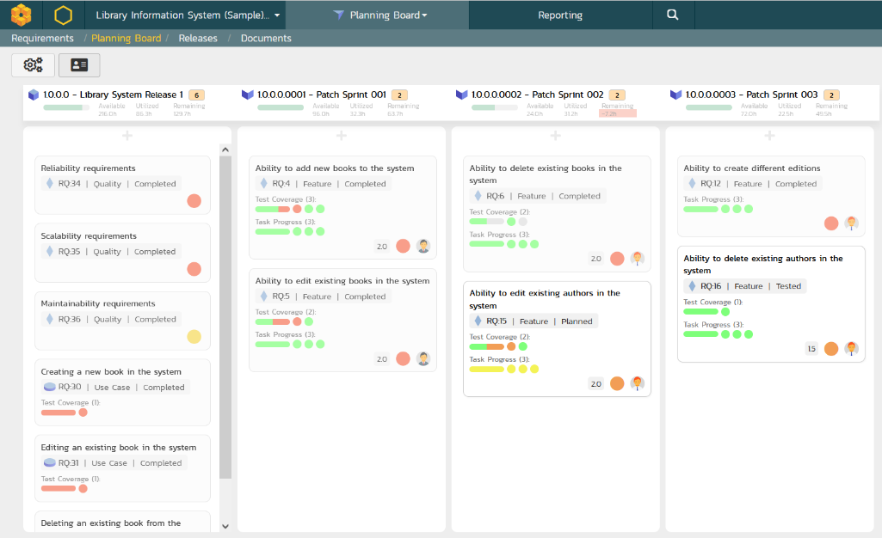
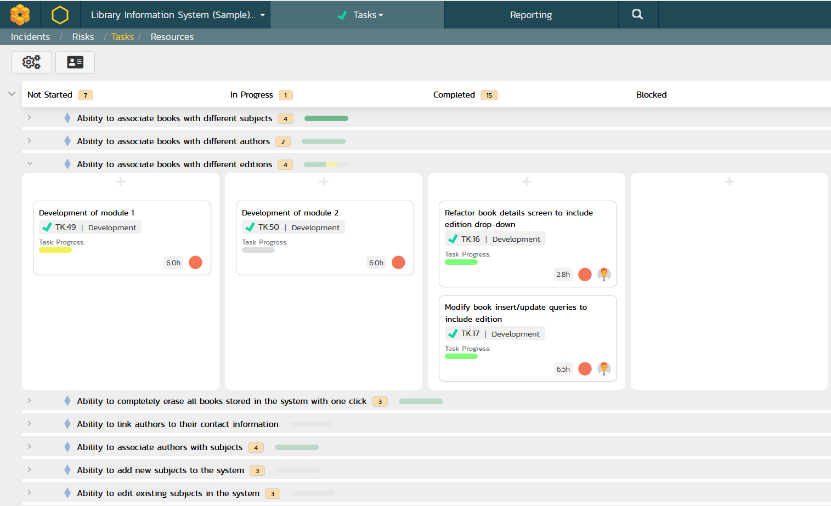
Agile Project Planning
Agile planning boards with test and task traceability that support multiple methodologies including Scrum and Kanban.

Slide 47
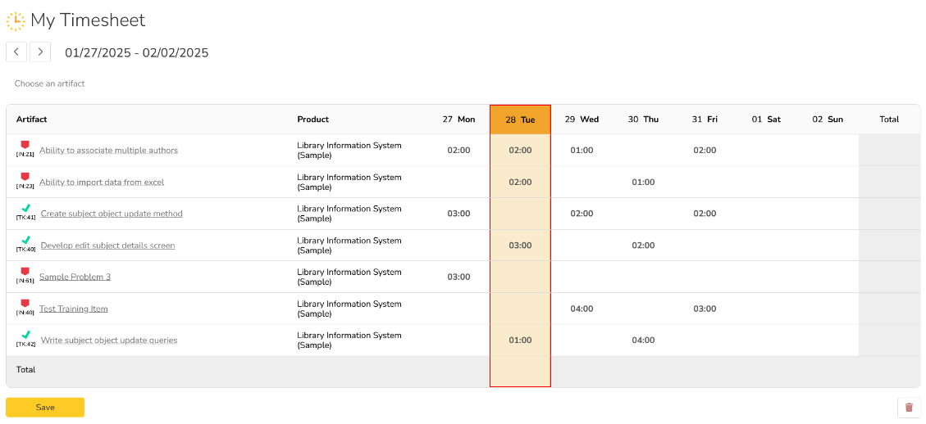
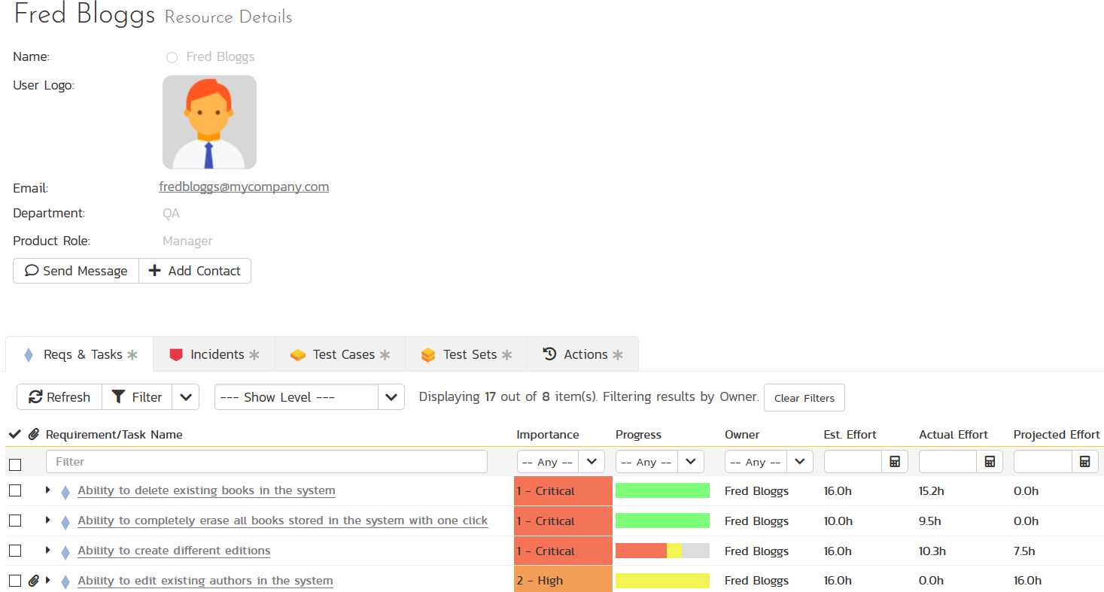
Resource Management & Time Tracking
Manage the people and teams on your projects with centralized timecard submission and resource planning.

Slide 48
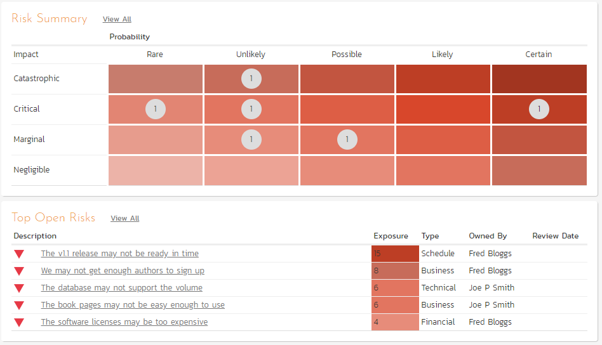
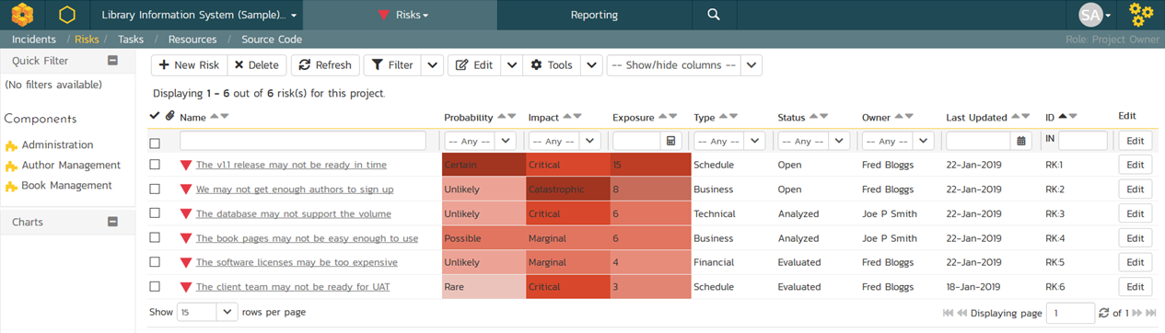
Risk Management
Manage your product and program risks, track mitigations and action items. Automated exposure calculations out of the box.

Slide 49
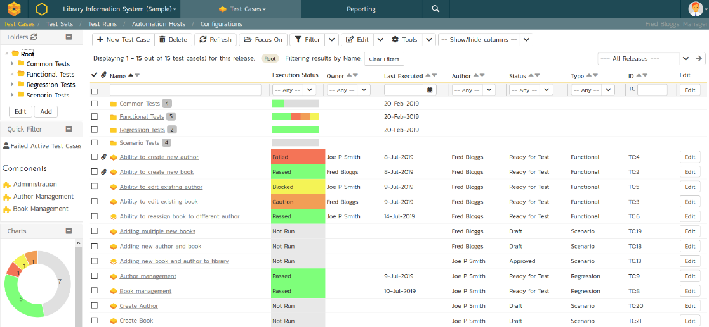
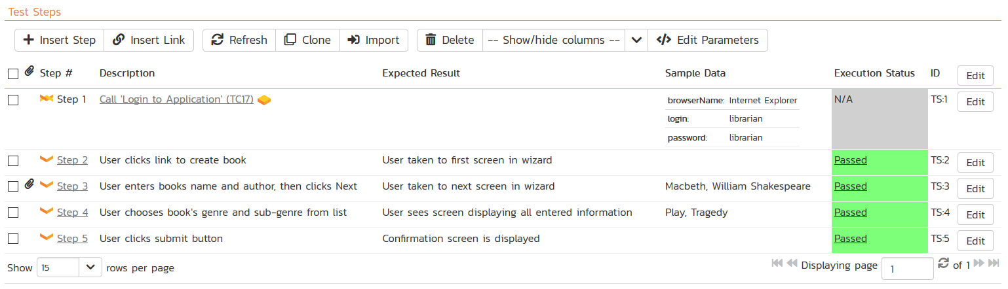
Test Management & QA
Manage your automated and manual test cases, test suites and testing artifacts in a central repository.

Slide 50
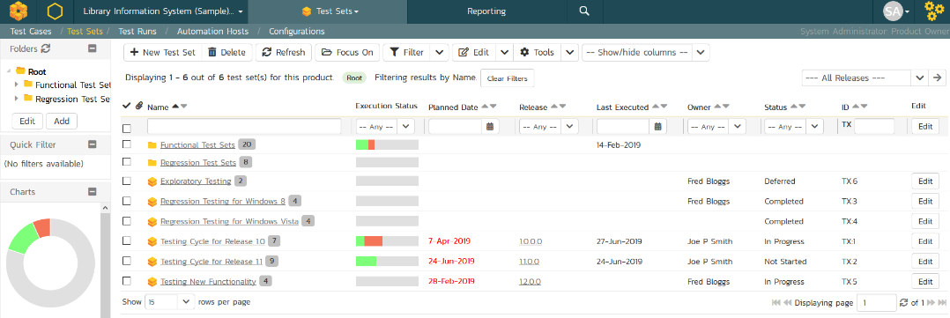
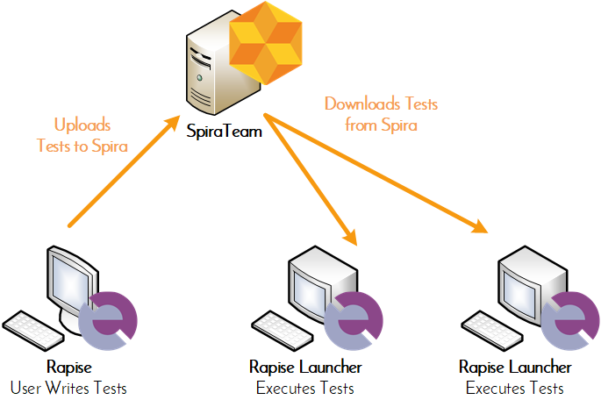
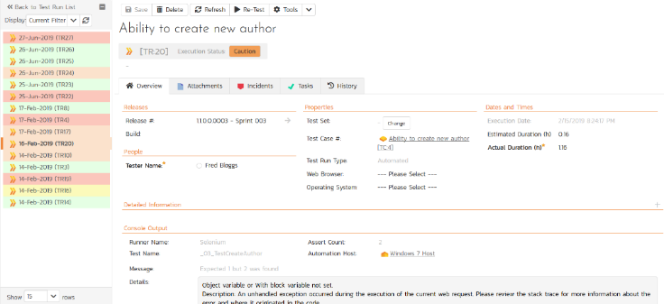
Automated Testing
Orchestrate your automated tests by linking Rapise® from Inflectra with SpiraTeam, with integrated test lab management.

Slide 51
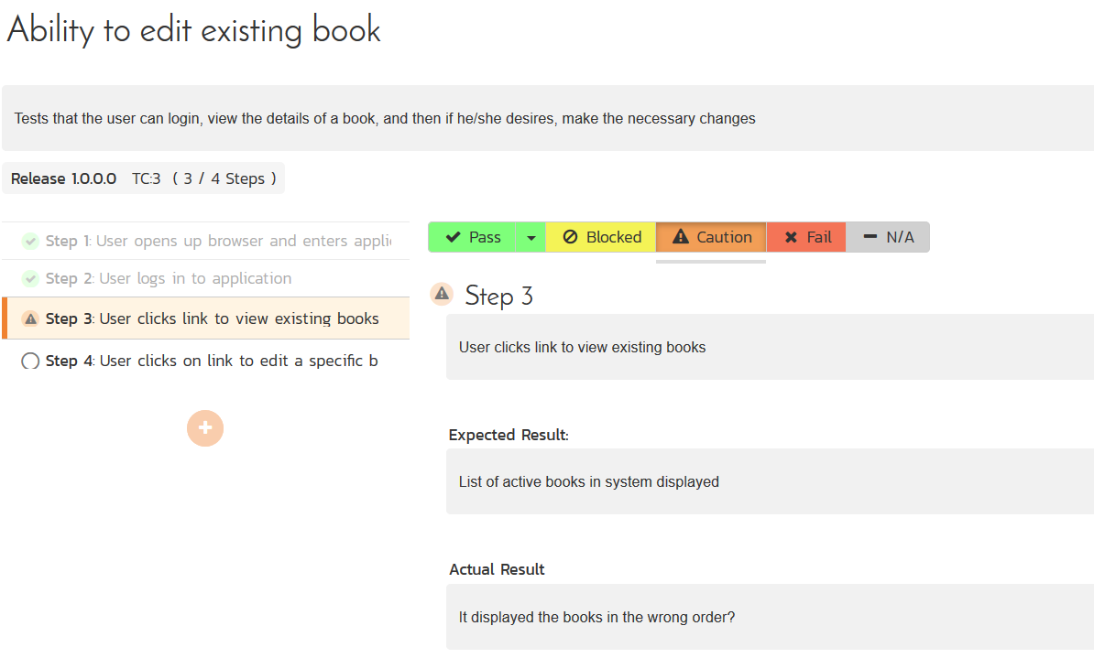
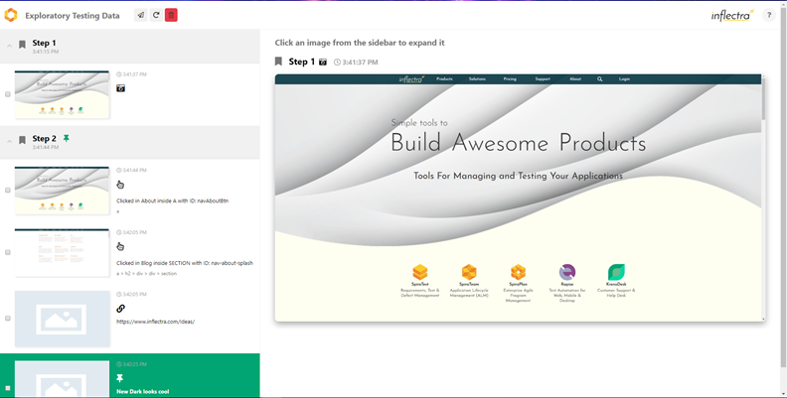
Manual & Exploratory Testing
SpiraTeam provides an easy to use testing wizard for manual and exploratory tests, with SpiraCapture™ for session capture.

Slide 52
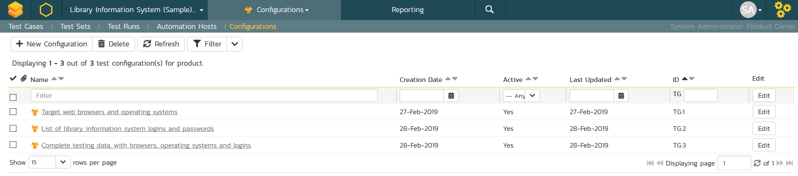
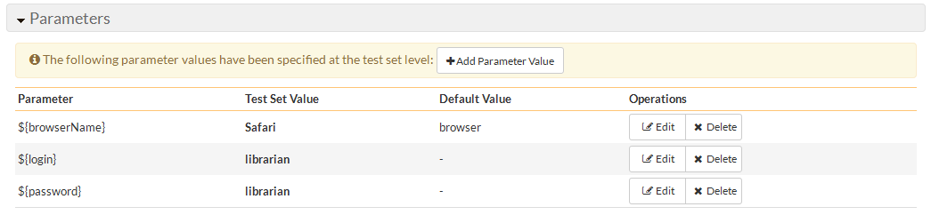
Data-Driven Testing
SpiraTeam lets you parameterize your test cases and execute them using different data combinations for full coverage.

Slide 53
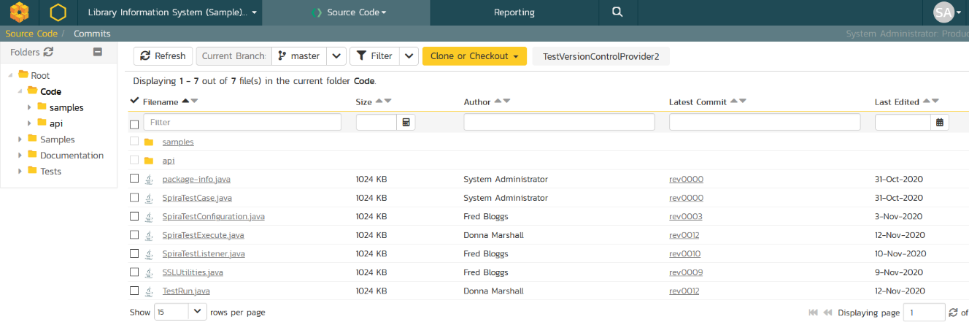
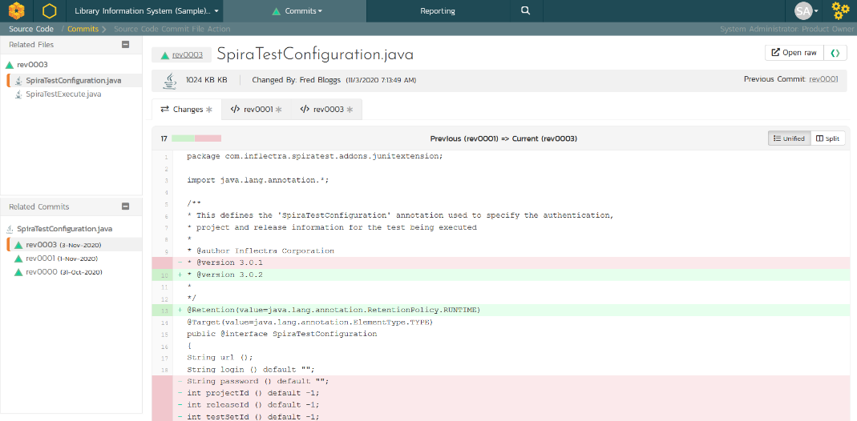
Source Code Management
&
Integrated source code management using Git or Subversion. Plugins for GitHub and GitLab. Allows code-level traceability.

Slide 54
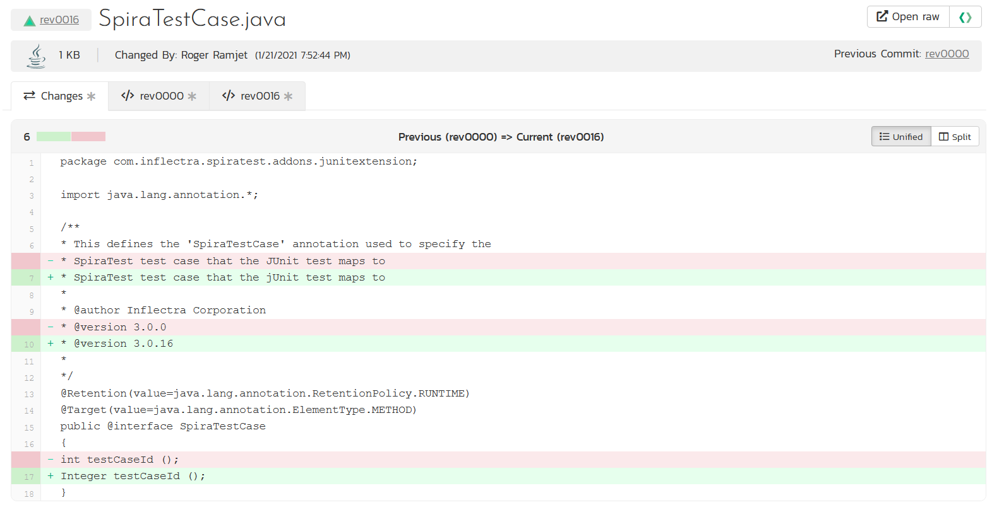
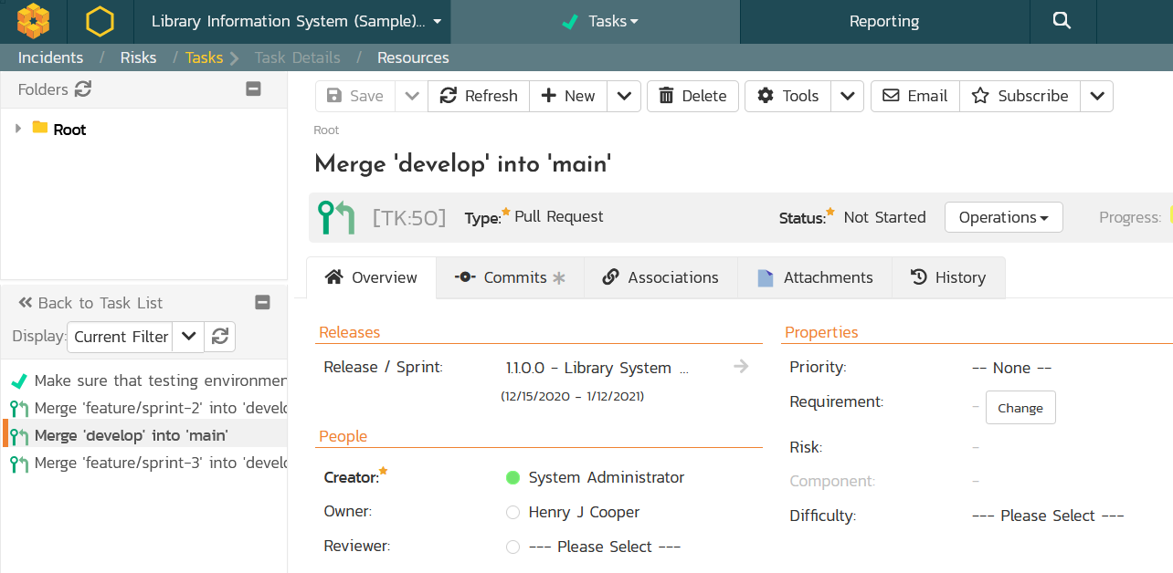
Code Reviews & Pull Requests
Manage your development workflows including merge/pull requests and code reviews with full traceability.

Slide 55
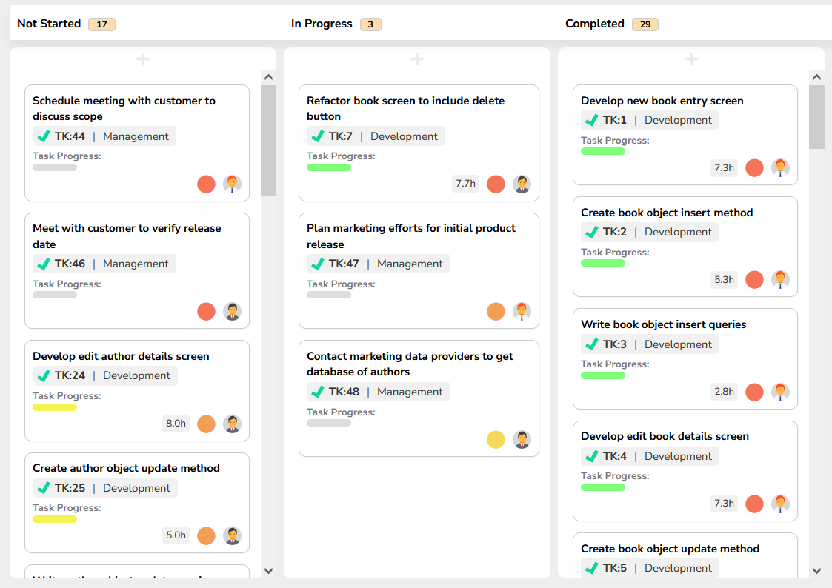
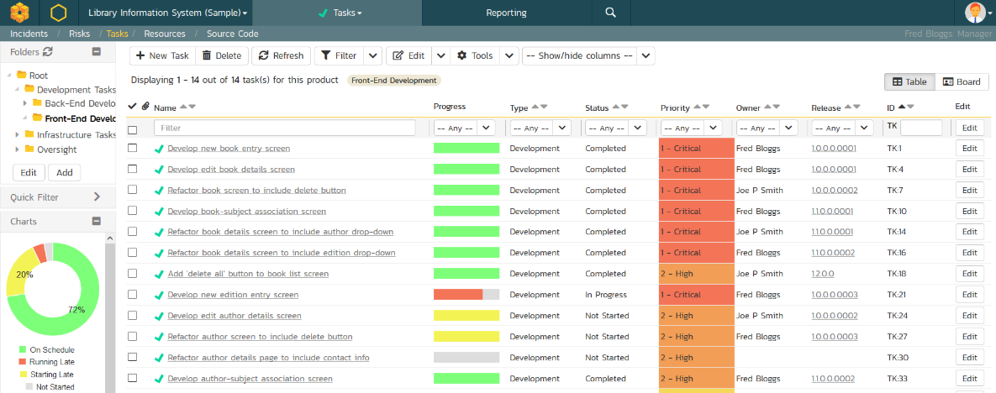
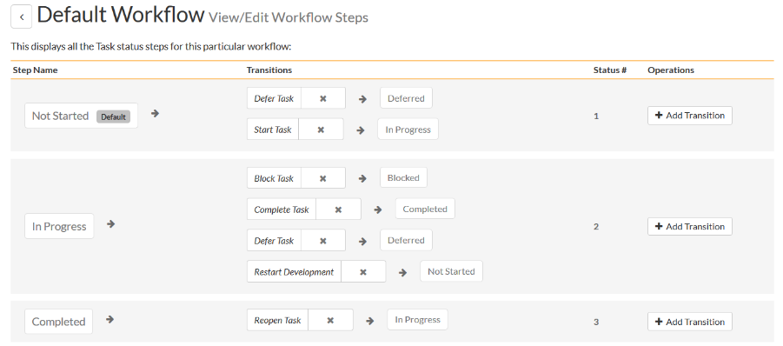
Task Tracking
Track project tasks with customizable workflows. Measure progress against the requirements and user stories

Slide 56
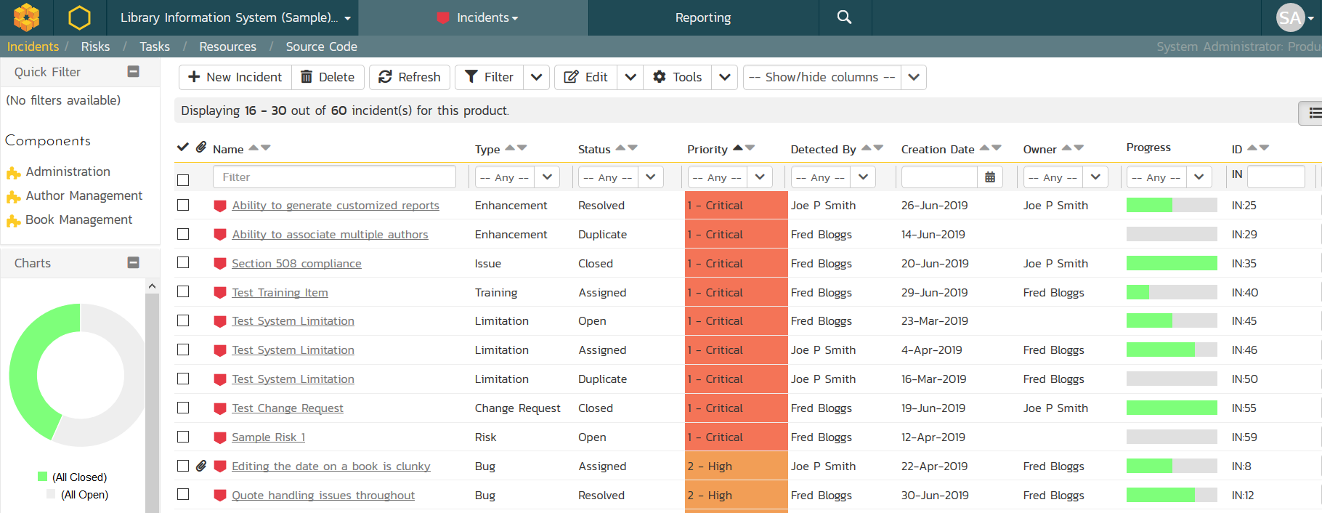
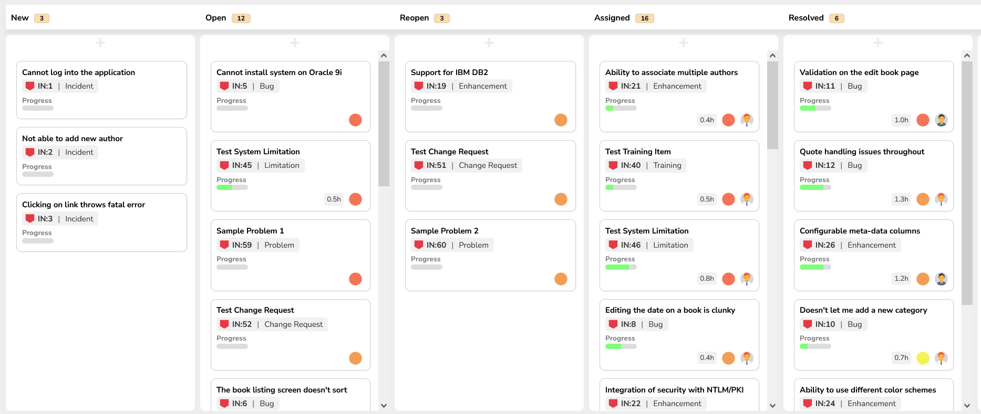
Issue & Defect Tracking
SpiraTeam includes a flexible bug and issue tracker with list and agile board views, and integrated workflow engine.

Slide 57
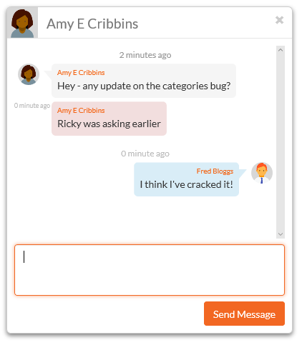
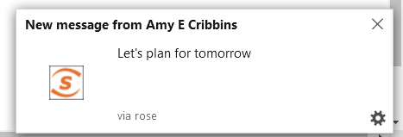
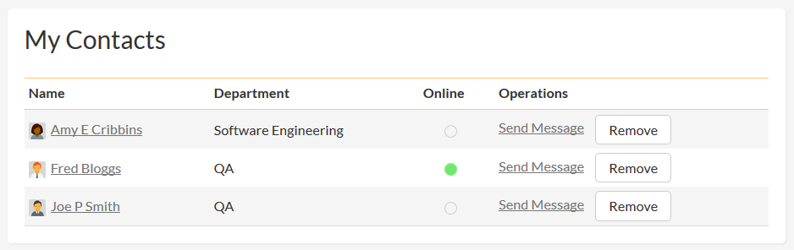
Collaboration and Instant Messaging
Real-time collaboration and communication with SpiraTeam instant messenger, artifact following, RSS Feeds and Email

Slide 58
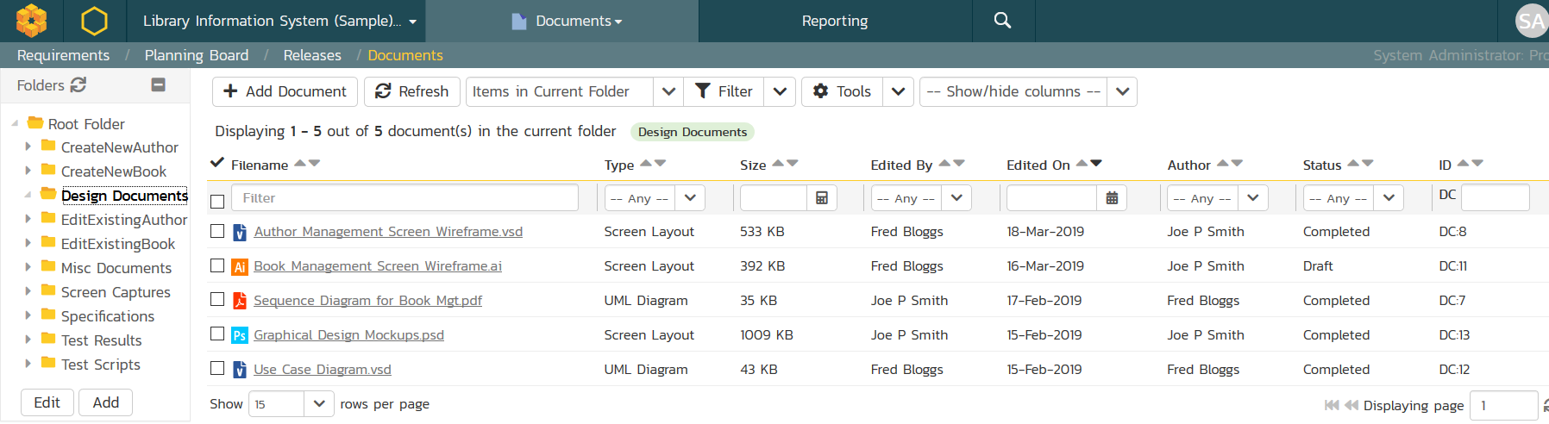
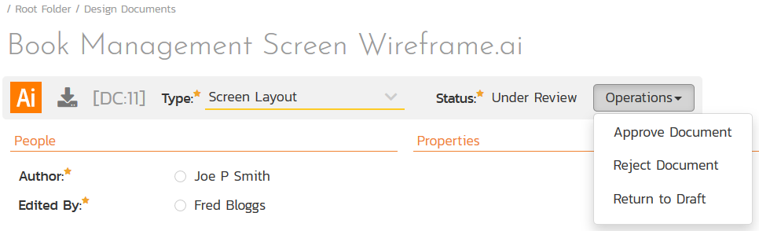
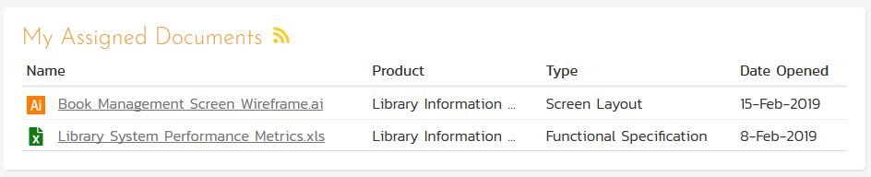
Document Management
Complete integrated document management system with versioning, check-in/out and approval workflows.

Slide 59
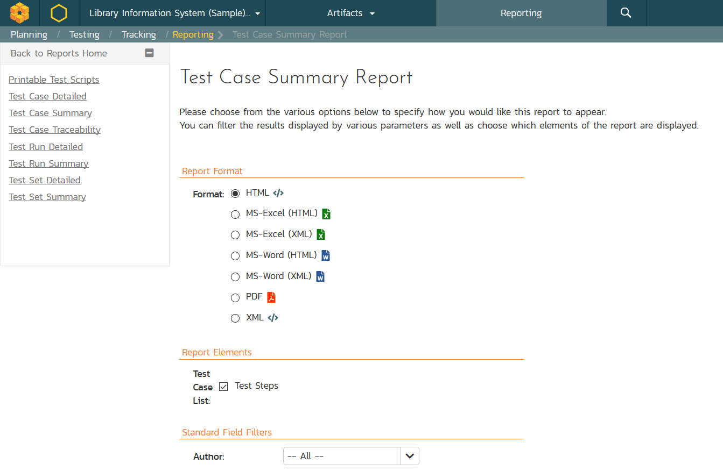


Customizable Reporting
Library of standard and custom reports, export in various formats including Word, PDF, Excel and PDF

Slide 60


Extensibility with SpiraApps™
SpiraApps are powerful add-ons that unlock the full potential of SpiraTeam by extending its core functionality to precisely match your specific requirements.
They empower allow you to optimize SpiraTeam to support your software development lifecycle and quality engineering practices.

Slide 61
Integration Options
SpiraTeam Fits into Your Ecosystem Seamlessly

Slide 62



























Extensive Integrations & Migrations
80+ INTEGRATIONS
35+ BUILT-IN MIGRATIONS

Slide 63








Integration with your Favorite IDEs

Slide 64


RemoteLaunch® - Automation Integration
Host #1
Windows 2008
IE 8.0
Manual
Tester #1
RemoteLaunch®
Host #2
Windows Vista
Mozilla Firefox
SpiraTeam®
Repository
Manual
Tester #2
RemoteLaunch®
Host #3
Ubuntu Linux
Google Chrome
Manual
Tester #3
RemoteLaunchX®
RemoteLaunch® lets you integrate other automated testing tools with SpiraTeam in addition to using Rapise®

Slide 65


Build Integrated with CI / CD Tools
Build Management in SpiraTeam lets you integrate with continuous integration build servers with full traceability for each build

Slide 66








































































Open Ecosystem – Over 80 Integrations
IDE
CI/CD
Automation
Unit Testing
Bug-Tracking
Detailed Integration List
Import / Conversion
Load Testing

Slide 67
Case Studies

Slide 68

GME (Manufacturing)
The Challenge
GME Pty Limited faced a significant challenge in managing the lifecycle of their consumer electronics, particularly with
regression testing as products neared their end-of-life phase. Their primary concern was to find an effective solution to streamline their application lifecycle management and test automation.
LIKELIHOOD TO RECOMMEND
Extremely likely: 10 out of 10
SUPPORT SATISFACTION
Satisfaction Score: 10 out of 10
The Solution
GME deployed SpiraTeam to develop a GPS-enabled version of their XRS radio. With SpiraTeam, GME achieved an effective verification and validation for market release. It significantly improved the process of setting up requirements and matching test cases. In addition, it efficiently managed the entire product lifecycle, for electronics approaching their end-of-life.
QUALITY OF OUTCOME
Satisfaction Score: 6 out of 6
Existing Tools in Place
Prior Inflectra's platforms, GME used Excel, which proved inefficient due to excessive setup and maintenance needs.
“The speed at which we could set up the requirements and matching test cases in Inflectra’s system was quite impressive. The Remote test feature was particularly beneficial for automating regression testing.” -- Derek M. PMO & Portfolio Manager

Slide 69

Philippine Land Registry (Government)
The Challenge
Land Registration Systems (LARES) faced significant challenges in test management and automation, crucial for the successful digital transformation in land registration. This required a robust and versatile solution that could handle complex data, ensure security, and maintain regulatory compliance.
The Solution
LARES opted for Inflectra's products, SpiraTeam and Rapise, due to their comprehensive feature set, flexible deployment options (both cloud and on-premise), and cost-effective pricing models.
SpiraTeam: Deployed for its advanced SDLC governance
capabilities, facilitating efficient management of the project’s multifaceted IT infrastructure.
Rapise: Chosen for its superior test automation capabilities, which were essential in ensuring the system's reliability and security.
Existing Tools in Place
“Coming from MicroFocus products, Inflectra products really helped us in providing comprehensive support at fraction of the
cost.” -- Jeff M. QA Manager

Slide 70

Generali (Insurance)
The Challenge
Generali needed to reduce the number of different tools being used within QA to simplify and streamline their processes. They were seeking a single platform tool on which they could share requirements and incidents between different projects, accommodate both waterfall and agile projects, and maintain integrations to additional software components in their system.
Key Outcomes and KPIs
Allowed real time visibility of test progress and test coverage.
Improved reporting and workflow generation.
Increased understanding of test processes in the company.
Replaced over one dozen tools with a single, easy-to-use solution.
Seamlessly Integrated other tools in Generali’s technology portfolio
The Solution
Generali evaluated numerous tools prior to making a decision. SpiraTeam made the migration from Testlink very easy, as well as the import of legacy documents with the free Microsoft Excel and Word import tool.
Existing Tools in Place
Prior to SpiraTeam, Generali used Bugzilla+Excel for bug tracking, TOSCA+ Testlink for test management, Ranorex + Rational Functional Tester for test automation as well as MS Outlook, Word, Jira, Jenkins, CA’s Service Desk Manager, Clarity/PPM and Workbench.
“SpiraTeam is a complete test management solution with a great price-to-functionality ratio. The quality of the product meets all our expectations”…-- Andreas Eckerle, Head of Test & Quality Management

Slide 71
Questions?

