Slide 1

Codeless AI-Driven Test Automation for Web, Mobile, Desktop, APIs and ERPs

Slide 2
Why Inflectra?

Slide 3
When Failure Isn’t An Option. We Help You Deliver.
And Prove It.
Inflectra unifies software delivery, quality, compliance, and traceability so you can ship at AI speed, reduce risk, and prove every release is ready.

Slide 4



With Inflectra, Deliver Measurable Quality Fast!
Only 16% of software development projects are completed on time and within budget.
PRODUCT MANAGERS
QUALITY ASSURANCE
SOFTWARE TESTING
52%
of time spent on un-planned “fire-fighting” activities
40%
of software budget spent on Quality Assurance
5%
of companies carry out fully automated testing internally
60%
of businesses lack a plan to enhance their PM process
39%
of software projects fail due to poor requirements gathering
24%
of companies saw ROI uplift from automated testing
39%
of managers that worry about missing launch date
67%
of customers cite “bad experience” with products as their churn reason
35%
of companies use non-testers for software testing
Sources: “Software Survival in 2024”, Beta Breakers; “10 QA Statistics”, Testlio; “Product Management Statistics”, UXCam; “Software Testing Statistics – 2024”, TrueList

Slide 5








The Inflectra® Platform
RemoteLaunch®
Test Orchestration
SpiraCapture™
Exploratory Testing
SpiraApps™
Extensibility
SpiraPlan®
Enterprise Software Development Lifecycle Management
SpiraTeam®
Software Development Lifecycle Management for Teams
SpiraTest®
Requirements, Test & Defect Management
Rapise®
UI & API Test Automation
Inflectra.ai
Agentic AI Platform

Slide 6
Why Rapise?
Unlock the Power of AI-Driven Test Automation

Slide 7









Rapise® - Codeless Test Automation
KEY FEATURES & BENEFITS
DIFFERENTIATORS
AI-powered test automation platform for web / mobile / desktop applications, APIs, and enterprise resource planning (ERP) systems
Cross-functional capabilities that allow teams of automation engineers and testers to create highly efficient automated tests in tandem
1
Ability to automate testing for both user interfaces and APIs in both a script-less and JavaScript code environment, driving flexibility in end user type and maximum ROI
Intelligent recording, spy / object manager, self-healing locators, and reusable frameworks and components allow for easy maintenance
2
Extensive set of pre-existing libraries tailored to common applications / platforms such as Salesforce, Microsoft Dynamics & Office, Oracle Forms, ServiceNow, and SAP HANA
Tailored for highly regulated industries, enabling customers to deliver high quality, mission-critical software without sacrificing speed for compliance
3
Translates human-readable test steps into executable scripts using AI-enhanced natural language processing, enabling less technical team members to contribute.
4
Utilizes AI-driven object recognition for dynamic and complex UIs. Automates the maintenance of test scripts through self-healing mechanisms that adapt to changes in application interfaces.
POPULAR APPLICATIONS
END USER(S)
35%
40%
45%
Automation Engineers
Test Leads
QA Engineers
SDETs
Software Testers
faster
testing
productivity boost
better
ROI

Slide 8
Rapise®: Personas
AUTOMATION ARCHITECT
SOFTWARE DEVELOPER IN TEST
MANUAL TESTER
Demographics:
Age: 35-55
Role: Experience: 8+ years
Goals:
Design scalable, maintainable automation frameworks.
Standardize automation practices across teams and projects.
Integrate automation solutions into enterprise-wide CI/CD pipelines.
Pain Points:
Managing complex, multi-platform testing needs.
High maintenance costs due to poorly structured automation frameworks.
Lack of collaboration tools for overseeing distributed teams.
Demographics:
Age: 28-45
Experience: 3+ years
Goals:
Create robust, reusable automated tests for complex systems.
Integrate custom test scripts with open-source frameworks and enterprise tools.
Collaborate with developers to improve test coverage and quality.
Pain Points:
Limited flexibility in customizing test scripts for unique requirements.
Challenges integrating tests with enterprise frameworks and tools.
Inefficient debugging tools for identifying issues in test scripts.
Demographics:
Age: 25-40
Experience: 2+ years
Goals:
Learn and implement test automation with minimal coding expertise.
Transition manual test cases to automated workflows.
Ensure smooth collaboration with the broader QA team.
Pain Points:
Steep learning curve for traditional automation tools.
Difficulty linking manual test cases to automated test frameworks.
Lack of accessible tools for beginners in automation.

Slide 9
Rapise®: User Benefits
AUTONOMOUS TESTING
REDUCE MANUAL EFFORT
NO CODE TRANSLATION
SCENARIO-BASED TEST GENERATION
  Rapise integrates advanced AI models: AWS Bedrock and Azure OpenAI, to automate and memorize high volumes of functional and regression test creation, execution and maintenance with precision.
  Rapise generates optimized JavaScript and RVL (Rapise Visual Language) code based on user input, significantly reducing manual scripting efforts. The AI adapts generated code to objects and repositories within the testing framework.
  Using the AI Command feature, testers can provide high-level, human-readable instructions in plain English, which Rapise translates into executable JavaScript commands, enabling seamless automation for non-technical users.
  Using AI, Rapise can generate test scenarios from text prompts or images, automatically creating sequences of test commands tailored to high-level requirements.
MINIMIZE SCRIPT FAILURES
HYBRID APPLICATION TESTING
DATA-DRIVEN TESTING
VALIDATE ERP UPDATES
  AI-powered self-healing locators dynamically adapt to UI changes, minimizing script failures caused by application updates and reducing the need for manual intervention.
  Rapise is designed to test applications that use multiple technologies seamlessly, allowing a single test script to handle diverse application types.
  Rapise supports data-driven testing by allowing the creation of test scripts that run with various data sets, enhancing test coverage and reliability.
  Rapise offers extensive pre-built libraries for enterprise applications such as Salesforce, Microsoft Dynamics 365, Oracle Forms, and SAP, reducing time, effort for testing and fixing of customizations affected by ERP updates.

Slide 10











Rapise + SpiraTest: Better Together
KEY FEATURES & BENEFITS
DIFFERENTIATORS
Centralized management of all factors that impact testing, including requirements, defects, and reporting
1
Modern UI with ease-of-use in mind; quick access to insights and consistent functionality
Easy-to-use, automated bug & issue identification for tracking, prioritization, and resolution of defects before they impact users
2
True “out-of-the-box” platform with a full set of capabilities that can be set up in as little as 10 minutes
Cross-project data storage; simple reporting across projects via pre-built dashboards
3
Streamlined planning, execution, and tracking of testing, including test case management and exploratory testing
Robust set of default workflows for customers in highly regulated industries
4
Extensive and pre-built integration library bolsters in-house capabilities; no need for dedicated admin to manage plug-ins
End-to-end traceability of product releases, tested requirements, and resolved defects, with electronic signature capabilities
5
POPULAR INTEGRATIONS
END USER(S)
95%
40%
30%
Test Managers
QA Managers
Software Testers
Project Managers
Developers
requirements coverage
faster test cycles
cost
reduction
AWS Bedrock

Slide 11





Customer Onboarding & Self-Guided Enablement
1
2
3
4
5
Getting Started Videos
Introduces our products and walks you through your first 10 days.
Inflectra Campus
Online Training
Includes free introductory courses followed by paid advanced modules and certificates
Live Webinars
& Q&A
Regular webinars on key product releases, customer roundtables, and other interactive sessions
YouTube
Channel
Recordings of our webinars, advanced product insights and other key Inflectra information
InflectraCon360
Thought leadership content from industry leaders, Inflectra customers and partners
Learn more
Learn more
Learn more
Learn more
Learn more

Slide 12





Technical Support & Customer Success
1
2
3
4
Live Tech Support
Legendary technical support via email, phone, forums. Free standard support with every purchase.
Knowledge Base
A repository of expert-written articles covering product troubleshooting, best practices, and tips & tricks.
Documentation
Quick-start guides, in-depth manuals, and integration instructions for smooth deployment & optimal performance.
Account Managers
Experienced account executives providing strategic guidance from pre-sales consultations through the entire lifecycle.
Premium Support
Combined advanced customer success and tailored technical support delivered by highly skilled professionals.

Slide 13



Security & Compliance
Our cloud platform is SOC2 Type II certified
Our website and payment systems are PCI-DSS certified
Data encrypted in transit and at rest using strong ciphers
Multi-factor authentication (MFA) and Single Sign On (SSO)
Physical infrastructure provided by Amazon Web Services.
Learn more

Slide 14














Compliance with International Standards
Guidance on Data Integrity
EudraLex
Volume 4
Part I & II

Slide 15
































Representative Customers
Energy, Industrial & Transport
Financial & Business Services
Media & Telecom
Government & Defense
Healthcare & Bio-Technology

Slide 16























Global Partnership Ecosystem
SOLUTION PARTNERS
TECHNOLOGY PARTNERS
TIERS
# PARTNERS
AREAS OF FOCUS:
  Artificial Intelligence (AI)
  DevOps & CI/CD
  Test Automation
  Device Management
  Modeling Tools
Platinum
9
Modernization
Agile Transformation
Implementation Services
Training
Load Testing
Gold
10
Silver
31
Blue
69

Slide 17
Customer Testimonials
“
We have been using the Rapise automation tool for a few years now. I have been very impressed with just how simple the tool is to setup and record your automation scripts. As we have learned more about the tool we have found it to have all the functionality we need without all the complexity of many other tools out there… We can rely on the trusted Inflectra customer support team that has always been awesome.
- Daniel Hauser, Sr. QA Analyst RegEd
“
It was very easy to learn and get started using the tool to automate our manual test cases. The Inflectra support has been great in working with us to identify and add features as needed. We are currently using Rapise to automate our regression test bed for Microsoft Dynamics AX ERP System. The customer support has been great in helping us to get started. The tool integrates well with SpiraTeam, so we can launch our tests and record results. Rapise has been easy to learn and quick to make progress on automating our regression test bed. We are very happy with the tool and the support that we have received from Inflectra. It is a high quality product at a great price..
- Kevin D., Kent Corporation
“

Slide 18
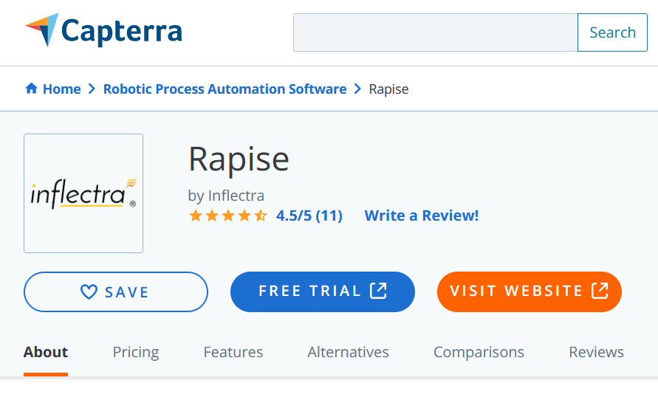
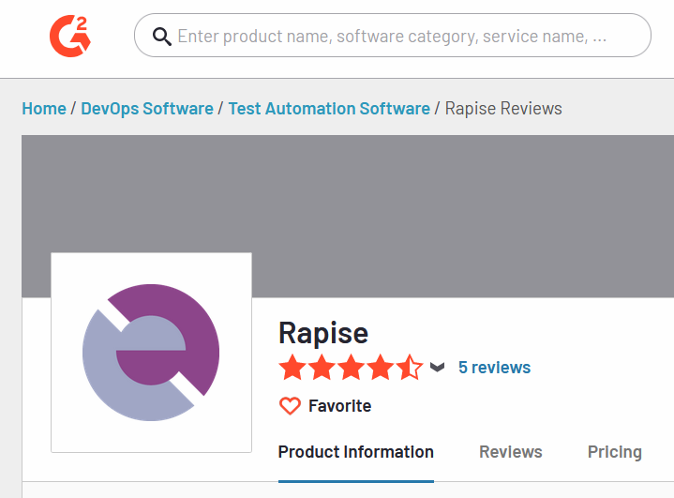
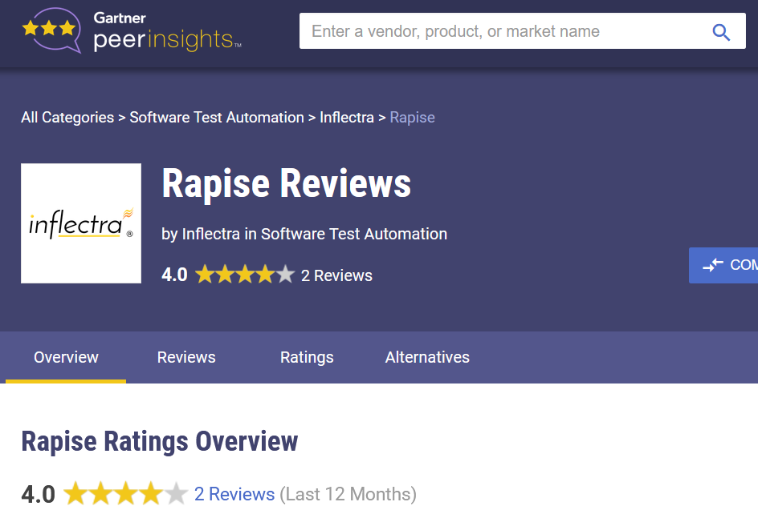
Awards and Recognition*
*Gartner, G2 Crowd, Capterra

Slide 19
Feature Overview
Let's Look at the Key Features in Rapise

Slide 20
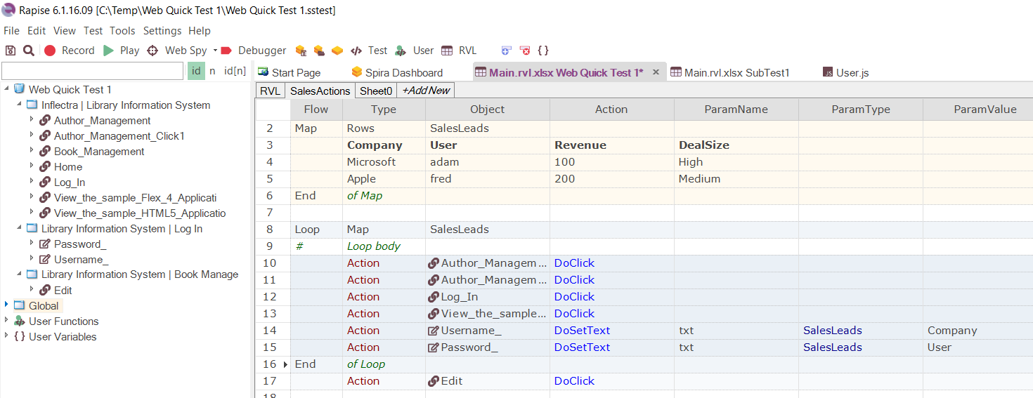
Codeless Test Automation
Rapise comes with its unique Rapise Visual Language that lets you create powerful test frameworks without any code. Of course, Rapise lets you add script when you need.

Slide 21





















Handles Your Testing Needs In One Tool
Web Applications
Mobile Applications
Cross-Platform Technologies
Windows Applications
Enterprise Applications
Third-Party Component Libraries
Unit Test Frameworks
Integrations

Slide 22
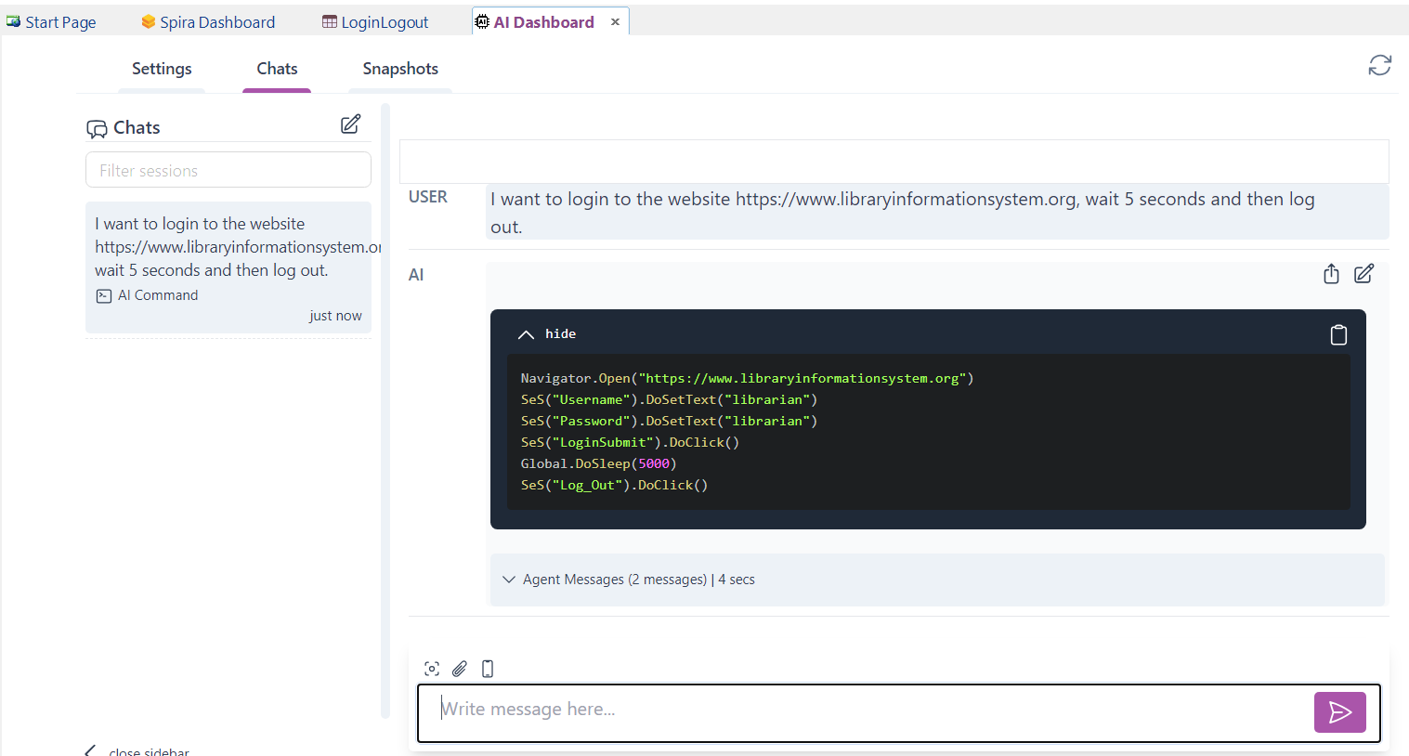
Integrated AI Assistant for Test Writing
The integrated AI assistant lets you converse with Rapise in natural language. It will write codeless tests in RVL for you, using the existing recording objects and locators.

Slide 23
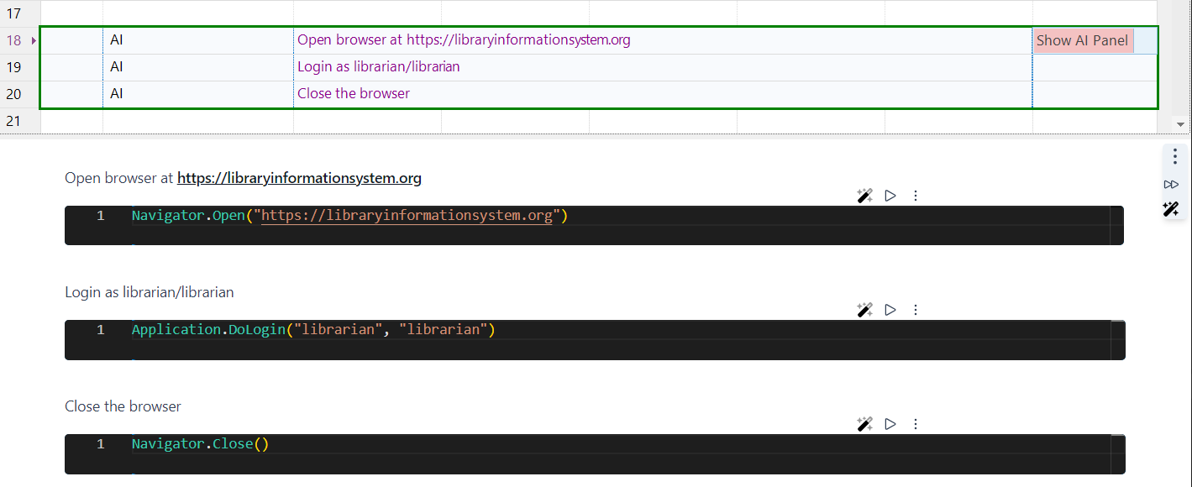
Write Tests in Natural Language
Taking AI a step further, the AI commands in Rapise let you write tests in natural language. Rapise dynamically converts that into script dynamically and executes it “on the fly”.

Slide 24
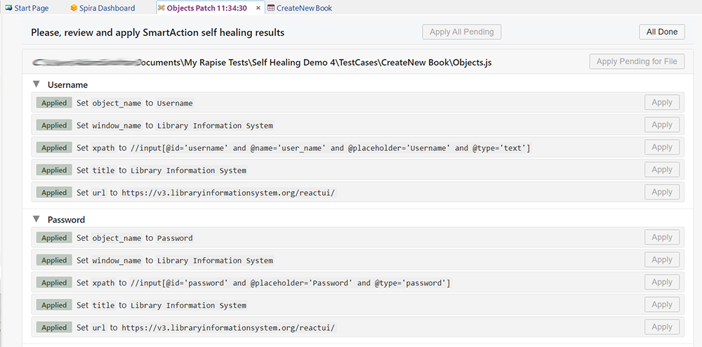
Self-Healing Tests Using SmartActions™
Rapise has special SmartActions™ that record the business intent behind every action. This allows Rapise to automatically fix tests as applications change, reducing maintenance cost by over 70%.

Slide 25
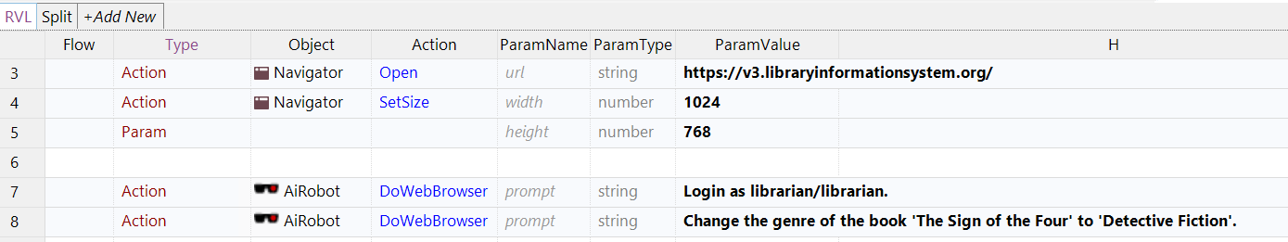
Autonomous Testing with AI Robot
The AI Robot feature uses the Anthropic Computer Use feature to enable automated exploratory testing. This also allows execution of manual tests directly from natural language.

Slide 26
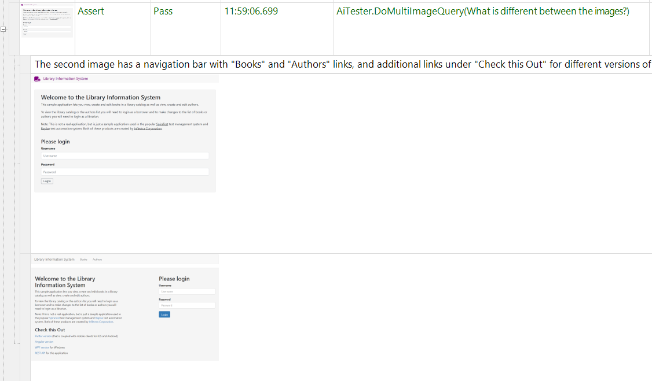
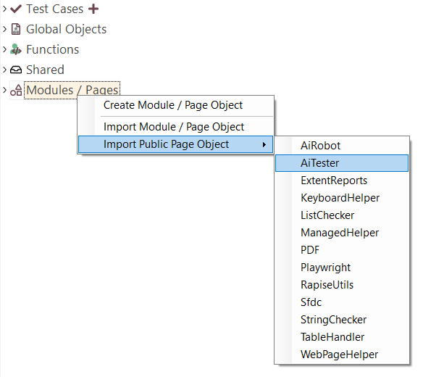
Autonomous Verification with AI Tester
AI Tester ensures a more thorough review of the user interface, identifying issues with the usability as well as functionality, all while maintaining the speed and consistency of automated execution.

Slide 27
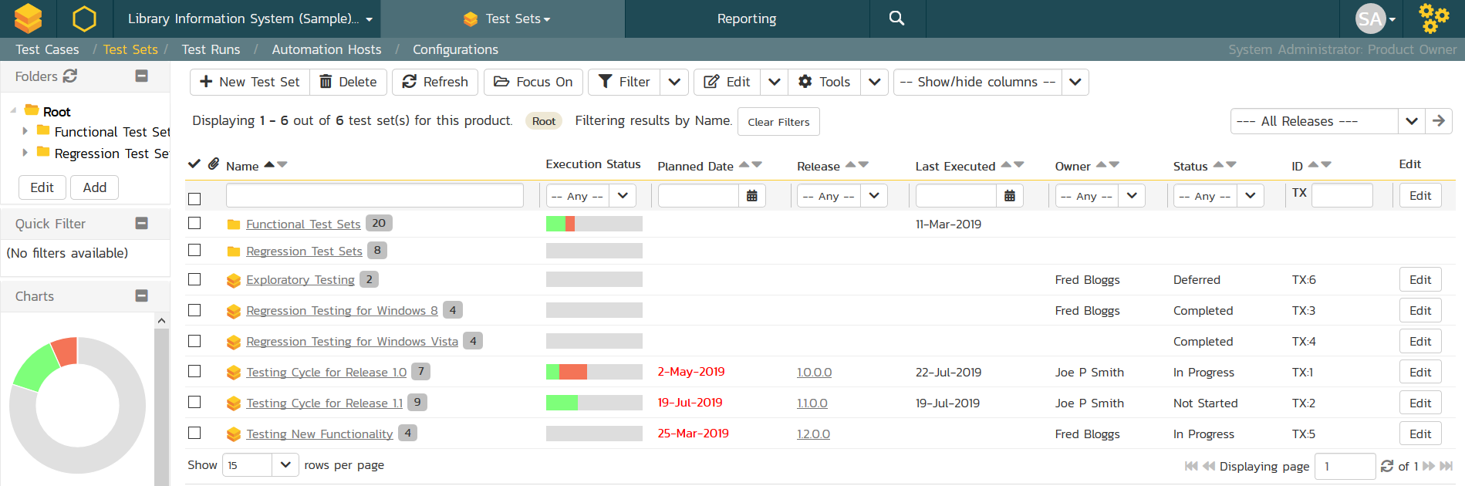
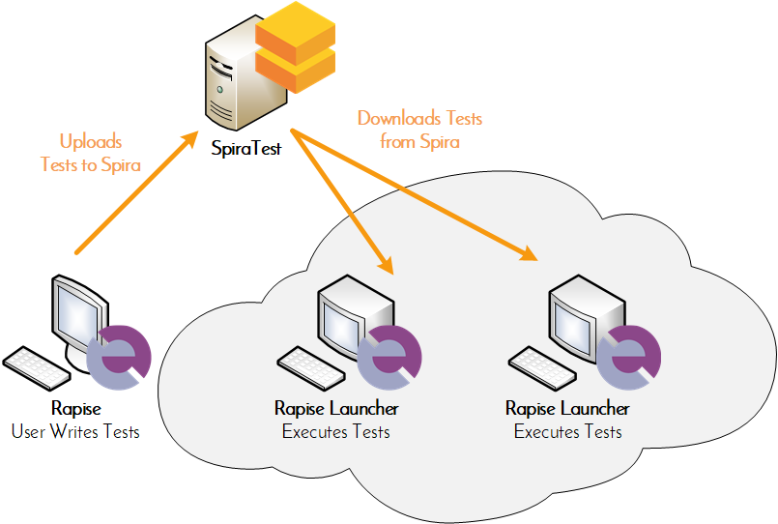
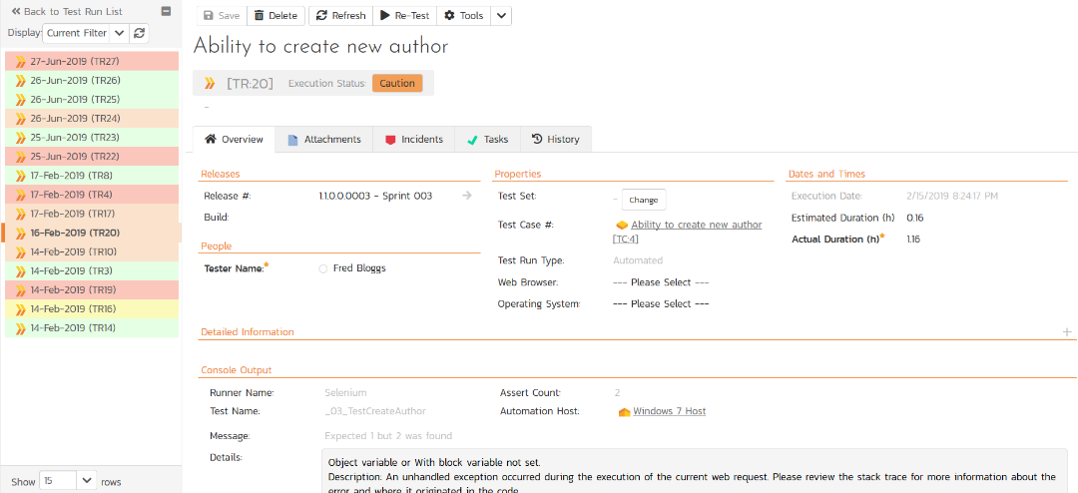
Distributed Test Scheduling & Execution
Orchestrate your automated Rapise tests from SpiraTest, with integrated test lab management and data-driven testing

Slide 28
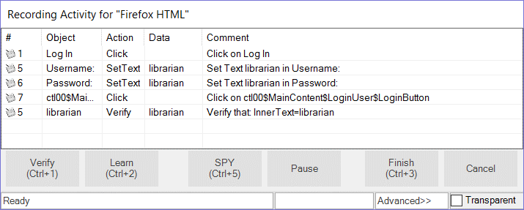
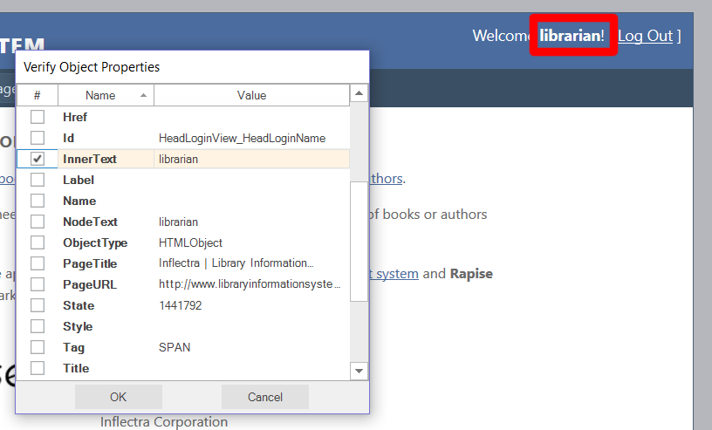
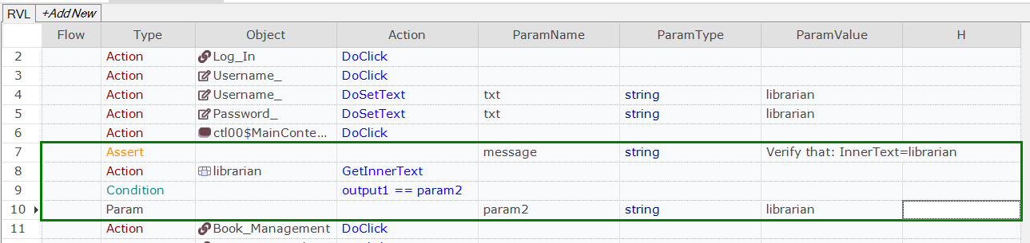
Automated Recording & Verification

Slide 29
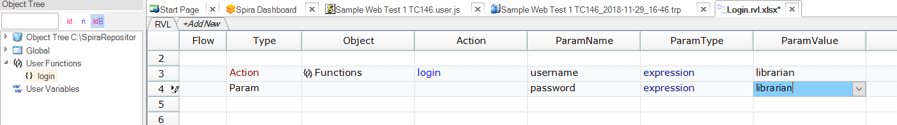
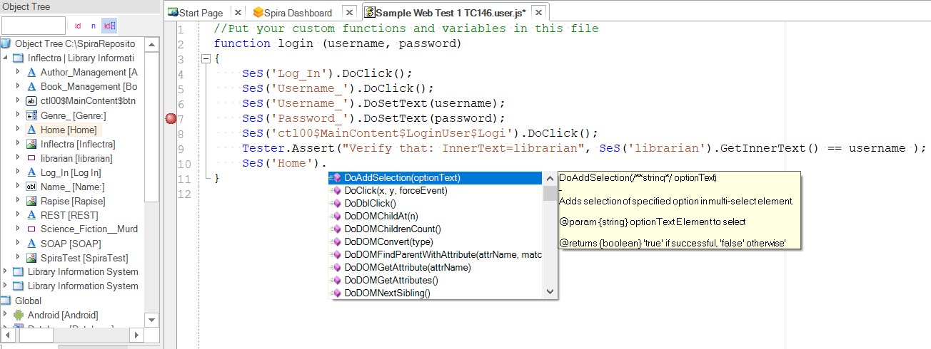
Extensible with Code (when needed!)

Slide 30
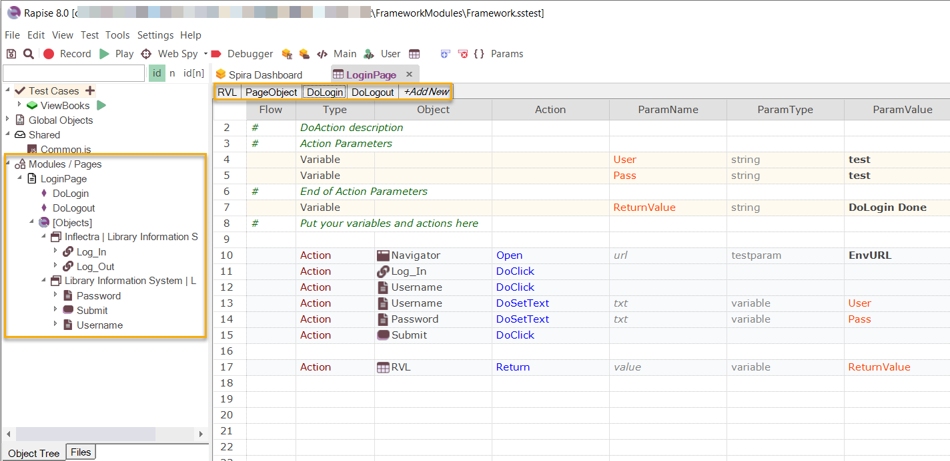
Scalable Test Frameworks
Rapise comes with an out of the box test framework that lets you scale your testing without needing to create your own.

Slide 31
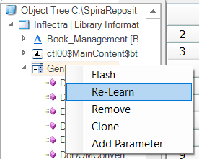
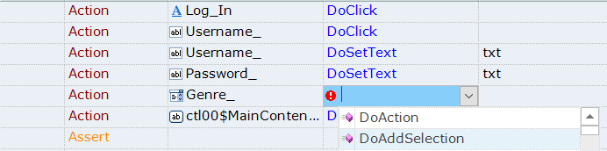
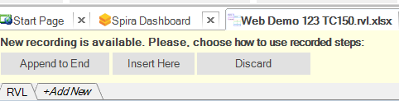
Easy Test Refactoring & Updates

Slide 32
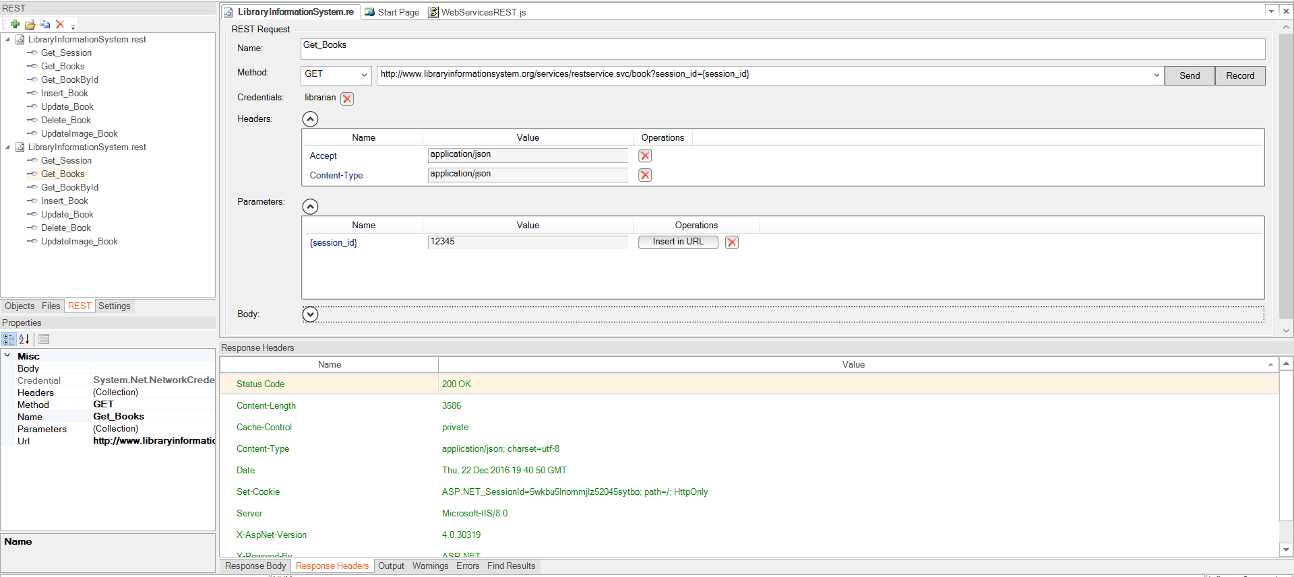
Support for Integrated UI and API Testing
Rapise provides native support for testing APIs. API endpoints can be integrated with user interface tests for complete coverage.

Slide 33
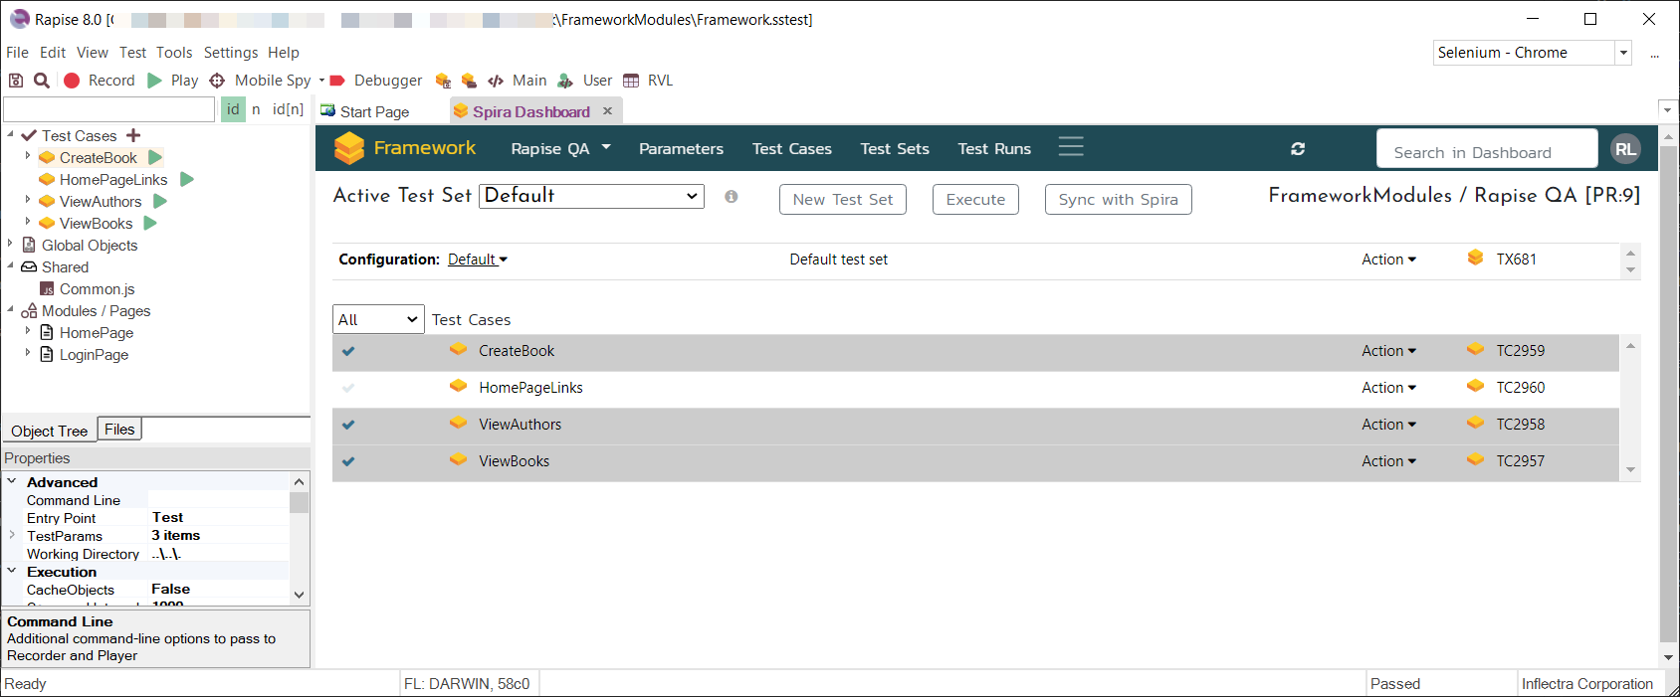
Integration with Test Management
Rapise integrates seamlessly with our SpiraTest® test management system, letting you plan and manage test execution in Rapise.

Slide 34
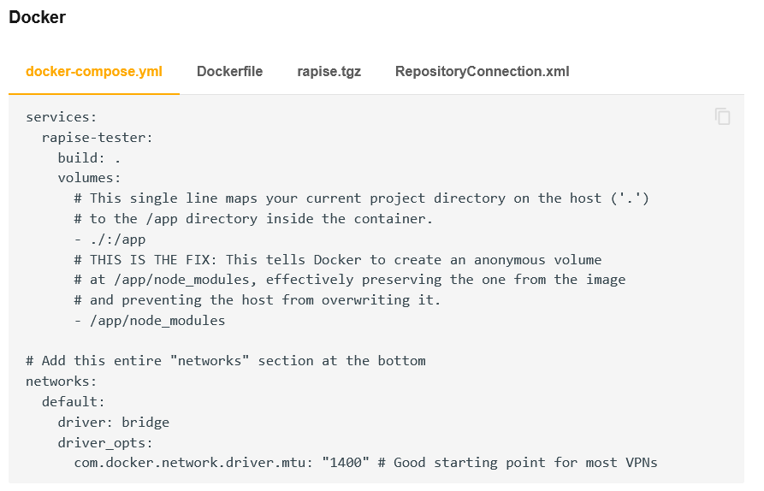
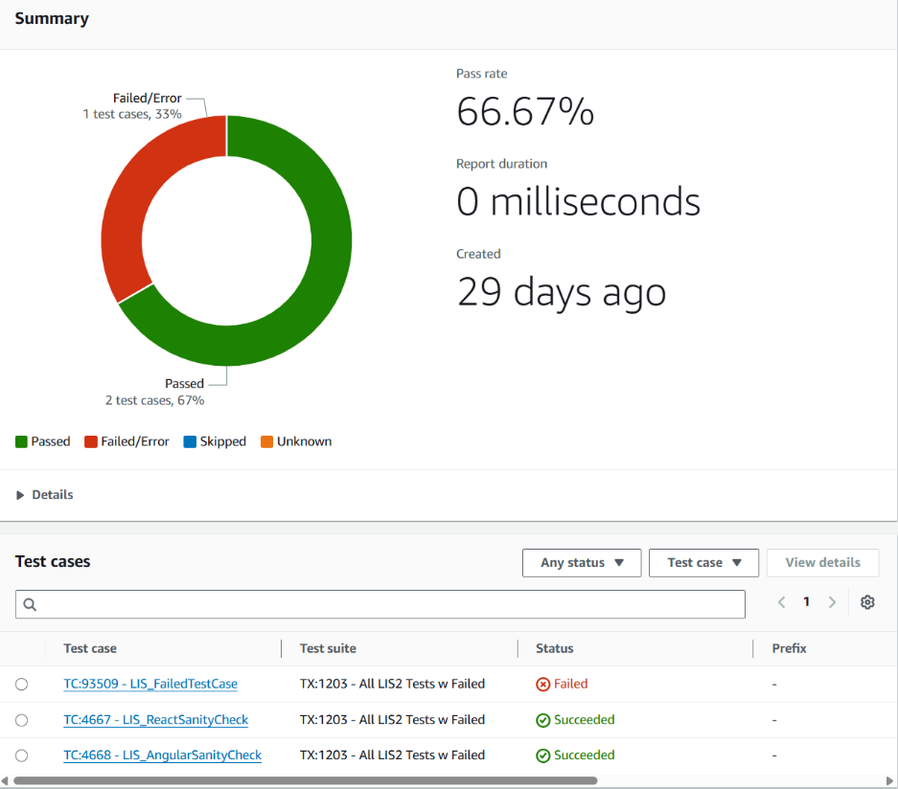
Deploy into CI/CD Pipelines Cross-Platform
Rapise includes a cross-platform test execution agent that lets you execute Rapise web and API tests on any platform that supports NodeJS, including Linux, macOS, Docker and CI/CD pipelines.

Slide 35
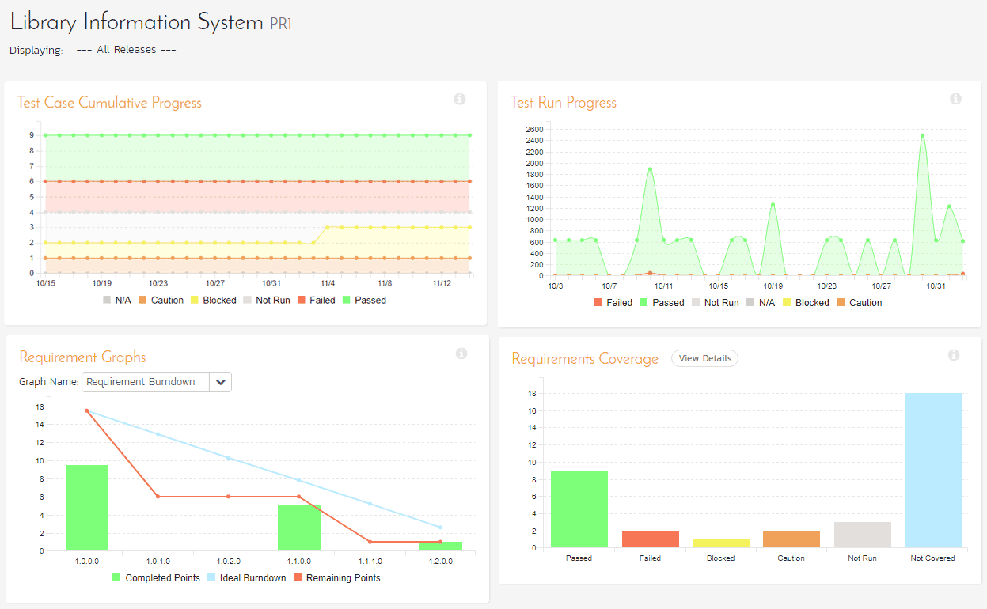
Powerful Reporting with SpiraTest®

Slide 36
Platforms Supported
Rapise is your best choice for web, mobile, desktop and APIs

Slide 37
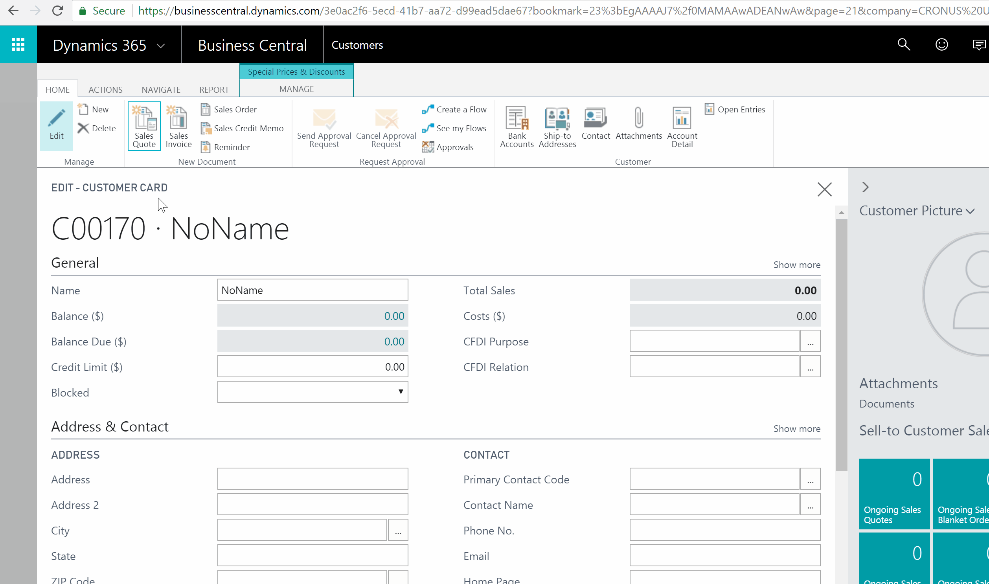
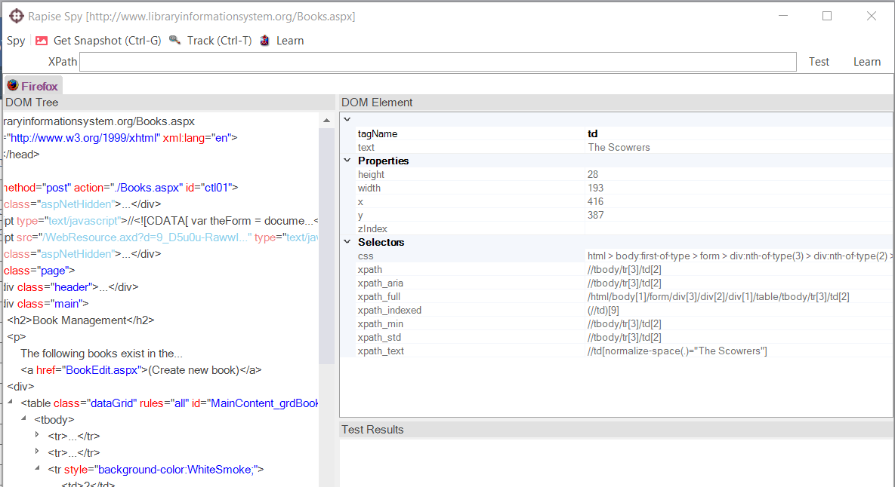

Web Applications
Rapise supports multiple versions of IE, Edge, Firefox Chrome, Safari and Opera. You can record in one browser and playback in all.

Slide 38
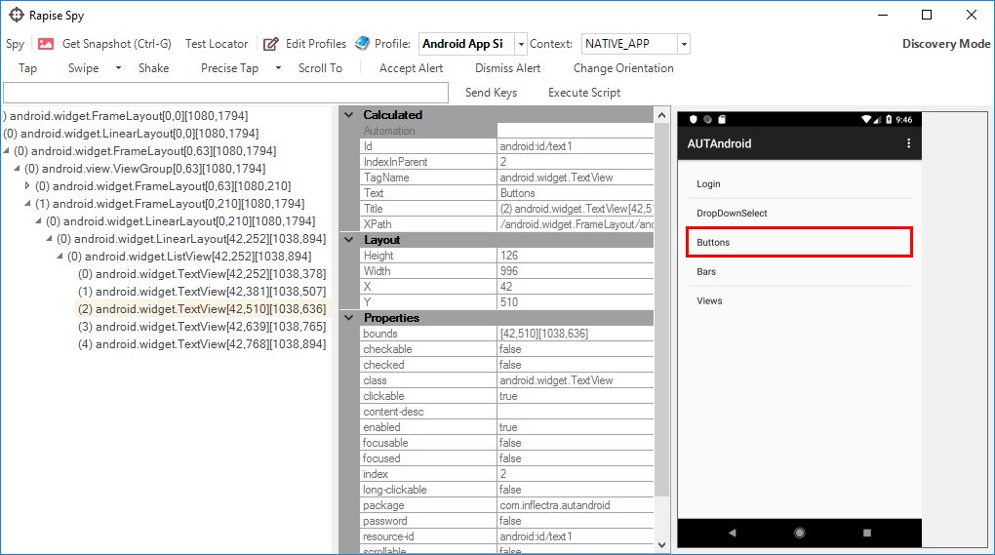
Mobile Apps
Automate Mobile Apps (native, web, iOS, Android)
Works with physical, simulated and cloud devices

Slide 39
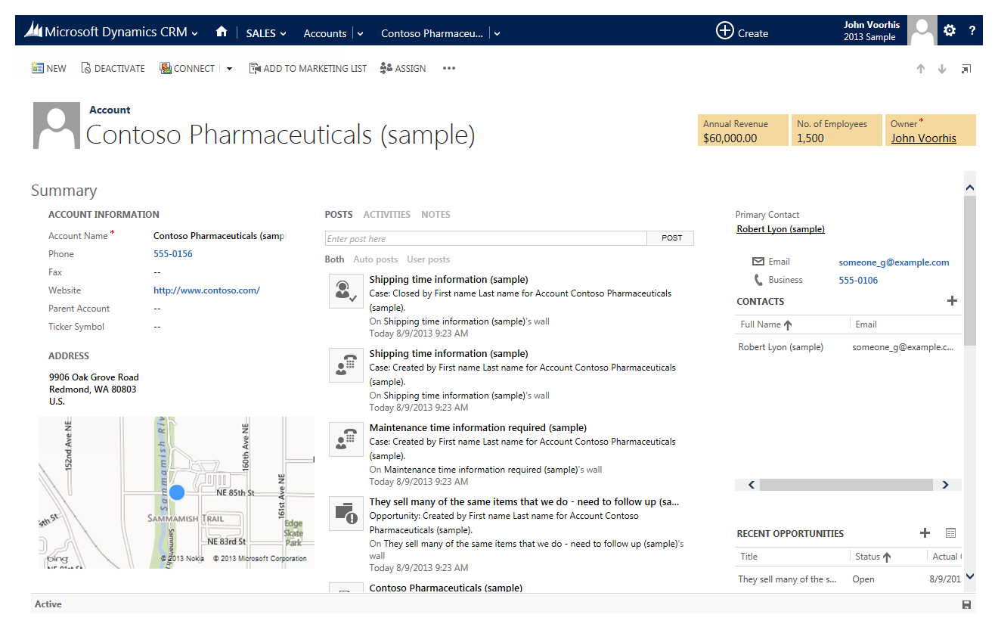
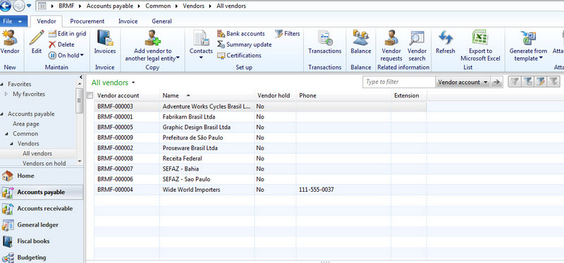
Desktop Applications
Rapise can automate most desktop applications
Support for Windows, Java, Qt, .NET Applications
Libraries for common third party components and controls

Slide 40
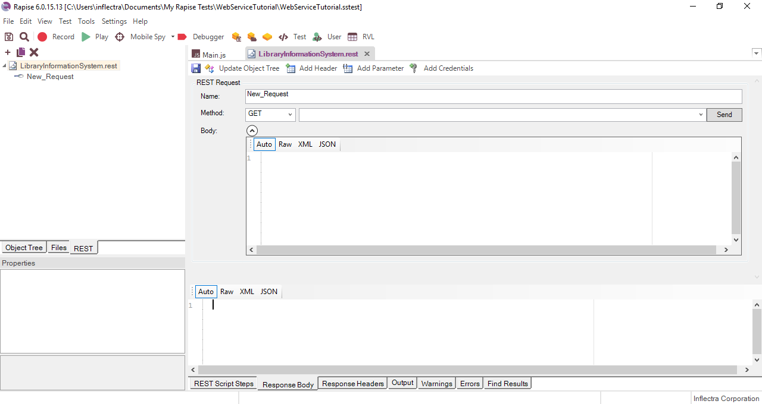
Web Services & APIs
Automates REST, SOAP, GraphQL, and other API endpoints.

Slide 41
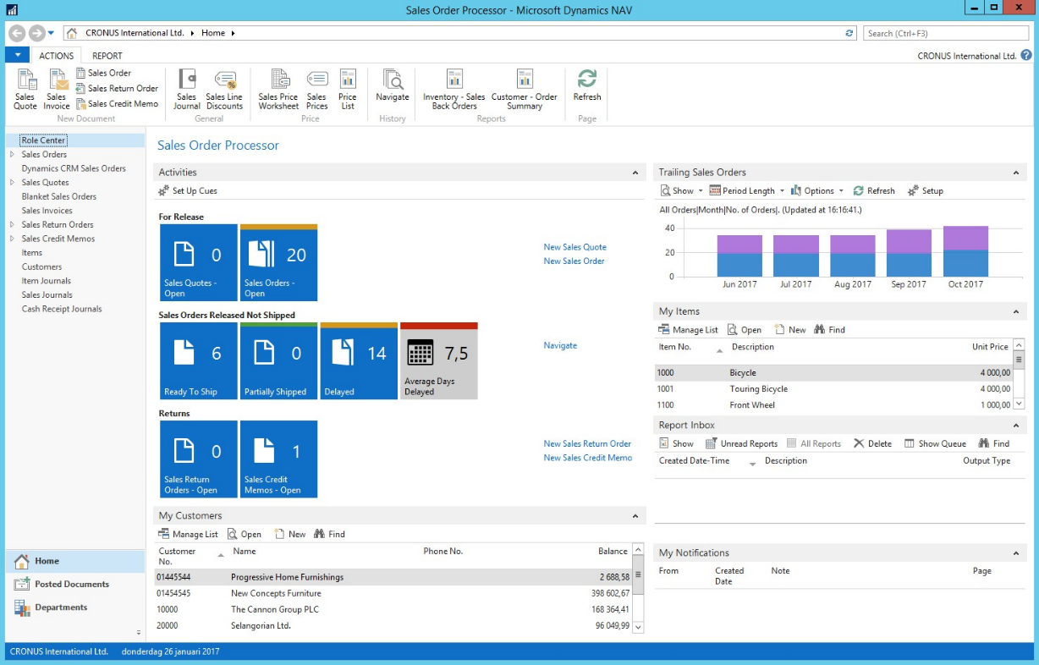
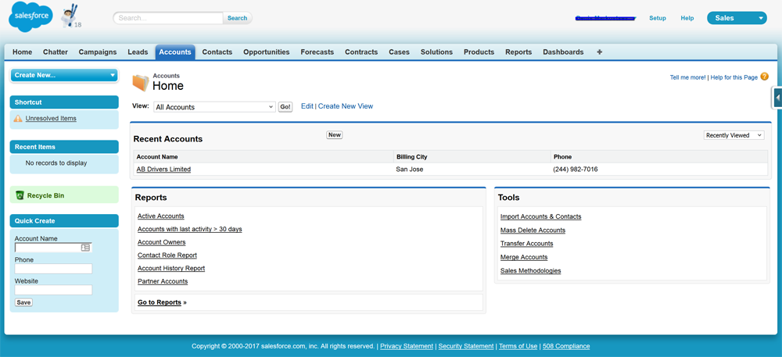
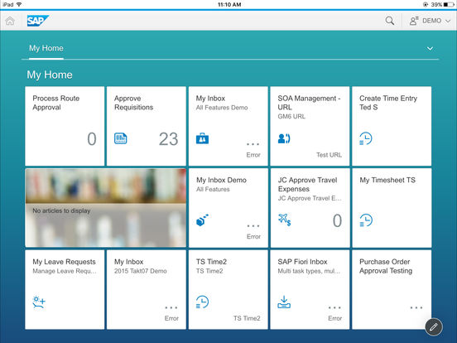
Enterprise Applications
Special support for CRM tools such as Salesforce and Dynamics 365
Support for ERP platforms: SAP and Dynamics AX & NAV

Slide 42
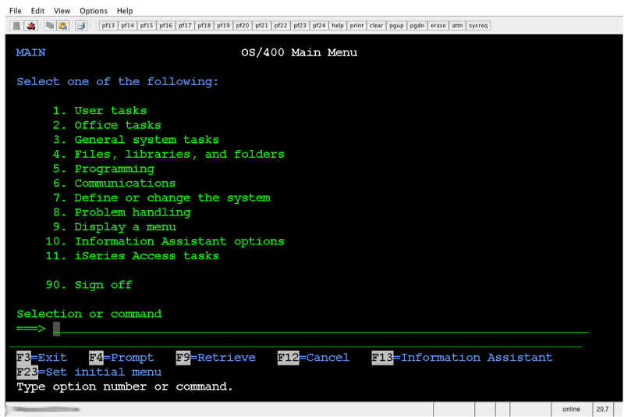
Terminal (Mainframe) Applications
Rapise has support for “green screen” mainframe applications running on VT100 or AS400 style terminals.
Rapise can connect to a variety of terminal emulators, both Java Swing or Windows native, to automate text-based terminal applications

Slide 43
Case Studies

Slide 44
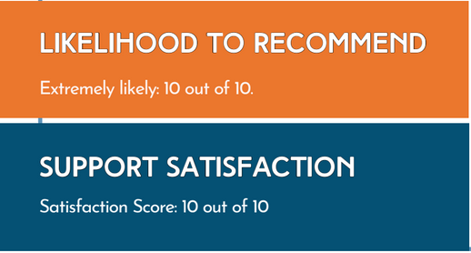
Philippine Land Registry (Government)
The Challenge
Land Registration Systems (LARES) faced significant challenges in test management and automation, crucial for the successful digital transformation in land registration. This required a robust and versatile solution that could handle complex data, ensure security, and maintain regulatory compliance.
The Solution
LARES opted for Inflectra's products, SpiraTeam and Rapise, due to their comprehensive feature set, flexible deployment options (both cloud and on-premise), and cost-effective pricing models.
SpiraTeam: Deployed for its advanced SDLC governance
capabilities, facilitating efficient management of the project’s multifaceted IT infrastructure.
Rapise: Chosen for its superior test automation capabilities, which were essential in ensuring the system's reliability and security.
Existing Tools in Place
“Coming from MicroFocus products, Inflectra products really helped us in providing comprehensive support at fraction of the
cost.” -- Jeff M. QA Manager

Slide 45

80% Improvement of Test Coverage
The Challenge
Telstra International faced growing demands for an advanced test automation for its Salesforce platform. The strict security standards, however, required full security review and approval of any automation solution, adding complexity to the selection process.
LIKELIHOOD TO RECOMMEND
Extremely likely: 10 out of 10
SUPPORT SATISFACTION
Satisfaction Score: 8 out of 10
The Solution
SpiraTest and Rapise were deployed to build a comprehensive and reliable regression test suite for Salesforce. Rapise’s flexibility enabled Telstra to automate repetitive and complex tasks within the Salesforce environment, such as regression and daily sanity testing. Furthermore, the team utilized SpiraTest to effectively manage and document their testing processes, ensuring full coverage.
Key Results & Metrics
Test coverage improved by 80%
Regression testing 100% automated
Reduced reliance on manual testing, boosted overall testing efficiency, reducing human error, and improving project agility.
” We have found Rapise to be a great automation tool, enabling us to complete regression and daily sanity testing efficiently. In the future, we plan to update the Rapise scripts to include downstream systems”….. – Nicholas B.

Slide 46
Questions?

