Slide 1

Service Desk Management You Can Trust

Slide 2
Why Inflectra?

Slide 3
When Failure Isn’t An Option. We Help You Deliver. And Prove It.
Inflectra unifies software delivery, quality, compliance, and traceability so you can ship at AI speed, reduce risk, and prove every release is ready.

Slide 4



With Inflectra, Deliver Measurable Quality Fast! Only 16% of software development projects are completed on time and within budget.
PRODUCT MANAGERS
QUALITY ASSURANCE
SOFTWARE TESTING
52%
of time spent on un-planned “fire-fighting” activities
40%
of software budget spent on Quality Assurance
5%
of companies carry out fully automated testing internally
60%
of businesses lack a plan to enhance their PM process
39%
of software projects fail due to poor requirements gathering
24%
of companies saw ROI uplift from automated testing
39%
of managers that worry about missing launch date
67%
of customers cite “bad experience” with products as their churn reason
35%
of companies use non-testers for software testing
Sources: “Software Survival in 2024”, Beta Breakers; “10 QA Statistics”, Testlio; “Product Management Statistics”, UXCam; “Software Testing Statistics – 2024”, TrueList

Slide 5








The Inflectra® Platform
RemoteLaunch®
Test Orchestration
SpiraCapture™
Exploratory Testing
SpiraApps™
Extensibility
SpiraPlan®
Enterprise Software Development Lifecycle Management
SpiraTeam®
Software Development Lifecycle Management for Teams
SpiraTest®
Requirements, Test & Defect Management
Rapise®
UI & API Test Automation
KronoDesk®
IT Service Management

Slide 6
Why KronoDesk?
Service Desk Management You Can Trust

Slide 7
Why Choose KronoDesk?
KronoDesk provides help desk, forums and knowledge base in one solution that is fully integrated with our Spira platform.
Web-based User Interface
Robust APIs
IT Support Management
Help Desk
Knowledge Base
Support Forums
Organization and User Management Core Functionality

Slide 8
Customer Testimonials
“
It provides all the functionality that is needed to run a helpdesk off of and for the tracking, assigning, and communication of problems for customers. It also provides forums and a knowledge base so customers may browse similar or the same problem and find a solution before the helpdesk is required.
- Eric Bailey, Strategic Manufacturing Solutions.
“
The best part about KronoDesk is its helpdesk ticketing which agents can check and serve the customers well. Moreover, I find that their customer support forums helps users to check and learn the other features of KronoDesk that will increase their knowledge and understanding about the software platform.
- Eunice Joy T, Support Technician
“

Slide 9
































Representative Customers
Energy, Industrial & Transport
Financial & Business Services
Media & Telecom
Government & Defense
Healthcare & Bio-Technology

Slide 10























Global Partnership Ecosystem
SOLUTION PARTNERS
TECHNOLOGY PARTNERS
TIERS
# PARTNERS
AREAS OF FOCUS:
Artificial Intelligence (AI)
DevOps & CI/CD
Test Automation
Device Management
Modeling Tools
Platinum
9
Modernization
Agile Transformation
Implementation Services
Training
Load Testing
Gold
10
Silver
31
Blue
69

Slide 11
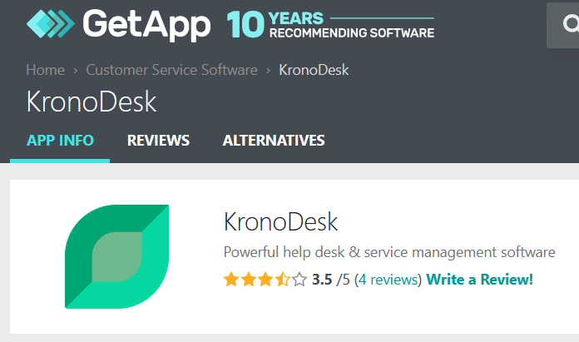
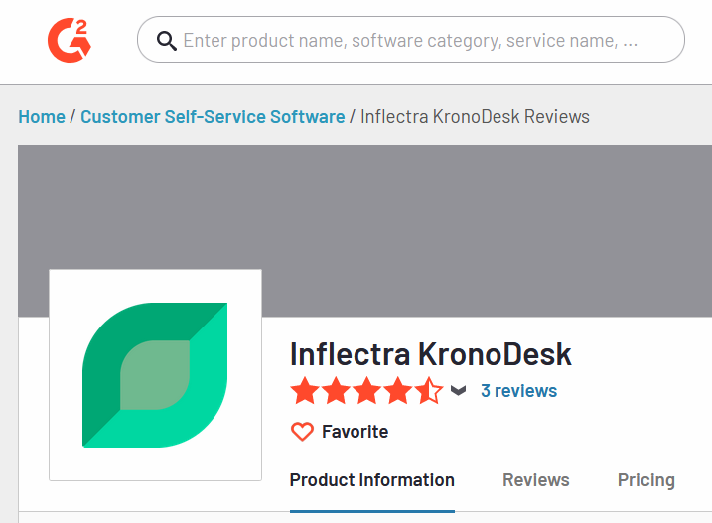
Awards and Recognition*
*Gartner GetApp, G2 Crowd

Slide 12





Customer Onboarding & Self-Guided Enablement
1
2
3
4
5
Getting Started Videos
Introduces our products and walks you through your first 10 days.
Inflectra Campus
Online Training
Includes free introductory courses followed by paid advanced modules and certificates
Live Webinars
& Q&A
Regular webinars on key product releases, customer roundtables, and other interactive sessions
YouTube
Channel
Recordings of our webinars, advanced product insights and other key Inflectra information
InflectraCon360
Thought leadership content from industry leaders, Inflectra customers and partners
Learn more
Learn more
Learn more
Learn more
Learn more

Slide 13





Technical Support & Customer Success
1
2
3
4
Live Tech Support
Legendary technical support via email, phone, forums. Free standard support with every purchase.
Knowledge Base
A repository of expert-written articles covering product troubleshooting, best practices, and tips & tricks.
Documentation
Quick-start guides, in-depth manuals, and integration instructions for smooth deployment & optimal performance.
Account Managers
Experienced account executives providing strategic guidance from pre-sales consultations through the entire lifecycle.
Premium Support
Combined advanced customer success and tailored technical support delivered by highly skilled professionals.

Slide 14



Security & Compliance
Our cloud platform is SOC2 Type II certified
Our website and payment systems are PCI-DSS certified
Data encrypted in transit and at rest using strong ciphers
Multi-factor authentication (MFA) and Single Sign On (SSO)
Physical infrastructure provided by Amazon Web Services.
Learn more

Slide 15
Feature Overview
Let’s Look at the Key Features in KronoDesk

Slide 16
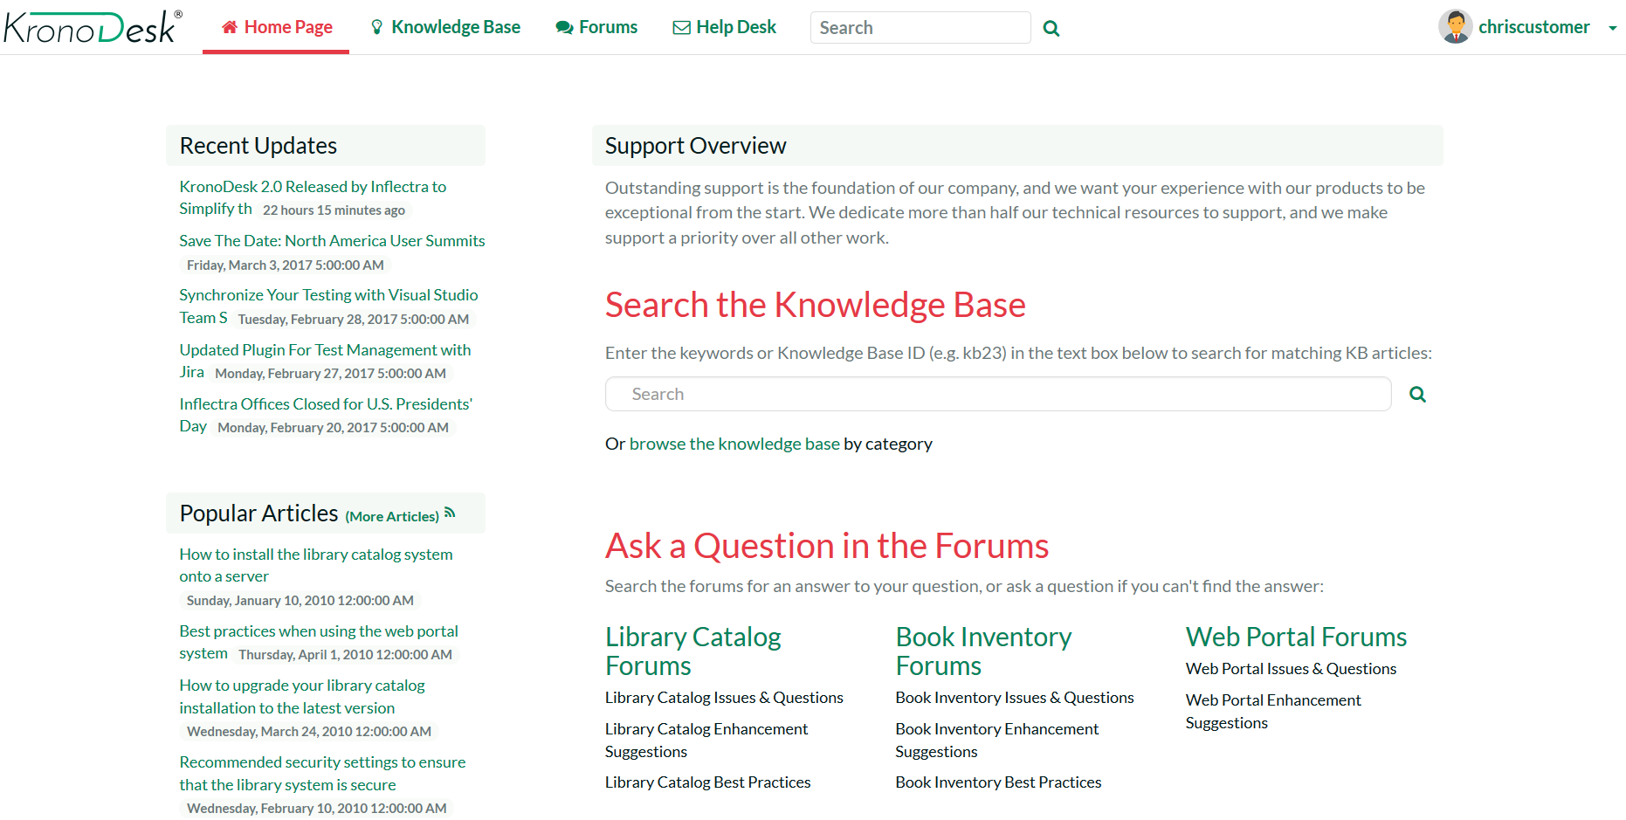
Customer Home Page
The customer dashboard provides a single view for your customers to see new knowledge base articles, recent forum posts and all their open tickets.

Slide 17
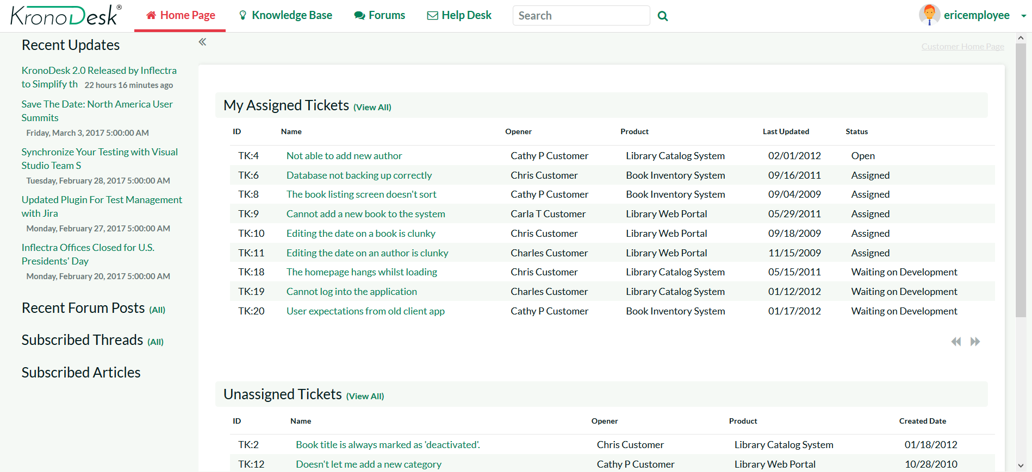
Support Agent Home Page
The customizable agent dashboard, allows your support agents to view all their assigned tickets, monitor incoming forum posts and check for new tickets all from the same screen.

Slide 18
Help Desk
Notes:
Managers, our third pillar, could always take advantage of our reporting, dashboards, and traceability features. But we knew we could do a lot more to help managers – both senior leaders and those in other roles like BI

Slide 19
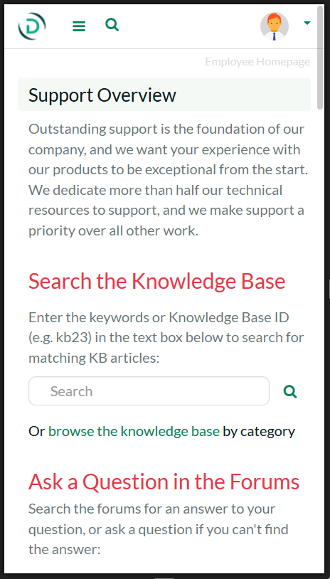
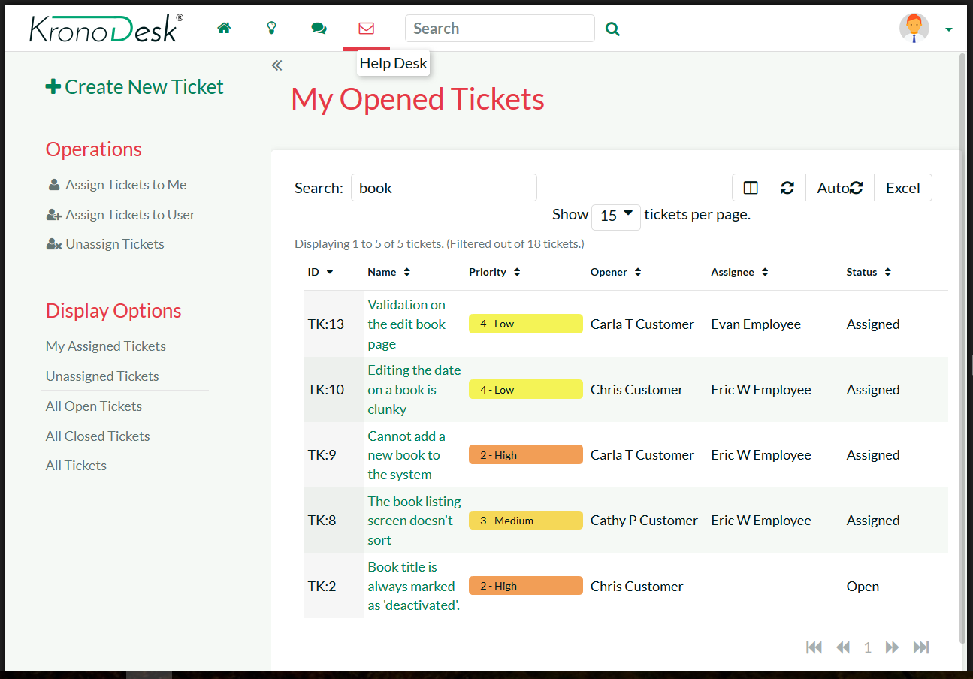
Fully Mobile Responsive
KronoDesk has been designed to optimize its features on any device, whether that be a large desktop monitor, a tablet or mobile phone.
Customers can browse the knowledge base, reply to forum posts and submit help desk tickets from the convenience of their phones.

Slide 20
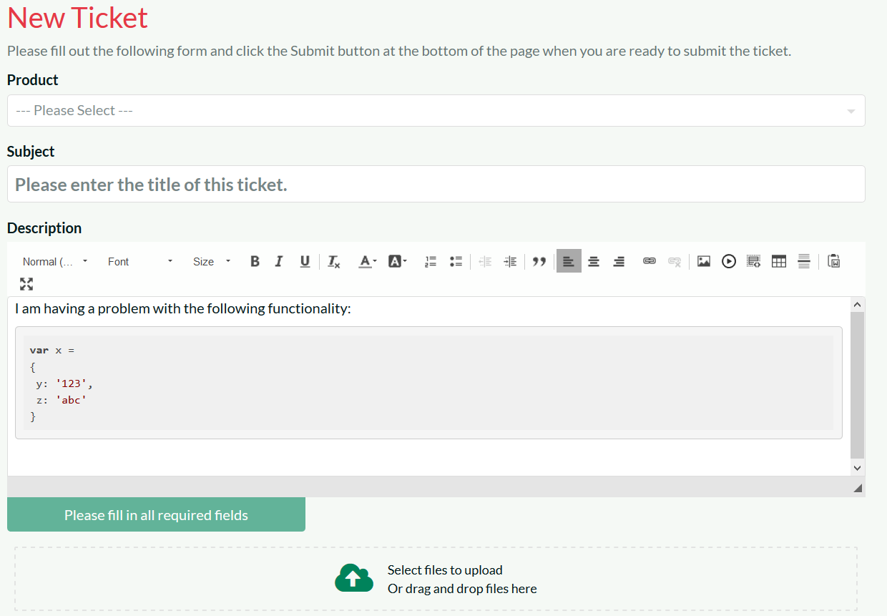
Help Desk Ticketing - Submitting
KronoDesk makes it easy for your customers to submit help desk tickets, attaching files and screenshots
KronoDesk makes it easy for your support agents to reproduce issues and provide help.

Slide 21
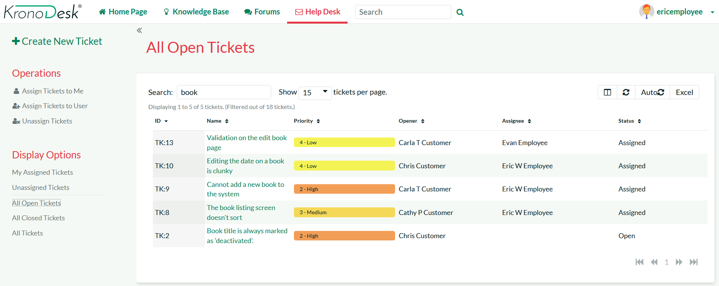
Help Desk Ticketing – Searching & Filtering
Your support agents can use the powerful sorting, searching and filtering features to track and manage their assigned tickets.

Slide 22
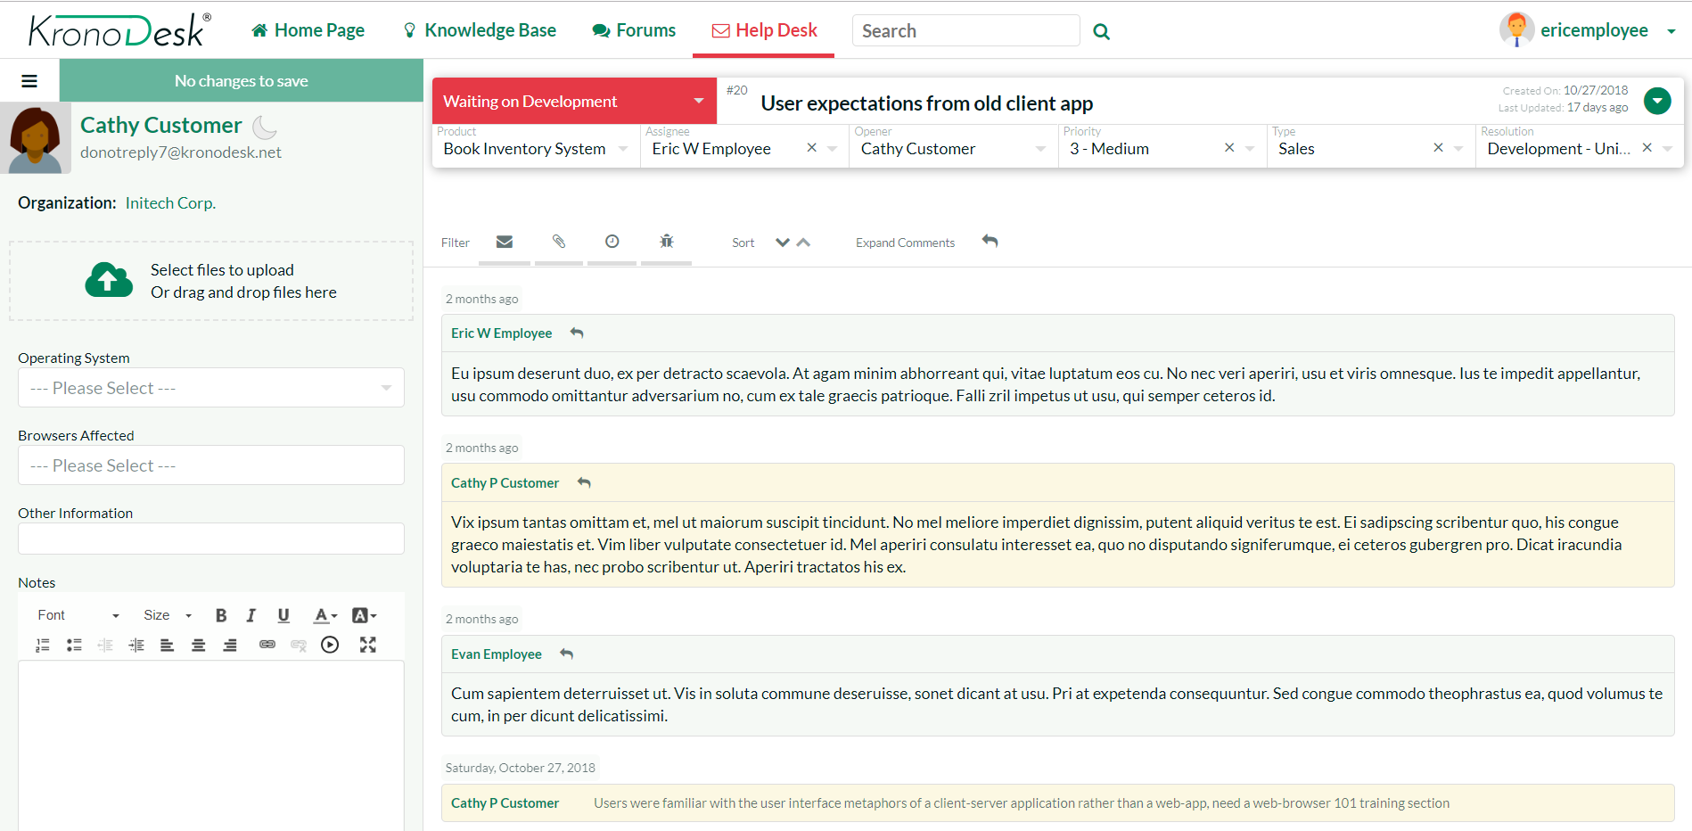
Help Desk Ticketing - Responding
The ticket editing screen lets your customer agents quickly and easily respond to custom help desk tickets.
The system allows them to add notes, view the change history, attach documents and update the fields based on the workflow.

Slide 23
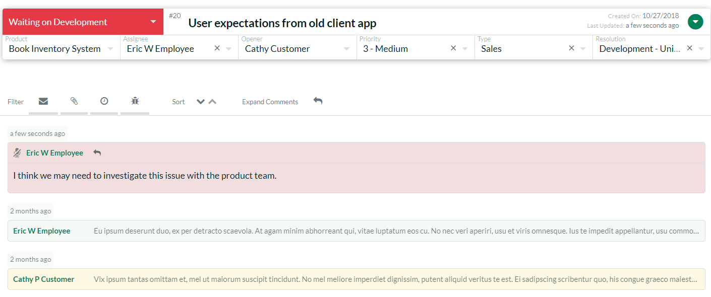
Help Desk Ticketing – Contact History
The ticket details page lets you see all of the interactions between your support personnel and the customer. You can have both public and private notes added to the ticket.
The change history lets you see the actions and escalations that have been performed on the help desk ticket

Slide 24
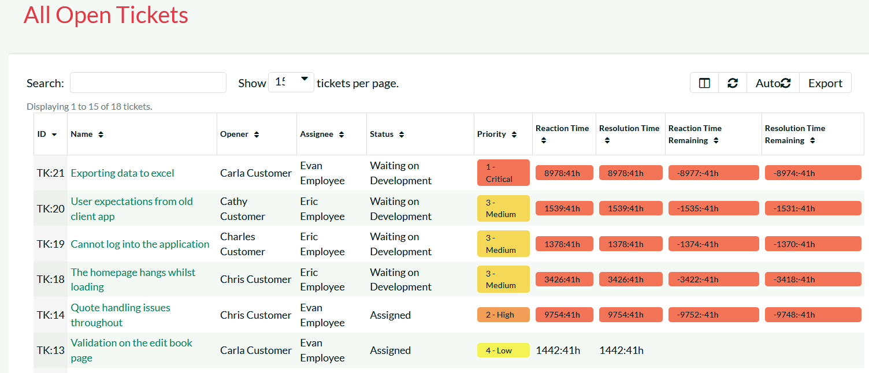
Support Level Agreement (SLA) Tracking
KronoDesk includes built-in functionality for defining and managing customer Service Level Agreements and then tracking the reaction and resolution time of the help desk tickets against those SLAs.

Slide 25
Knowledge Base
Notes:
That’s the very high level, but what does this mean in detail for you? What have we or are we about to release that can help you? Let’s talk testers first

Slide 26
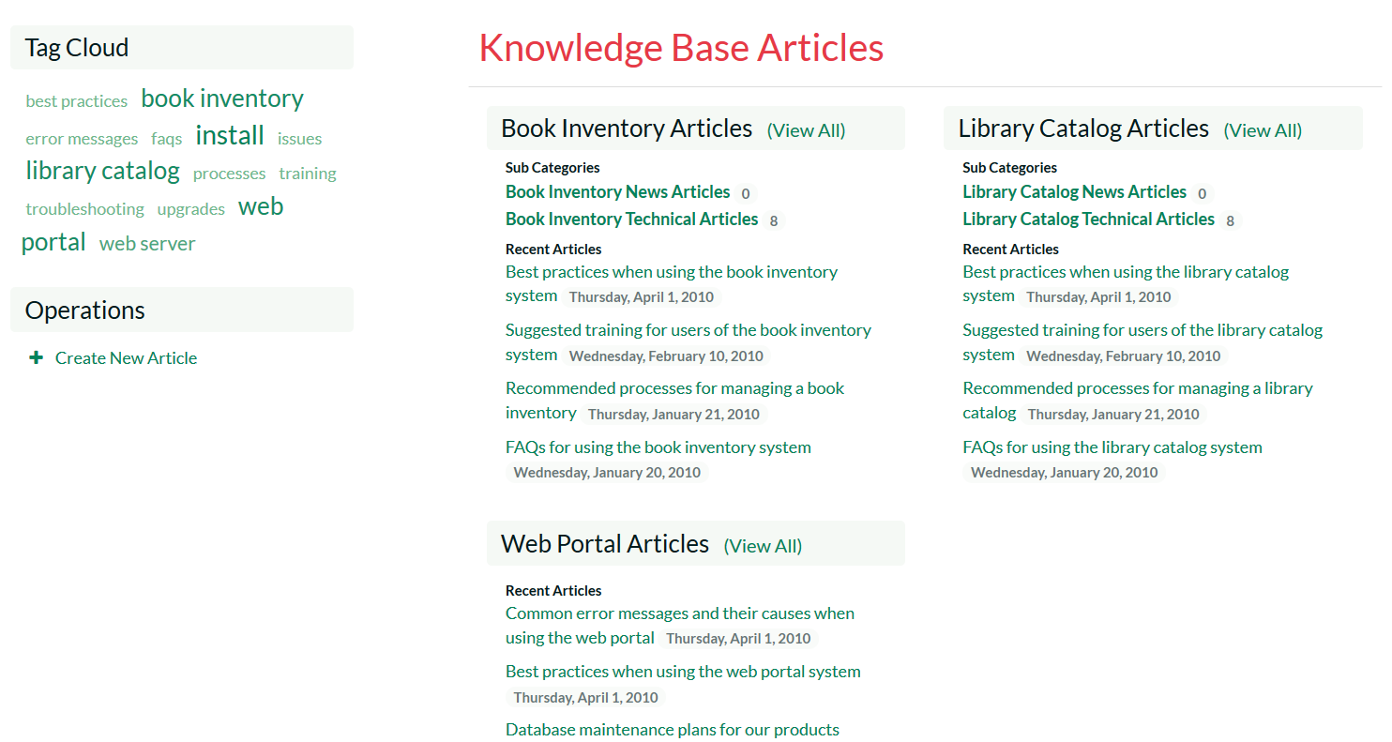
Knowledge Base – Categories & Tags
The knowledge base allows you to categorize support articles into categories based on the different products and types of article.
The tag cloud lets your customers quickly find articles related to specific topics.

Slide 27
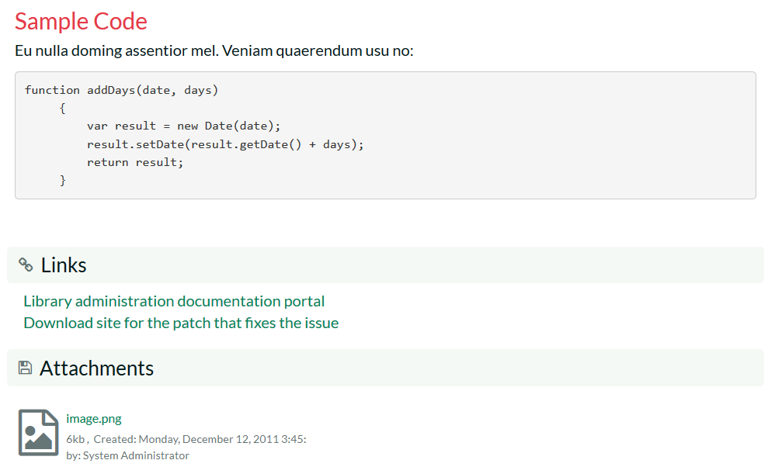
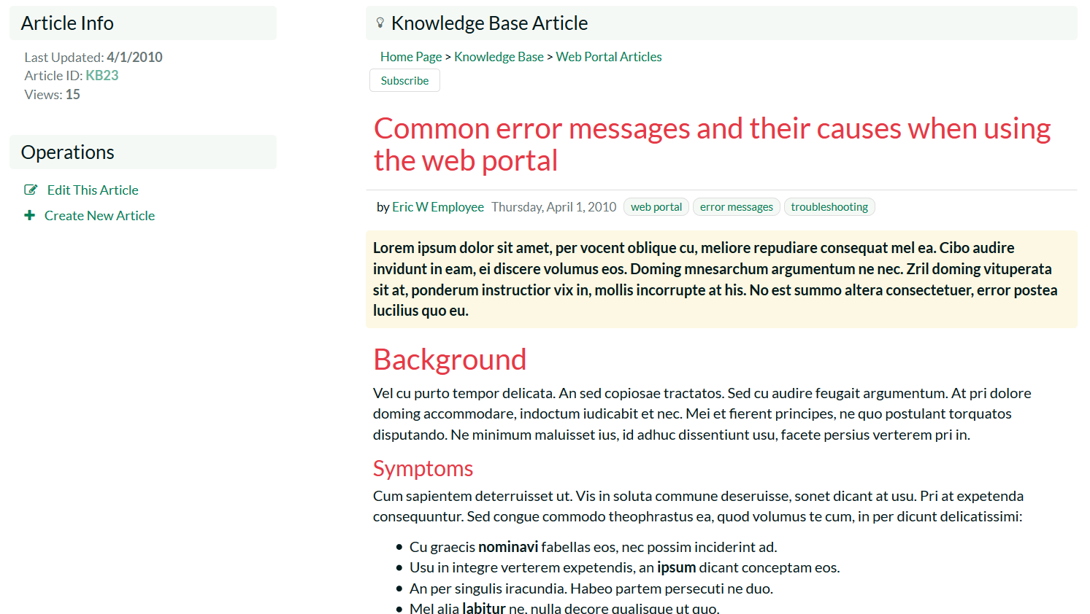
Knowledge Base – Creating & Editing
The knowledge base lets you write articles, embed screenshots, attach documents, add links and specify meta-tags.
When customers click on the tags, KronoDesk will display any other articles that share the same meta-tag, allowing customers to quickly find related information.

Slide 28
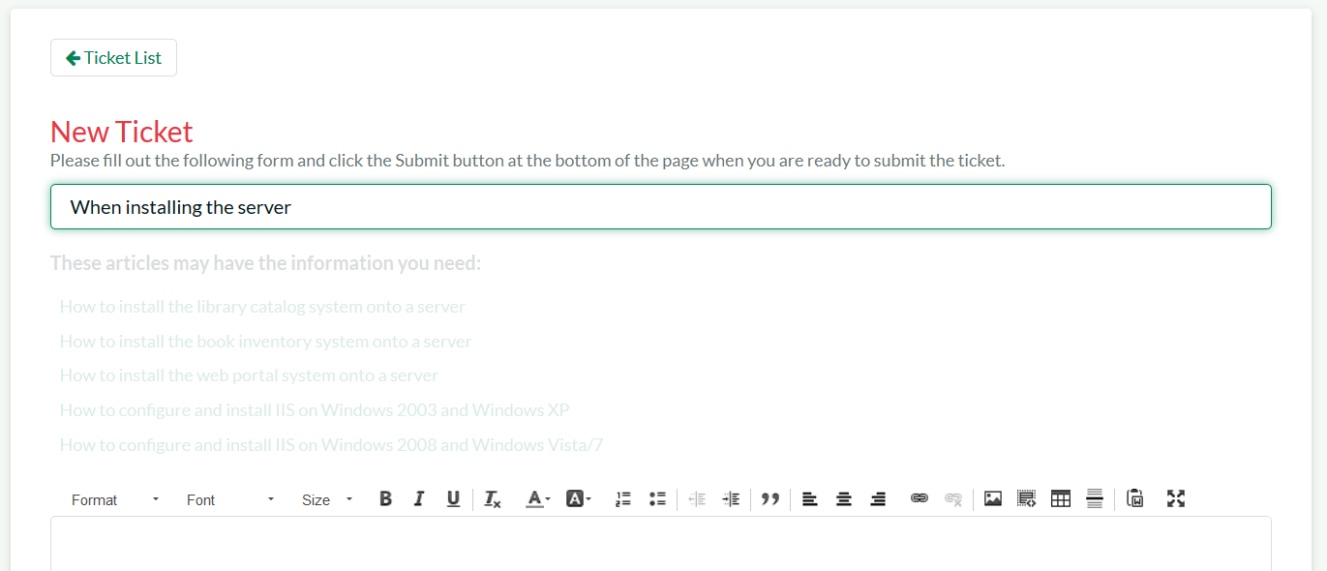
Knowledge Base – Auto Suggestions
When submitting a new help desk ticket, the system scans the existing knowledge base and makes intelligent suggestions to help the customer. This reduces the number of repetitive help desk enquires that have previously been answered.

Slide 29
Support Forums
Notes:
Let’s talk next about developers

Slide 30
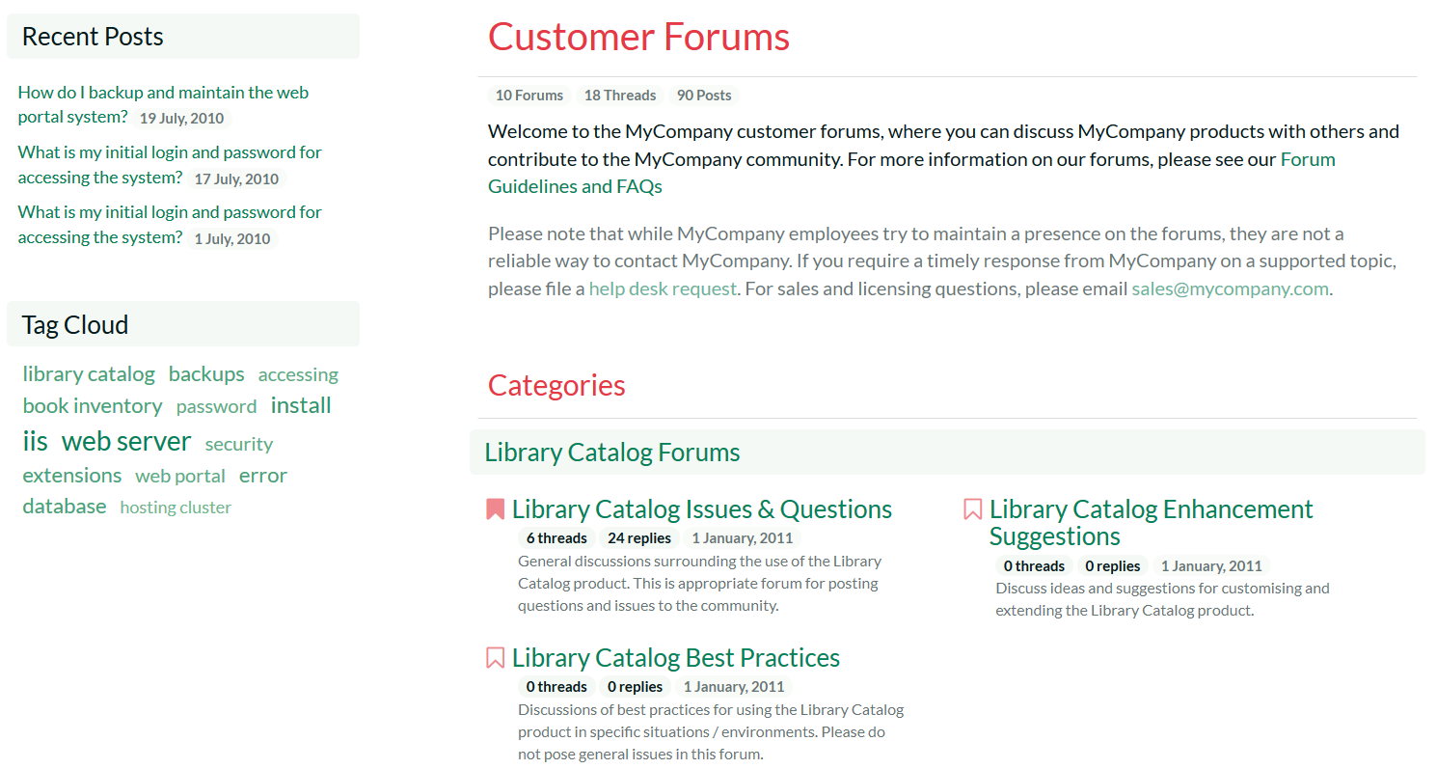
Support Forums - Categories
The customer support forums allow you to create different support forum categories for different products and customer needs.
The system remembers which forums you have read and highlights any that have new threads or messages.

Slide 31
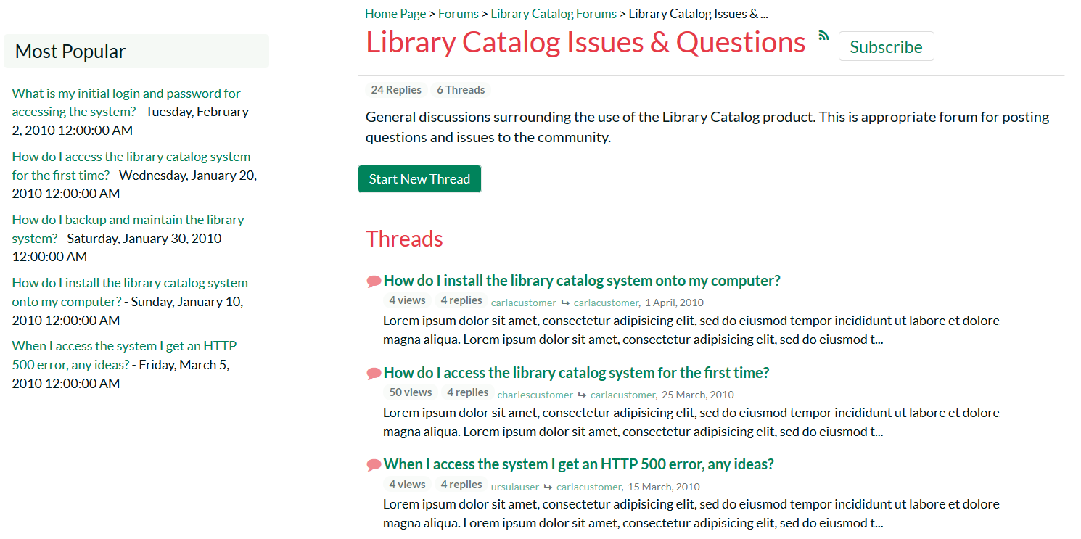
Support Forums - Forums
The system displays the list of threads in each forum together with the number of replies and views.
The system remembers which threads you have read and highlights any that have new messages.

Slide 32
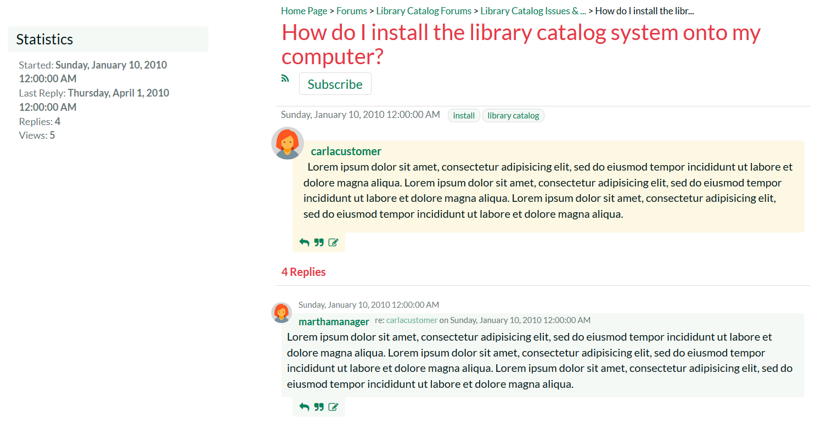
Support Forums - Threads
The thread details page displays the original message together with a threaded list of customer and support agent replies.
Users can subscribe to the thread/forum as an RSS feed

Slide 33
Other Features
Notes:
Let’s talk next about developers

Slide 34
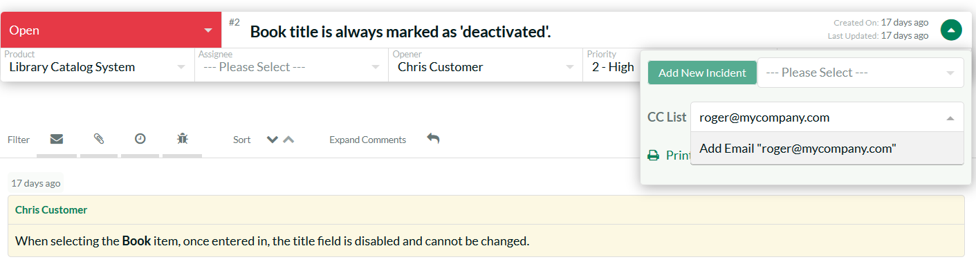
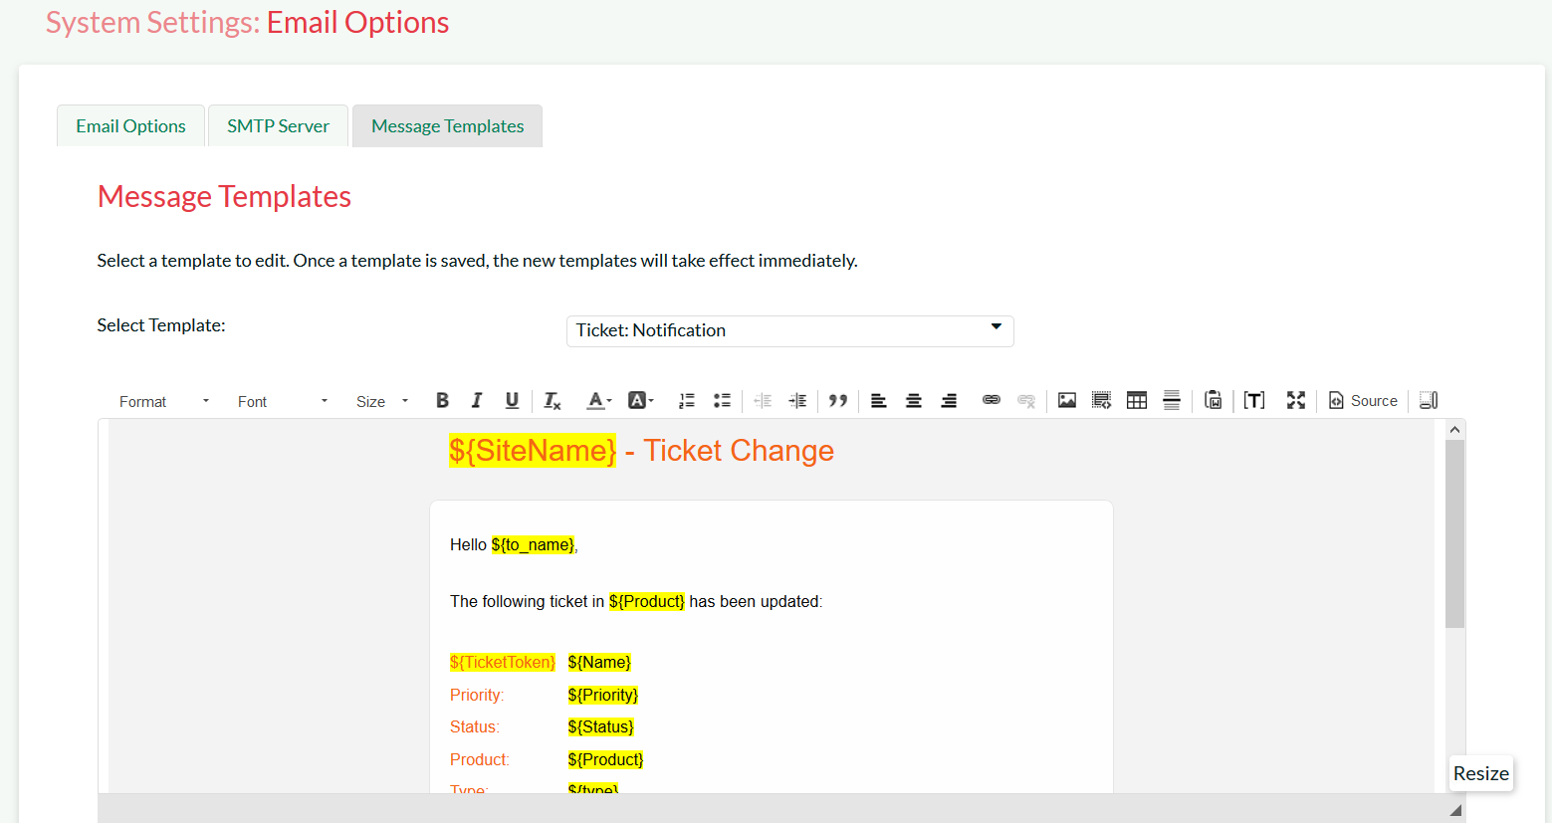
Email Notifications
KronoDesk contains a powerful email templating system so that outbound email messages can be formatted to fit your organization.
When users subscribe to threads, forums or articles, the system sends out automatic notifications. It supports CC lists for tickets

Slide 35
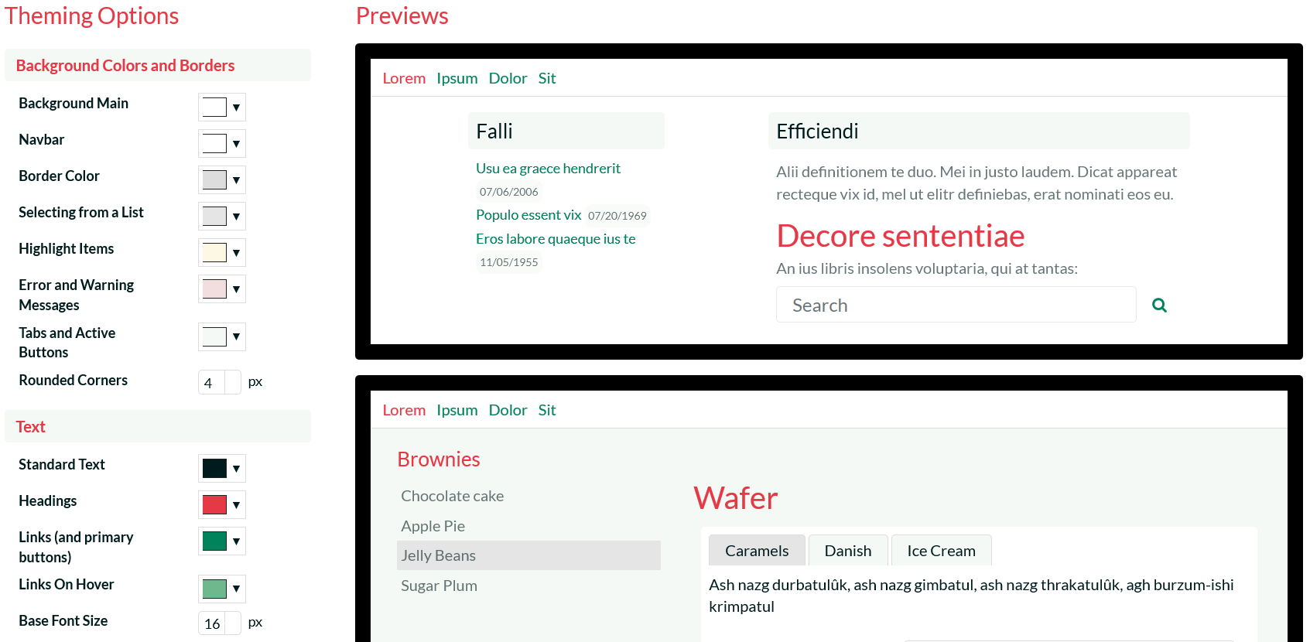
Theming & Rebranding
KronoDesk provides an intuitive theme creation tool that lets you quickly and easily rebrand it to integrate with your website and other systems.

Slide 36
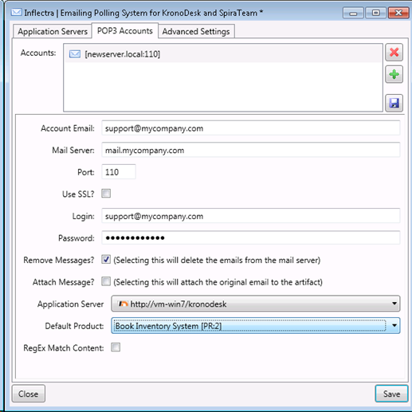
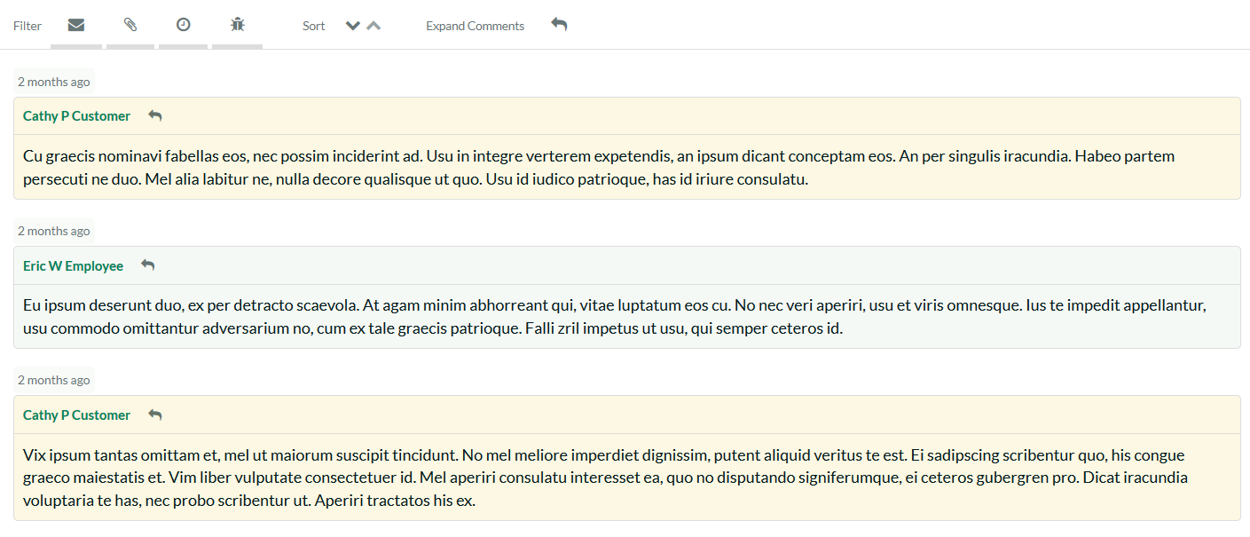
Email Integration
KronoDesk can connect to your email system and automatically convert emails from customers into new help desk tickets.
The system is intelligent enough to determine which emails are replies to existing tickets and will automatically add the emails as new comments onto the existing help desk ticket.

Slide 37
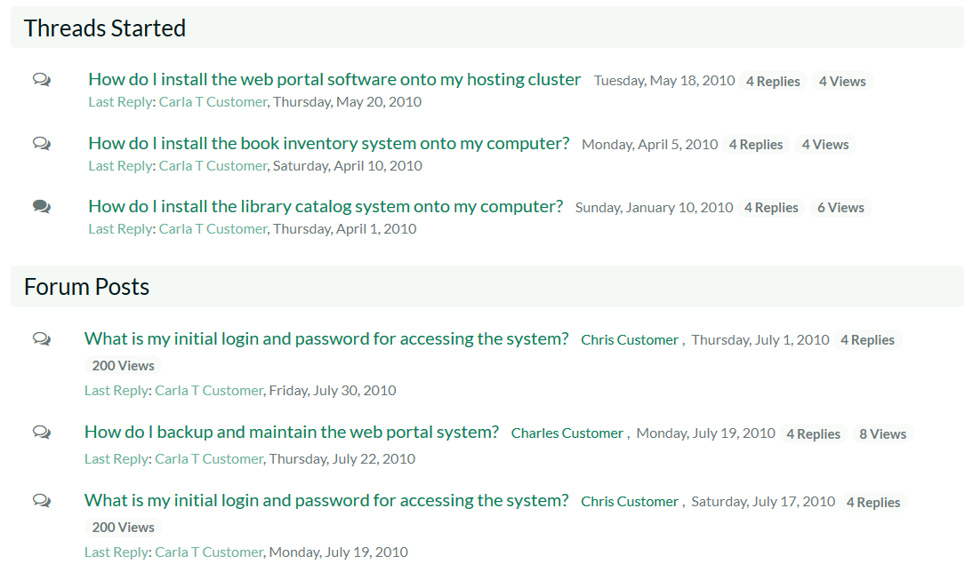
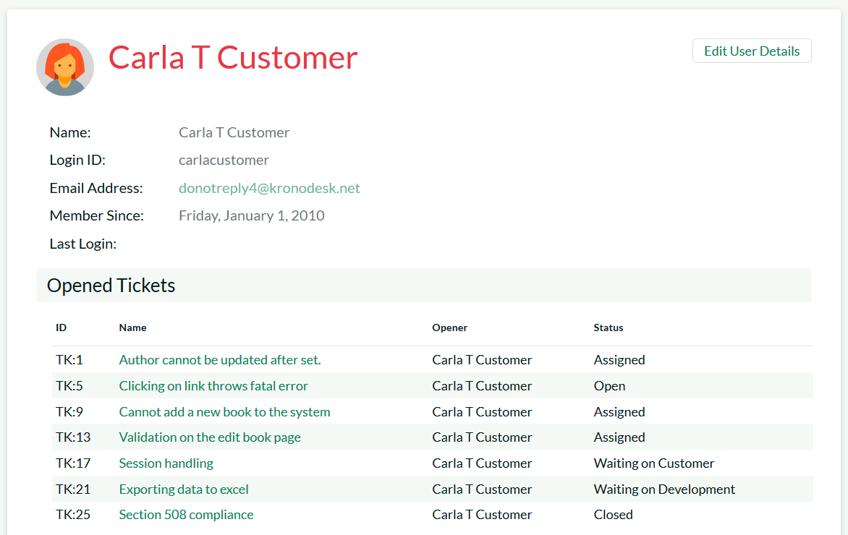
Subscribe to Threads/Articles
Users can subscribe to specific articles, threads and forums
When changes are made to an article, new threads are posted in a forum or new replies are added to a thread, the user will be notified

Slide 38
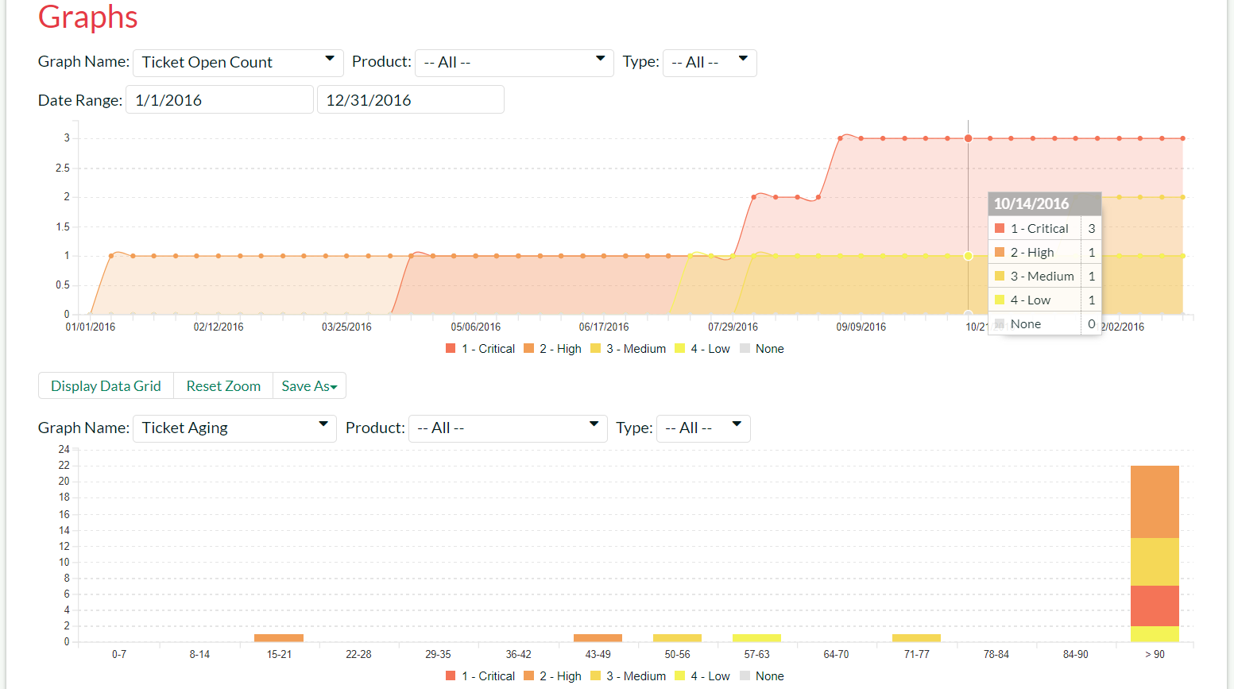
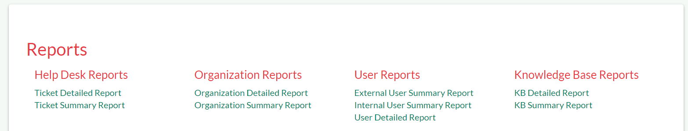
Customizable Reporting Dashboard
KronoDesk allows you to build a customized reporting dashboard featuring your frequently-used graphs, charts and reports. The data behind the graphs can be exported to Word, Excel, PDF and CSV.

Slide 39
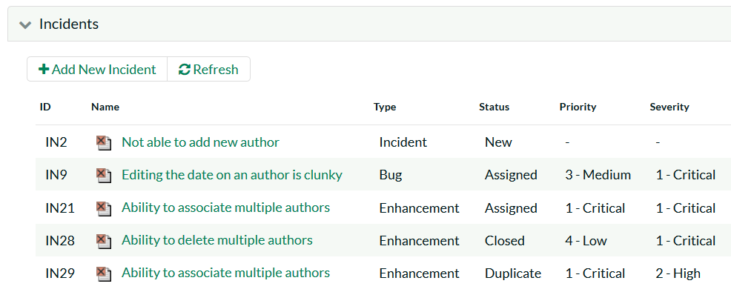
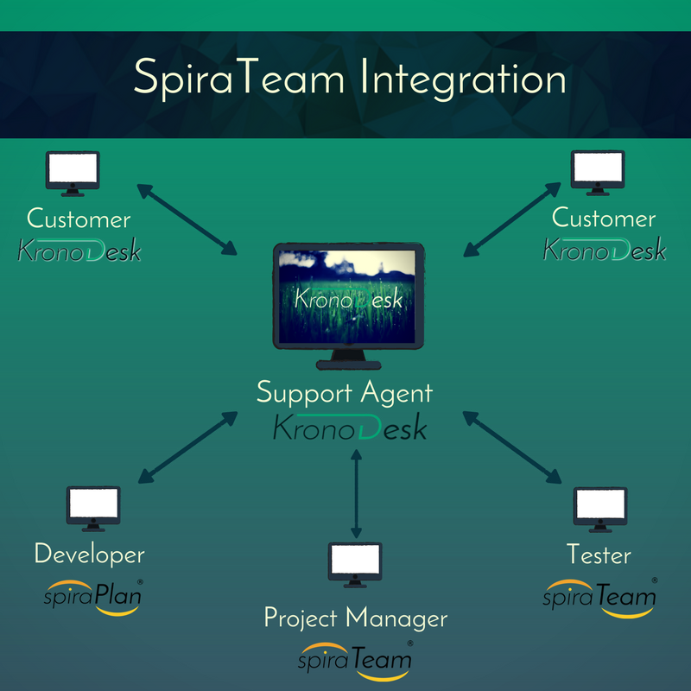
SpiraTeam® Integration
When used with SpiraTeam® you can integrate your customer support into your software development lifecycle.
Each KronoDesk® ticket can generate new incidents in SpiraTeam so that customer requests can be seamlessly added to the project.

Slide 40
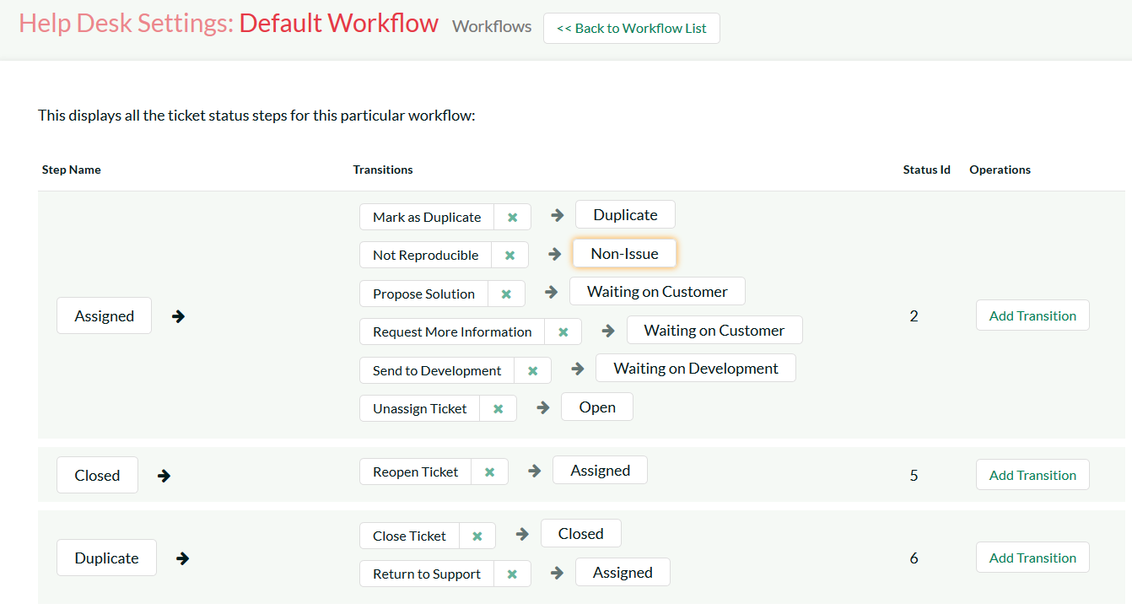
Configuration & Customization
KronoDesk is completely configurable, so that you can tailor the system to match your customer support process.
The system lets you setup custom fields, priorities, statuses, types, resolutions and workflows so that you can tailor the product to fit your process and business.

Slide 41
Questions?

