Slide 1
Automation 3
The Power of RPA Using Rapise
@Inflectra | #InflectraCon

Slide 2
Denis Markovtsev
Principal Software Engineer, Inflectra
@dmarkovtsev
denis.markovtsev@inflectra.com

Slide 3
Agenda
Robotic Process Automation
Common RPA Scenarios & Tasks
Rapise Capabilities for RPA
Demo: Invoice Processing System

Slide 4
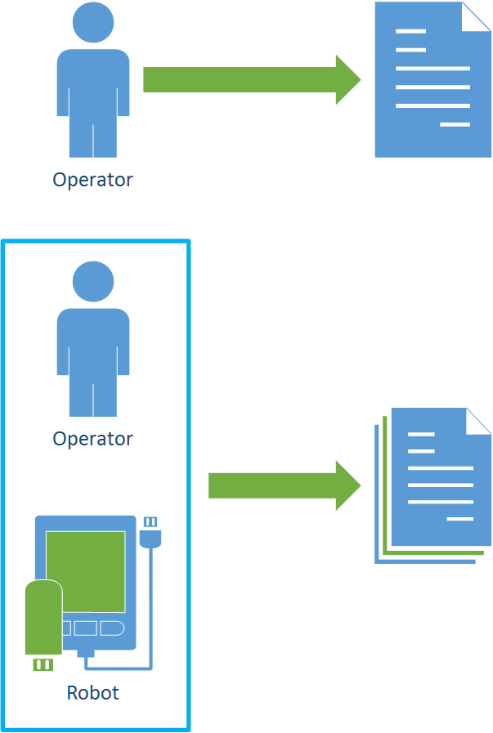
RPA Purpose
Assist humans with boring repeatable tasks to increase speed and stability of operation
Offload human operated tasks to software robots

Slide 5
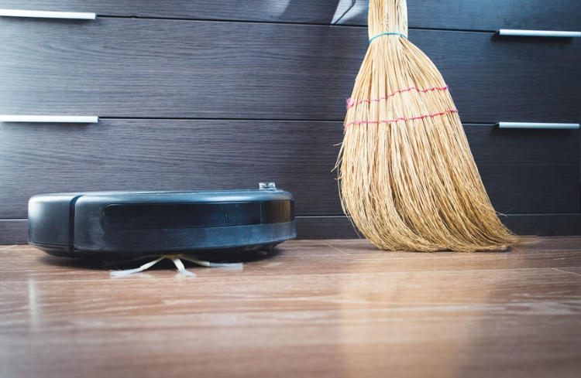
RPA Concept Example

Slide 6
RPA Benefits
Increases data processing speed
Improves data processing quality
Saves money
Reduces risks

Slide 7
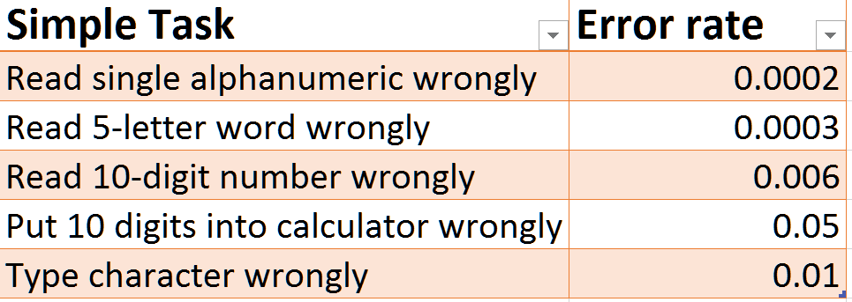
Human Failures: Action Errors
Not doing what you meant to do
Slip: simple action goes wrong
Lapse: omit to perform a required action

Slide 8
Human Failures: Thinking Errors
Do the wrong thing believing it to be right
Rule-based mistake: choosing a wrong rule
Knowledge-based mistake
Lack of experience
Insufficient information

Slide 9
Human Errors: Non-Compliance
Routine: ignore “excess” rules
Situational: work under pressure
Exceptional: solving a problem in unusual circumstances

Slide 10
Industries Using RPA
Save time
Repetitive tasks
24/7
Save budget
Work autonomously
Analyze Process
Integrate legacy systems
large volumes of data
for employees
Banking
Insurance
Retail
Manufacturing

Slide 11
Common RPA Scenarios
Customer onboarding
Claims processing
Sales order processing
Account opening

Slide 12
Common RPA Tasks
Fill a form based on data in external file
Act on incoming email, send email notifications
Do web and screen scraping
Perform file & command line operations
OCR a document, extract data from PDF

Slide 13
Rapise Capabilities
Automation for Desktop, Mobile and Web applications
Independent of screen resolution and coordinates
REST and SOAP calls to third-party systems
Email processing
File & Command Line operations
Text manipulation
Full support for Excel spreadsheets

Slide 14
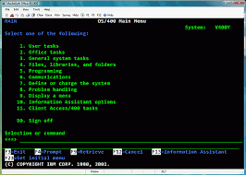
Platforms & Technologies
Web Browsers
Mobile Platforms
Cross-Platform Technologies
Windows Applications
Desktop Applications
Web Applications
Terminal Applications
Non GUI

Slide 15
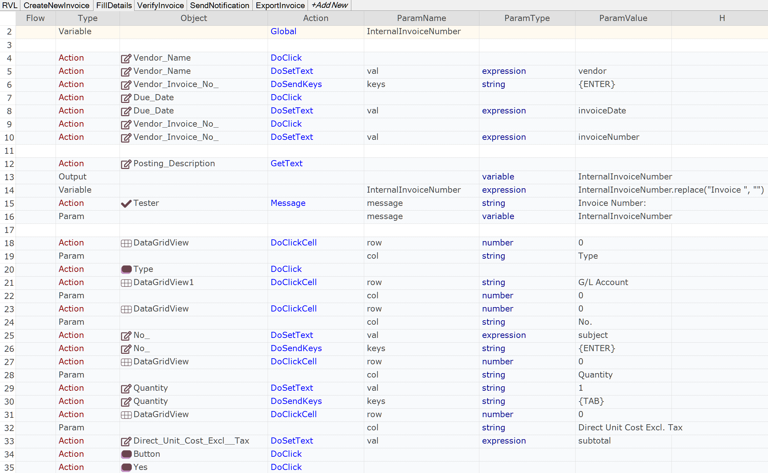
Rapise Visual Language (RVL)

Slide 16
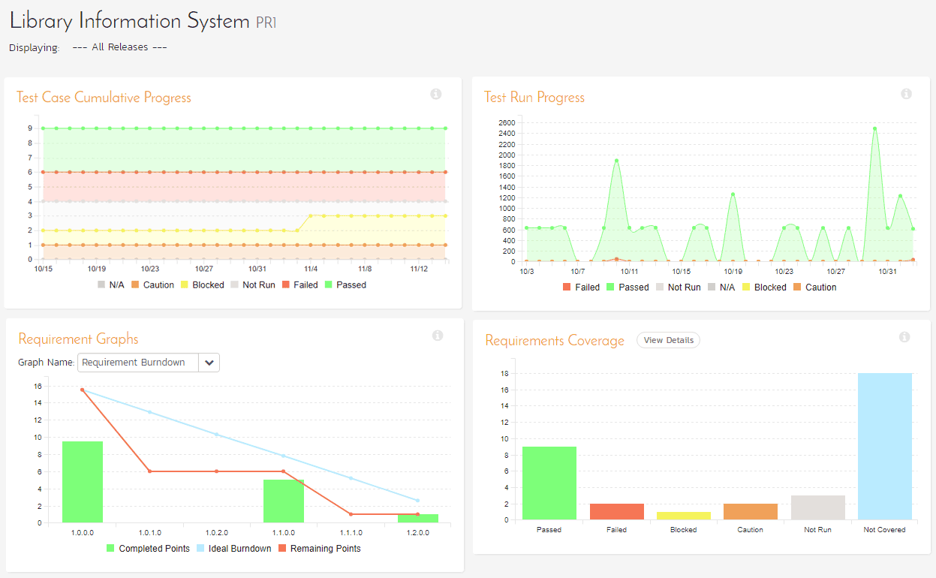
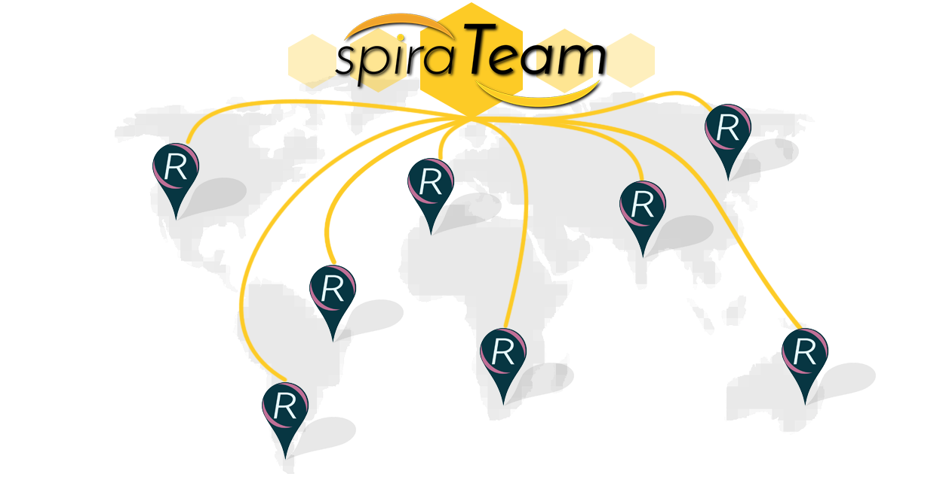
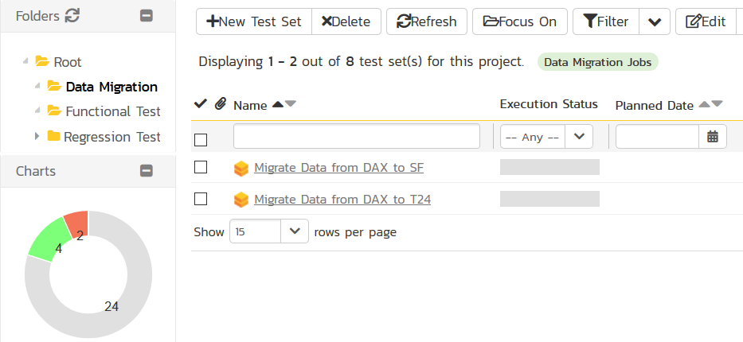
Process Orchestration with SpiraTeam

Slide 17
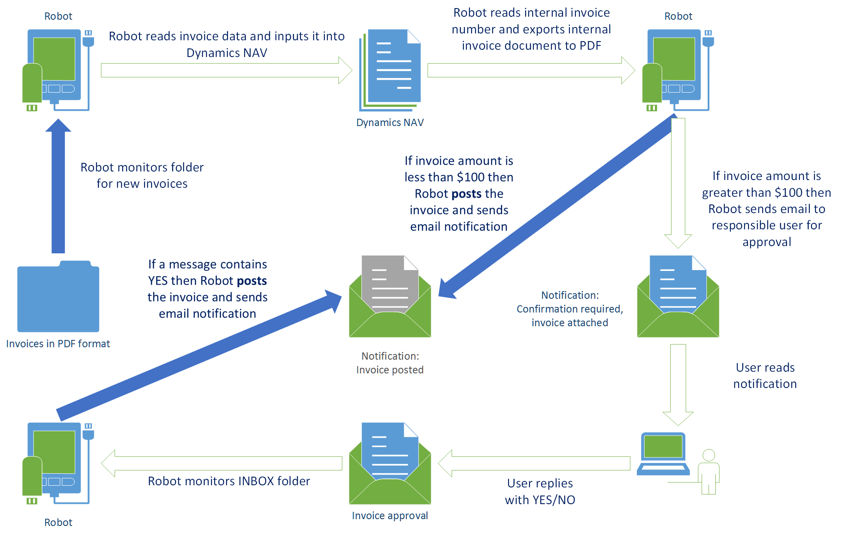
Demo: Invoice Processing System

Slide 18
Demo: Invoice Processing System

Slide 19
Q&A
Contact me:
@dmarkovtsev
denis.markovtsev@inflectra.com

