Slide 1
The Future of ALM:
All Silos Are Banned
@Inflectra | #InflectraCon

Slide 2
Adam Sandman
Director, Inflectra
Programmer from the age of 10
Working in the IT industry for over 20 years
Adam lives in Washington, DC, USA
@adammarksandman

Slide 3
Session Objectives
Explore ALM: Past, Present and Future
Discuss How the World is Changing
Outline some example “futures”

Slide 4
ALM: The Past

Slide 5
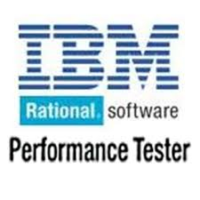
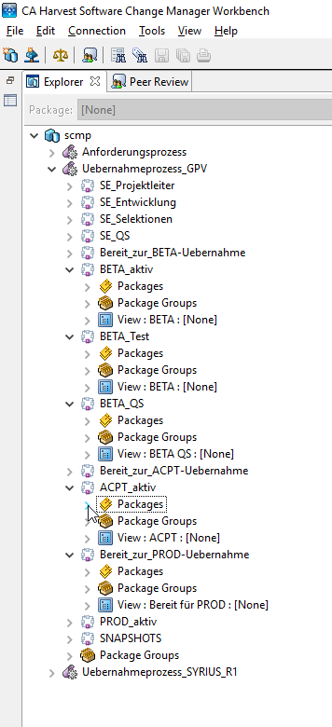
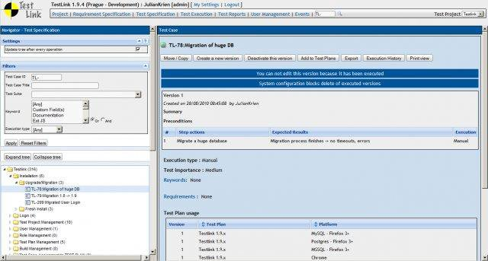
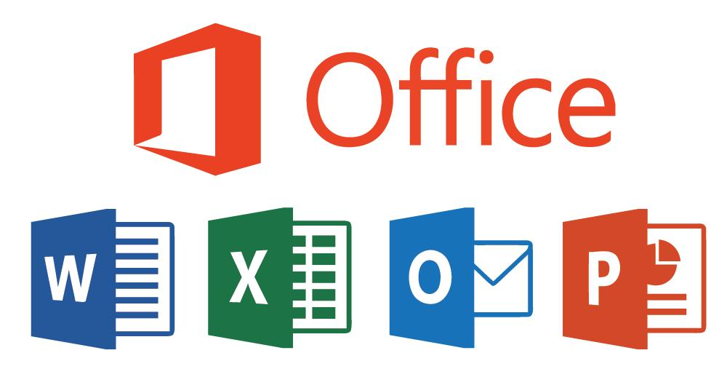
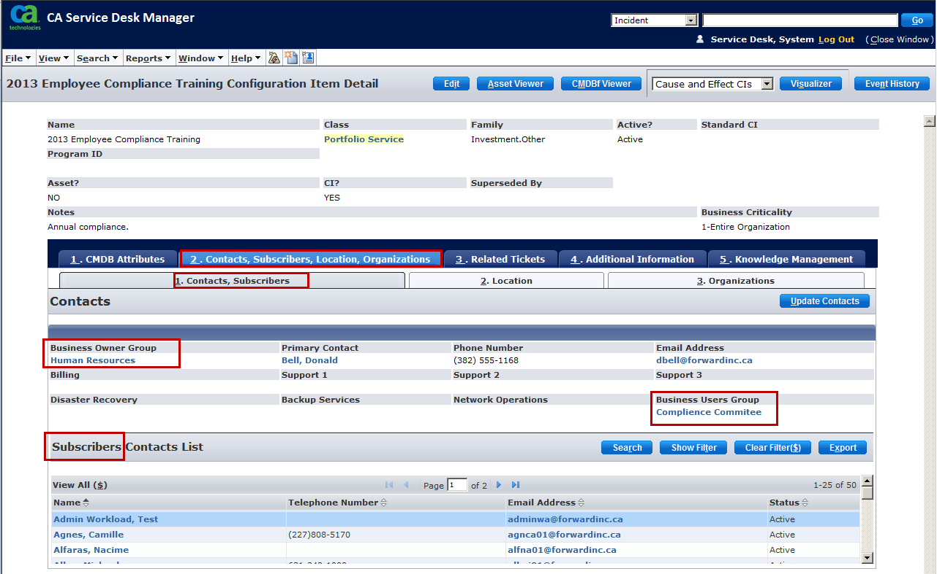
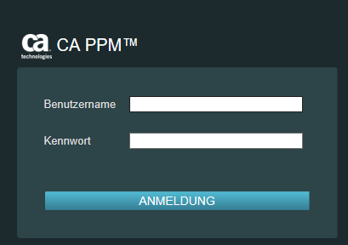
Islands of Data and Process
In our ancient years
we documented requirements and the related test cases
…. without any inner-connection between them
…. and in different tools like:

Slide 6
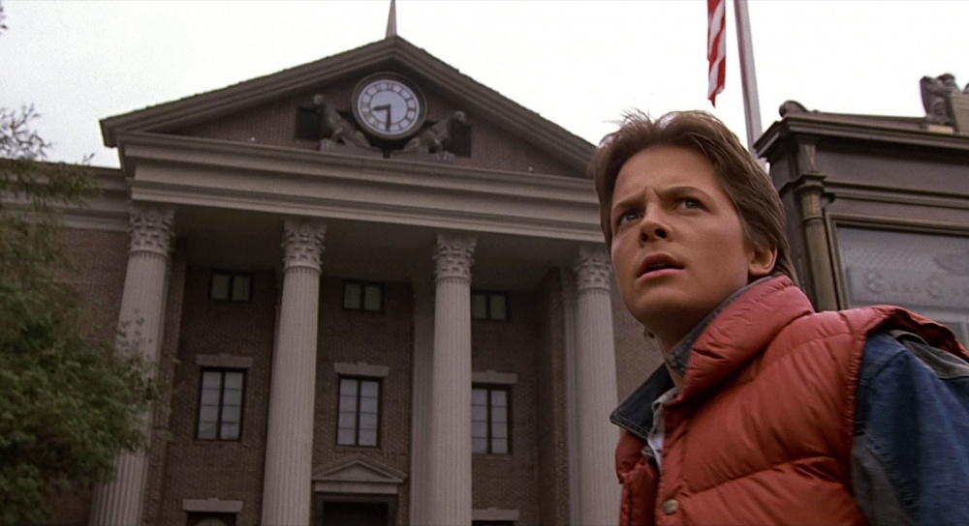
ALM: The Present

Slide 7
Spira Platform
QA
Product management
Progams & portfolios
Source code
Risk management
Agile Planning

Slide 8
Factors Driving Change
Faster Cycles, Continuous Delivery
Increased Regulation, Data Privacy, Security
Global Supply Chains of H/W and S/W
Artificial Intelligence & Machine Learning
Data Federation Across Vendors & Suppliers

Slide 9
The Evolution of ALM
Dev
Dev
Customer
Product Owner
Scrum Master
UI
DBA
Test
Test

Slide 10
Scaling to Team of Teams
Product A
Team 2
Team 1
Team 3
Program Manager

Slide 11
Scaling to Products & Portfolios
Product A
Product B
Product C
Product D

Slide 12
Enterprise Planning & Roadmaps
Company Strategy & Objectives
Product A
Product B
Customer Support & Service Delivery
Product C
Product D
Infrastructure, DevOps, Culture, Values

Slide 13
Integrated, X-Enterprise ALM
Company 1
Company 2
Company Strategy & Objectives
Company Strategy & Objectives
Product A
Product B
Product A
Product B
Customer Support & Service Delivery
Customer Support & Service Delivery
Product C
Product D
Product C
Product D
Infrastructure, DevOps, Culture, Values
Infrastructure, DevOps, Culture, Values
Outsourced Supplier
Industry Regulators
Other Suppliers
Company Strategy & Objectives
Product A
Product B
Customer Support & Service Delivery
Data Privacy Authorities
Product C
Product D
Service & Solution Partners
Infrastructure, DevOps, Culture, Values

Slide 14
Resource planning
Fine grained notifications
Improved SCM
Gannt charts
Teams and tracks
Financial management
Improved instant messenger
Risk-based testing
Enterprise views
Webhook support
Dynamic Test sets
Portfolio artifact pages
Scheduling
AI-powered testing
Baselining
Time tracking
EVM module
Charts and reports
Freeform notes
Simplified integration with third party tools
Managers
Cross-platform
Testers
Developers

Slide 15
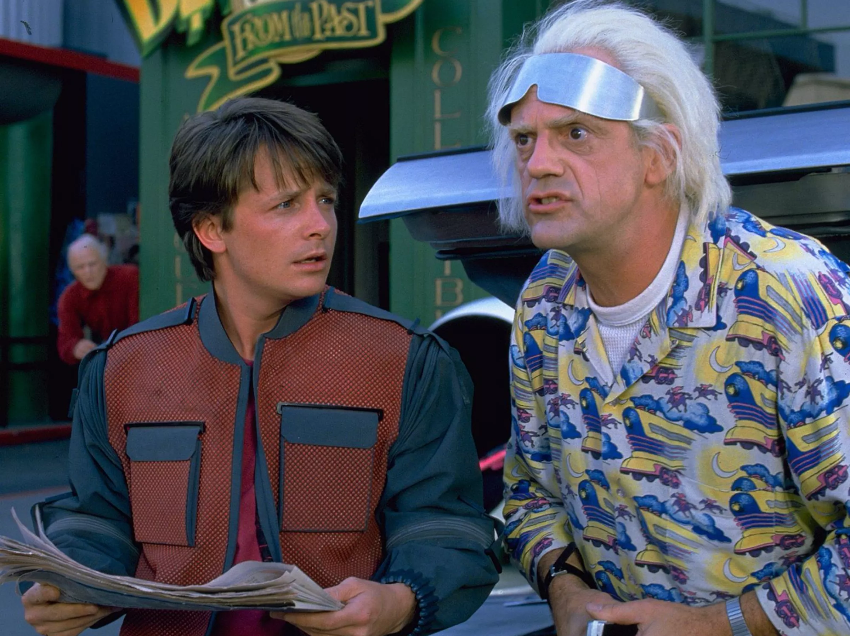
ALM: The Future

Slide 16
The World in 2025?
Developers will be using different tools and frameworks than they do today.
Machine learning and AI will be part of many software projects.
Requirements will describe models that get refined by feedback and coded by computers
Users will be using different interfaces at work – watch, glass, touch, IOT, HUD, VR, etc.
Clouds and systems will be partitioned to address data privacy and regulatory constraints
We will still have human testers, designers, engineers and managers

Slide 17
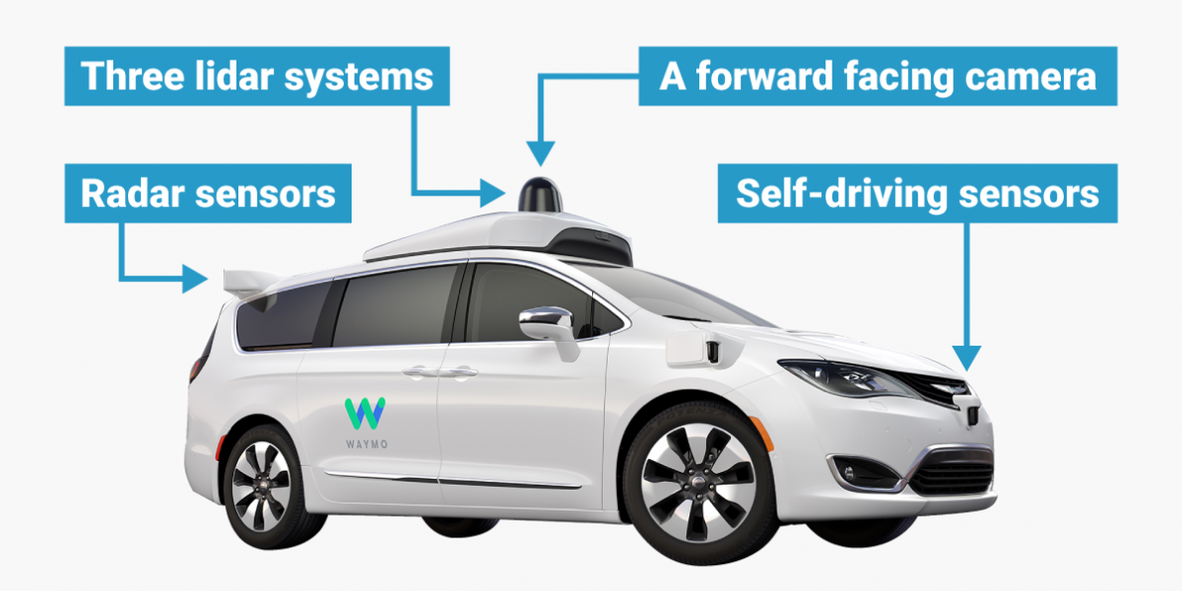
Example 1: Self-Driving Vehicles
Image, courtesy of Waymo, BusinessInsider.com
Significant amount of safety & quality documentation (ISO 26262)
Embraces agile methodologies with regulatory oversight
Machine-learning algorithms, high-level user “requirements” tied to self-learning feedback loop
Melding of hardware and software components, external interfaces
Security built into lifecycle (SecOps)

Slide 18
Example 2: Healthcare IT Systems
Enterprise Program Project
Data Data Data
Data privacy and compliance rules at the project team level
Need to federate data between project, program and enterprise
Ability to isolate HIPAA, PHI data from management data
Strong audit ability, electronic signatures, traceability and single-sign-on
Agile approach in between specific regulated phases

Slide 19
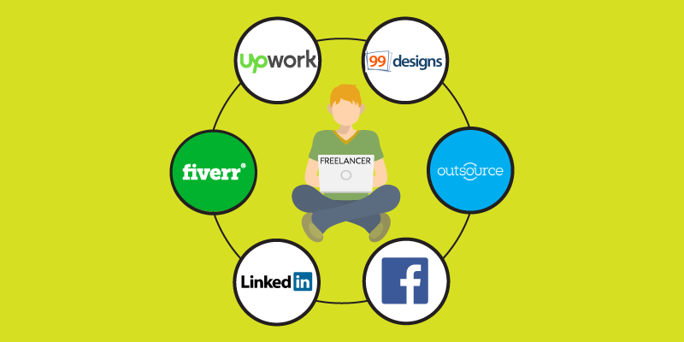
Example 3: The Virtual Company
Image, courtesy of YourStory.com
No physical office locations, all workers co-work or telework
Collaboration tools integrated highly into work streams
No salaried employees, 100% freelance, contract workers
Strong requirements for time, utilization management
Agile, goal driven freelance approach with rigorous metrics

Slide 20
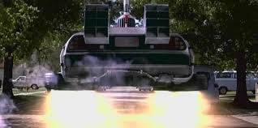
Implications?

Slide 21
Some things to consider…
Data is becoming more valuable than natural resources, labor and expertise
How do we incorporate AI and ML safely into our software development?
What does it mean to be a software worker in the year 2025?

Slide 22
harmony
Notes:
Make great products
Help you work together
Help you deliver your products faster, more easily, with less pain, and less stress
At a grand scale – we’re passionate about making products that you will find transformative to how you work.
We both want to use our tools every day to help you do a whole number of complex things, and at the same time get out of your way so you don’t need to worry about SpiraPlan and can instead focus on helping your own customers

Slide 23
Questions?

