Slide 1
Compare & Contrast
How Industries Use Spira
@Inflectra | #InflectraCon

Slide 2
Remco Putker
Owner, Robust-IT
Program Manager, EY
@RPutker

Slide 3
Session Aims
Compare several projects using Spira
Understand the need for adaptation
Conclusions and lessons learned to share

Slide 4
PostNL

Slide 5
PostNL profile
Dutch mail monopolist with governmental heritage (1799)
Specialized in turnover decrease
Mail -10% / -15% each year
Parcels little growth but lots of competition and low margins
Turnover 3.1 billion dollar
38,000 employees
International satellite companies throughout Europe
Spira user for years

Slide 6
PostNL – Internet Explorer update (2014)
Context | IE upgrade impact >300 web based applications
Role | Test manager
Inflectra products used | SpiraTest (old on premise version)
Artifacts used | Test cases / Incidents / Documents
Highlights | 300 identical testcases uploaded at once (checklists RT) Over 65 ‘testers’ Timeboxed hunting for results Document section used for known issues and work instructions
Customization | None, out of the box
Spira

Slide 7
PostNL – SAP IaaS (2014/2015)
Context | Outsourced rebuild of 123 SAP systems and 1300 interfaces without down time
Role | Test manager later program manager
Inflectra products used | SpiraTest (old on premise version, later cloud), old TC structure essential for reporting
Artifacts used | Releases / Test cases / Incidents / Documents
Highlights | 5 clusters of systems in five major releases all with 4 sub releases (DTAP) Regression test cases created for each SAP system Default test cases created and uploaded for all interfaces >100 testers involved, cloud access major improvement >10.000 artifacts created, mainly test cases, test runs and incidents
Customization | Incident work flow adapted to increase control / Field settings in all artifacts used
Spira

Slide 8
PostNL – SAP Hana (2014)
Context | Consolidated replacement of 3 different BI environments in one solution on Hana
Role | Replacement test manager
Inflectra products used | SpiraTest (cloud)
Artifacts used | Releases / Test cases / Incidents
Highlights | Project out of control at start (>100 critical Incidents open, >1000 TC, no releases) No commitment from business and aversion to Spira Main activity has been cleaning and regaining control End result: 1 consolidated reporting environment and set of reporting products End result: Stakeholders happy with the use of Spira again
Customization | Incident work flow adapted l / Field settings in all artifacts used
Spira

Slide 9
PostNL – SAP BPC 10 (2015)
Context | Migration from IaaS to SaaS environment
Role | Test manager
Inflectra products used | SpiraTest (cloud)
Artifacts used | Releases / Test cases / Test sets / Incidents
Highlights | Stakeholders in 4 countries, sets of products to be accepted by all Test cases never to be tested in isolation, always E2E Test sets used to enable multiple accepting stakeholders per group of test cases Only business stakeholders, Spira training needed
Customization | Incident work flow adapted / Field settings in all artifacts used
Spira

Slide 10
PostNL – HR Payroll insourcing (2015/2016)
Context | Insourcing of SAP Payroll in preparation of SuccessFactors implementation
Role | Test manager
Inflectra products used | SpiraTest (cloud)
Artifacts used | Requirements / Releases / Test cases / Incidents / Documents
Highlights | Flawless payroll process 45.000 FTE Scope: payroll, interfaces, reporting
Customization | Incident work flow adapted / test case types / Field settings in all artifacts used
Spira

Slide 11
PostNL – HR Payroll insourcing (2015/2016)
Spira

Slide 12
PostNL – BPC Account Navigator (2016)
Context | Replacement of custom Excel reporting (A&C) file by SAP BPC
Role | Test advisor Scrum team
Inflectra products used | SpiraTest (cloud)
Artifacts used | Requirements / Releases / Test cases / Incidents / Documents
Highlights | Phase out of legacy Excel reports Huge commitment from business and involvement in Scrum teams Single point of truth for all through SpiraTest PostNL IT Project of the Year award
Customization | Full Scrum implementation including sprint points, burn downs, etc. (before SpiraTeam)
Spira

Slide 13
PostNL – BPC CR and annual report (2017)
Context | Increase of SAP BPC usage on other domains, continuation Scrum team
Role | Test advisor Scrum team
Inflectra products used | SpiraTeam
Artifacts used | Plan board / Requirements / Tasks / Releases / Test cases / Incidents
Highlights | Product owner junior Project supplier got ill / supplier les involved Scrum master (and coaches) prefered brown paper instead of digital plan board Test involvement minimal
Customization | Full Scrum implementation including sprint points, burn downs, etc. Best configured Spira environment… but project became a faillure
Spira

Slide 14
PostNL – SuccessFactors (2016 / 2017)
Context | Replacement of IaaS SAP HCM by SaaS SuccessFactors / Concur and several add ons
Role | Program test manager
Inflectra products used | SpiraTeam
Artifacts used | Requirements / Releases / Test cases / Incidents
Highlights | Large program Little commitment for structured testing and consequent use of tooling > 1000 test cases, >330 incidents after first iteration Challenges: landscape, data migration, planning Spira usage inconsistent due to number of test coordinators involved
Customization | Specific types of test cases, and incidents, fully customized work flows, field settings
Spira

Slide 15
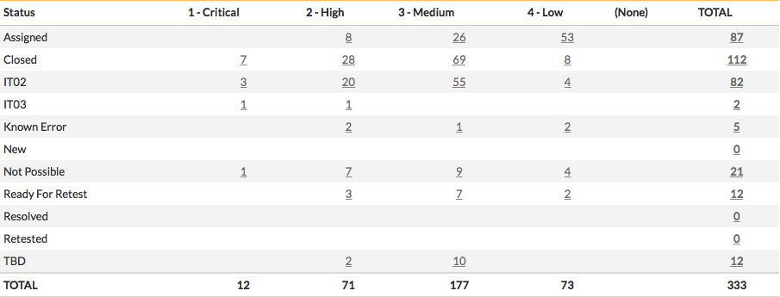
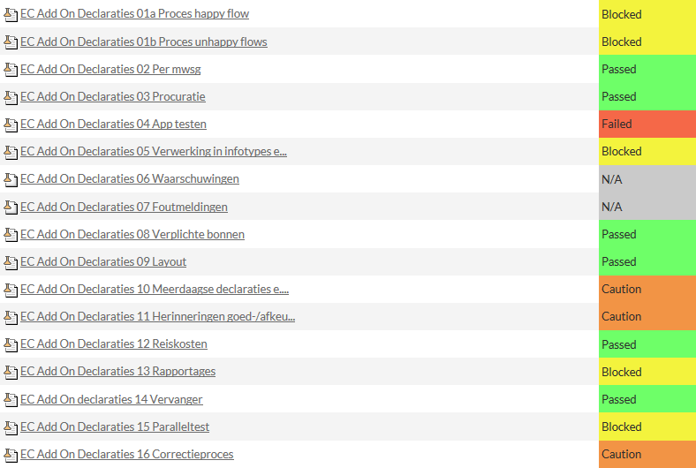
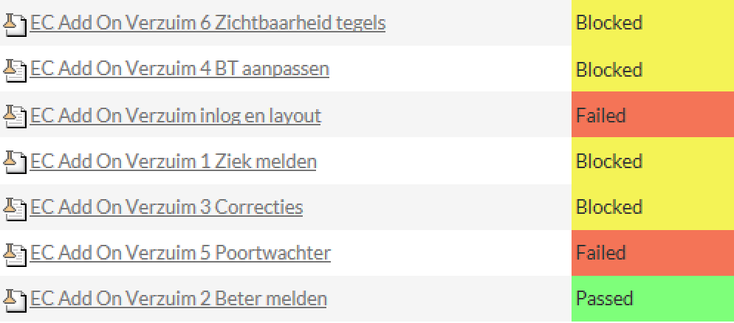
PostNL – SuccessFactors (2016 / 2017)

Slide 16
PostNL – Elevation (2017 / 2018)
Context | Replacement of IaaS SAP FICO by SaaS ByD and Sap Hybris
Role | Replacement program test manager
Inflectra products used | SpiraTeam
Artifacts used | Plan board / Requirements / Tasks / Releases / Test cases / Incidents
Highlights | Project out of control at start (>1500 open incidents 2 weeks prior to go live) Complete project clean-up, go live successful Transition to monthly releases in productive situation Release management defined using SpiraTeam
Customization | Specific types of test cases, and incidents, fully customized work flows, field settings, Plan board used including tasks and test cases
Spira

Slide 17
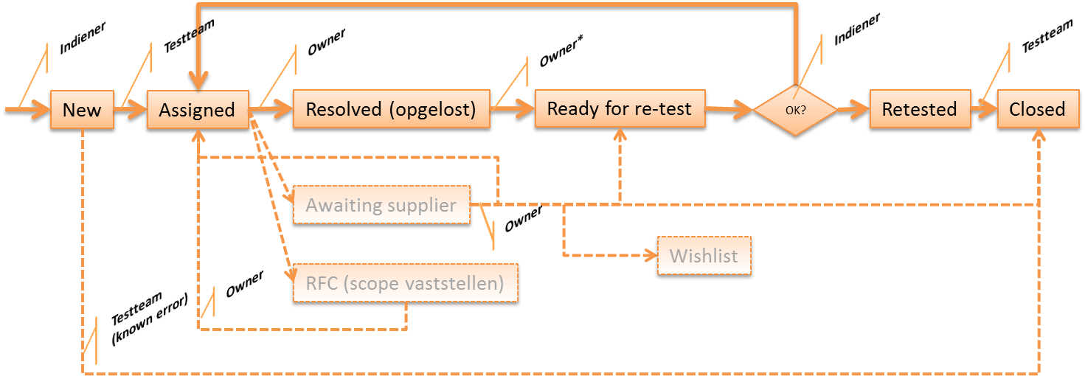
PostNL – Elevation (2017 / 2018)
Dashboard
Requirements management
Dashboard
Release en testmanagement

Slide 18
BP Europa

Slide 19
BP Europa profile
Merge of several BP companies
Belgium
The Netherlands
Austria
Poland
Germany
43 milion tons of Fuels each year
3900 gas stations
Brands: BP, Aral, Castrol

Slide 20
BP Europe – HR implementation (2018)
Context | Implementation of a new local HR system voor NL/DE
Role | Supplier
Inflectra products used | SpiraTeam
Artifacts used | Plan board / Requirements / Tasks / Releases / Test cases / Incidents
Highlights | Creation of a very lean template specific for Bp Field settings Types, work flows and notifications Work instructions No follow up due to project freeze ☹
Customization | Fully customized lean template
Spira

Slide 21
Parnassia Groep

Slide 22
Parnassia Groep profile
Largest mental health care institution in Europe
12.500 Employees
500 locations in The Netherlands
181.000 patients each year

Slide 23
Parnassia – Merger (2018 / 2019)
Context | Merger between 3 health care organisations
Role | Program manager HR systems
Inflectra products used | SpiraPlan
Artifacts used | Templates / Plan board / Requirements / Tasks / Releases / Test cases / Incidents
Highlights | Managing a forced merger distracted from the Spira implementation Test manager assigned les experienced with spira Organizational maturity insufficient for structured testing
Customization | Specific types of test cases, and incidents, fully customized work flows, field settings
Spira

Slide 24
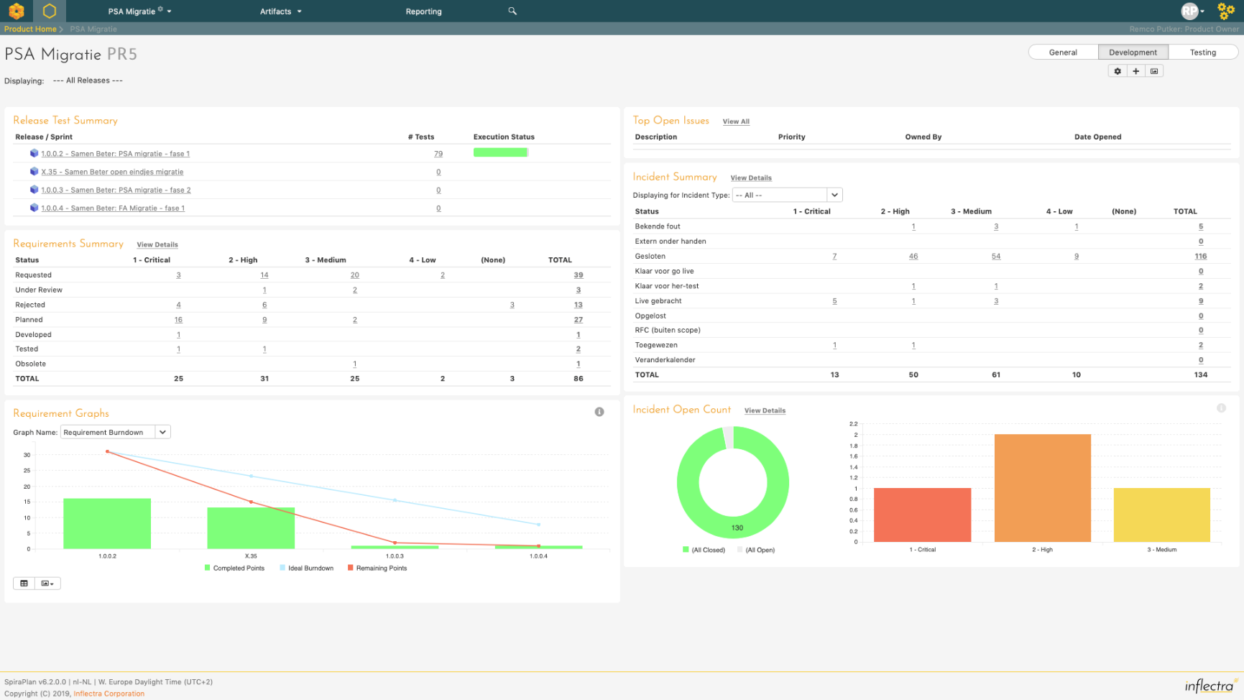
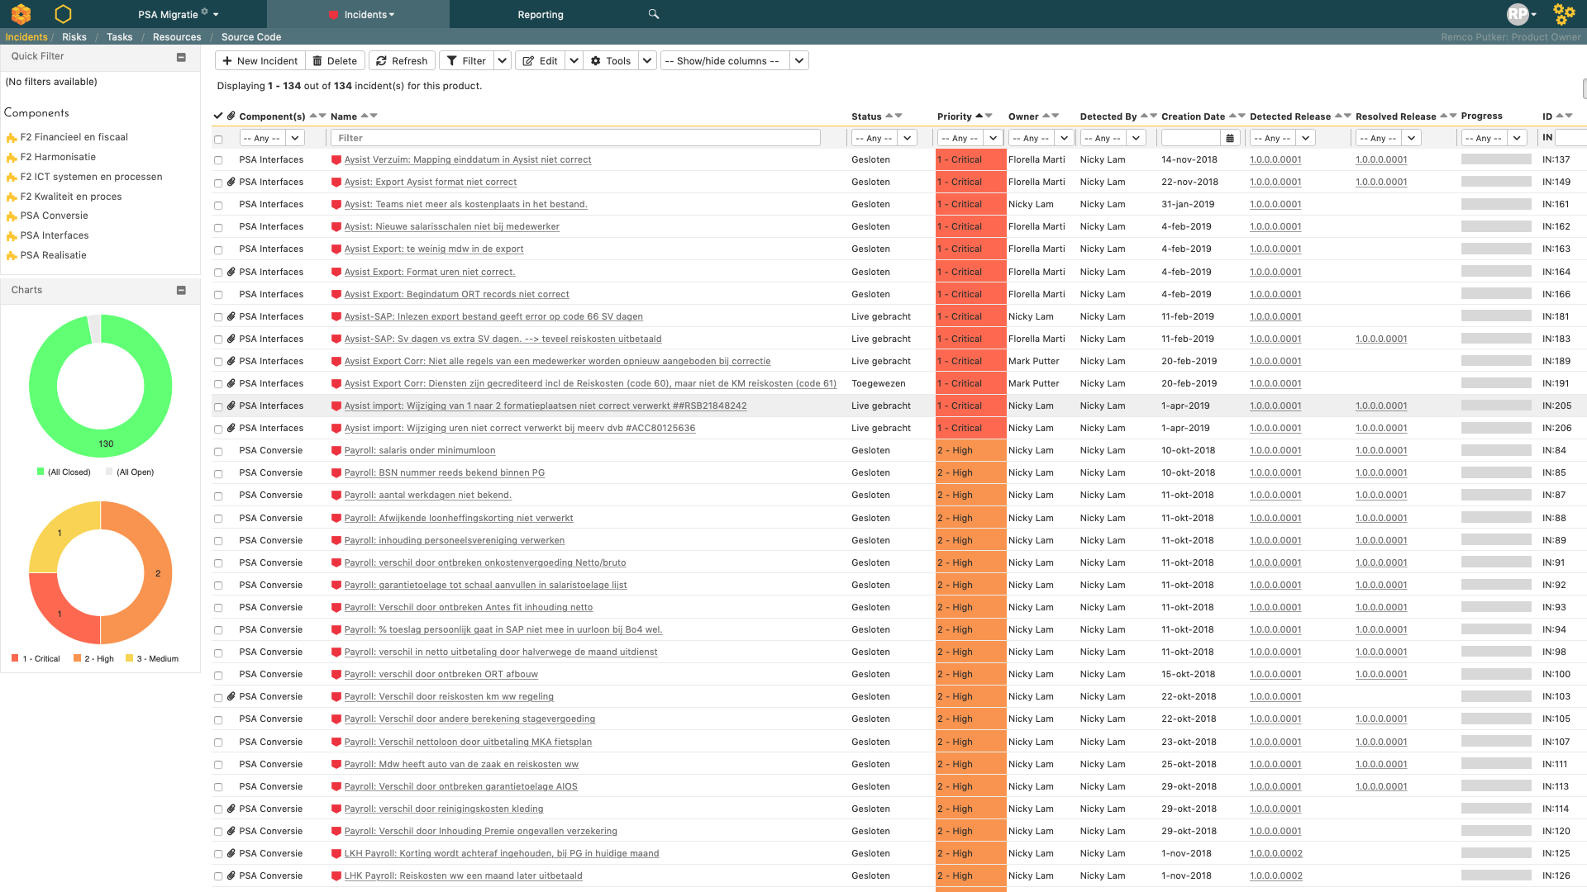
Parnassia – Merger (2018 / 2019)
Spira

Slide 25
Parnassia – Bizon (2019)
Context | Rebuild of IT hardware infrastructure
Role | Spira advisor
Inflectra products used | SpiraPlan
Artifacts used | Templates / Plan board / Requirements / Risks / Releases / Test cases / Incidents
Highlights | Default template created for the program Implementation of risk management Exploring the possibilities of SpiraPlan with the test manager
Customization | Specific types of test cases, and incidents, fully customized work flows, field settings, Plan board used including tasks and test cases
Spira

Slide 26
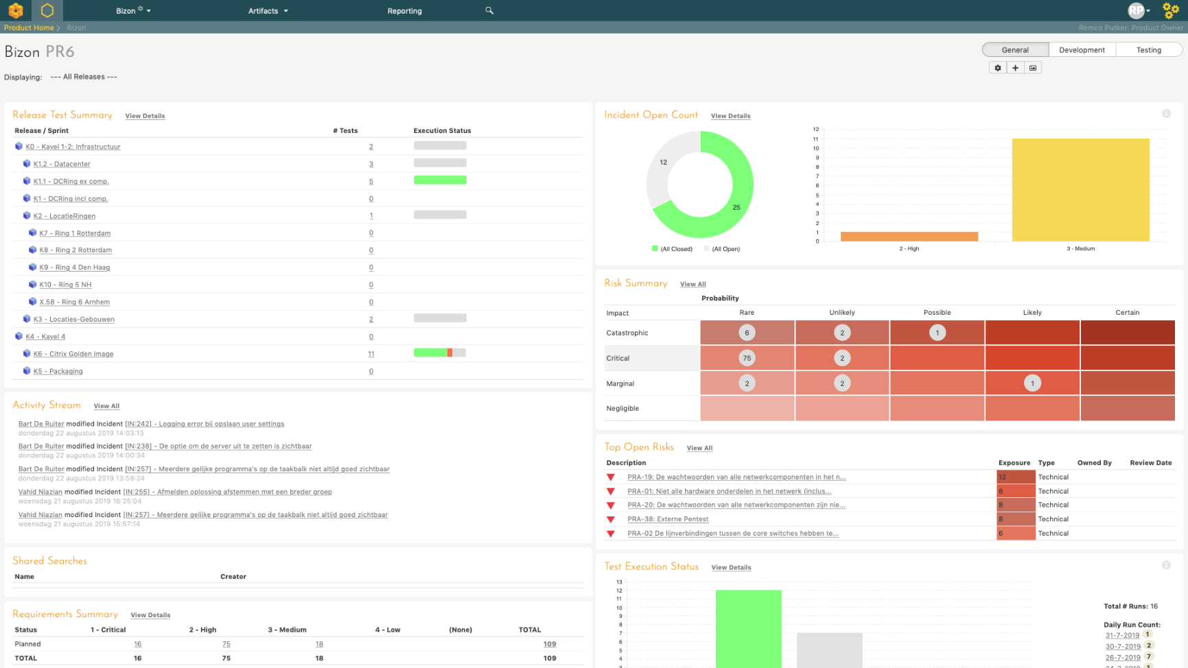
Parnassia – Bizon (2019)

Slide 27
Parnassia – G-E-A-R-S (2019)
Context | Replacement of time table system
Role | Initiating program manager
Inflectra products used | SpiraPlan
Artifacts used | Initiation phase no usage yet, only configuration
Highlights | -
Customization | Specific types of test cases, and incidents, fully customized work flows, field settings

Slide 28
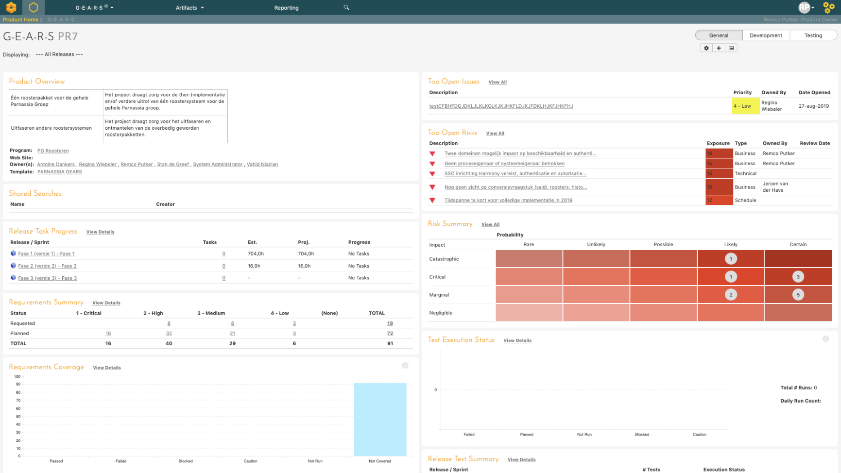
Parnassia – G-E-A-R-S (2019)

Slide 29
Robust-IT

Slide 30
Robust-IT – Start-up (2019)
Context | Solo proprietorship to holding with two daughter entities
Role | Owner
Inflectra products used | SpiraPlan
Artifacts used | Components / Plan board / Requirements
Highlights | Used the plan board to create a prioritised action list
Customization | None
Spira

Slide 31
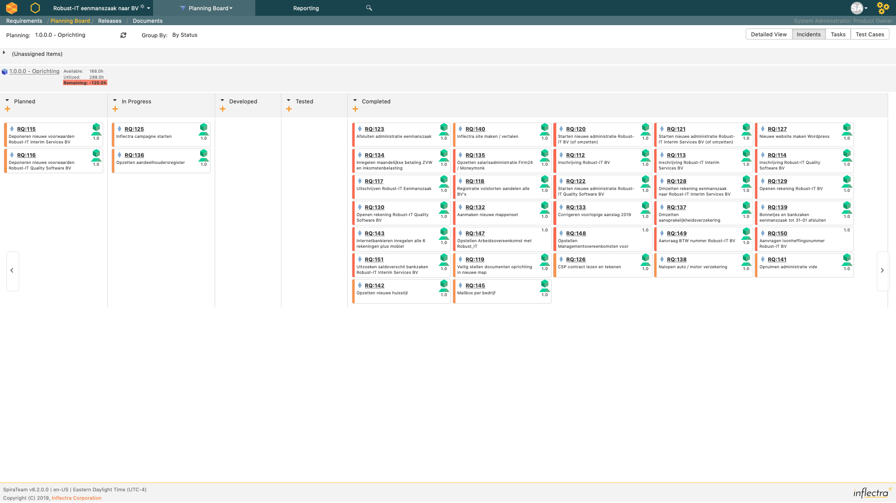
Robust-IT – Start-up (2019)
Spira

Slide 32
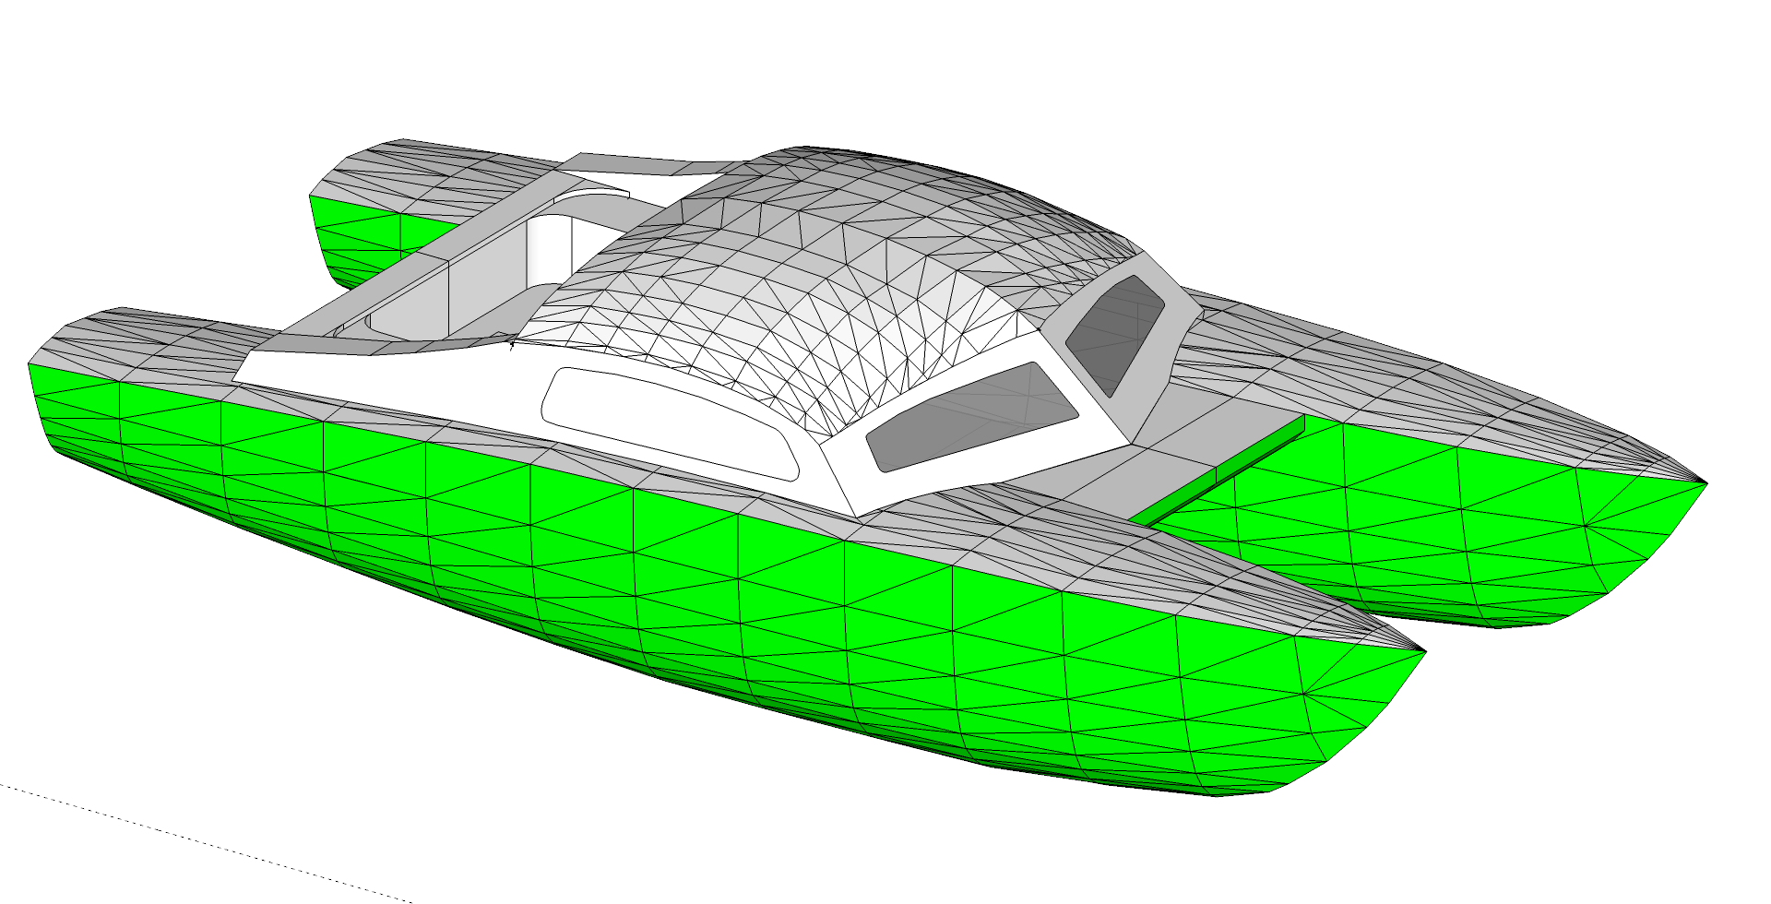
Iroquios MkII Lady Karemaniya

Slide 33
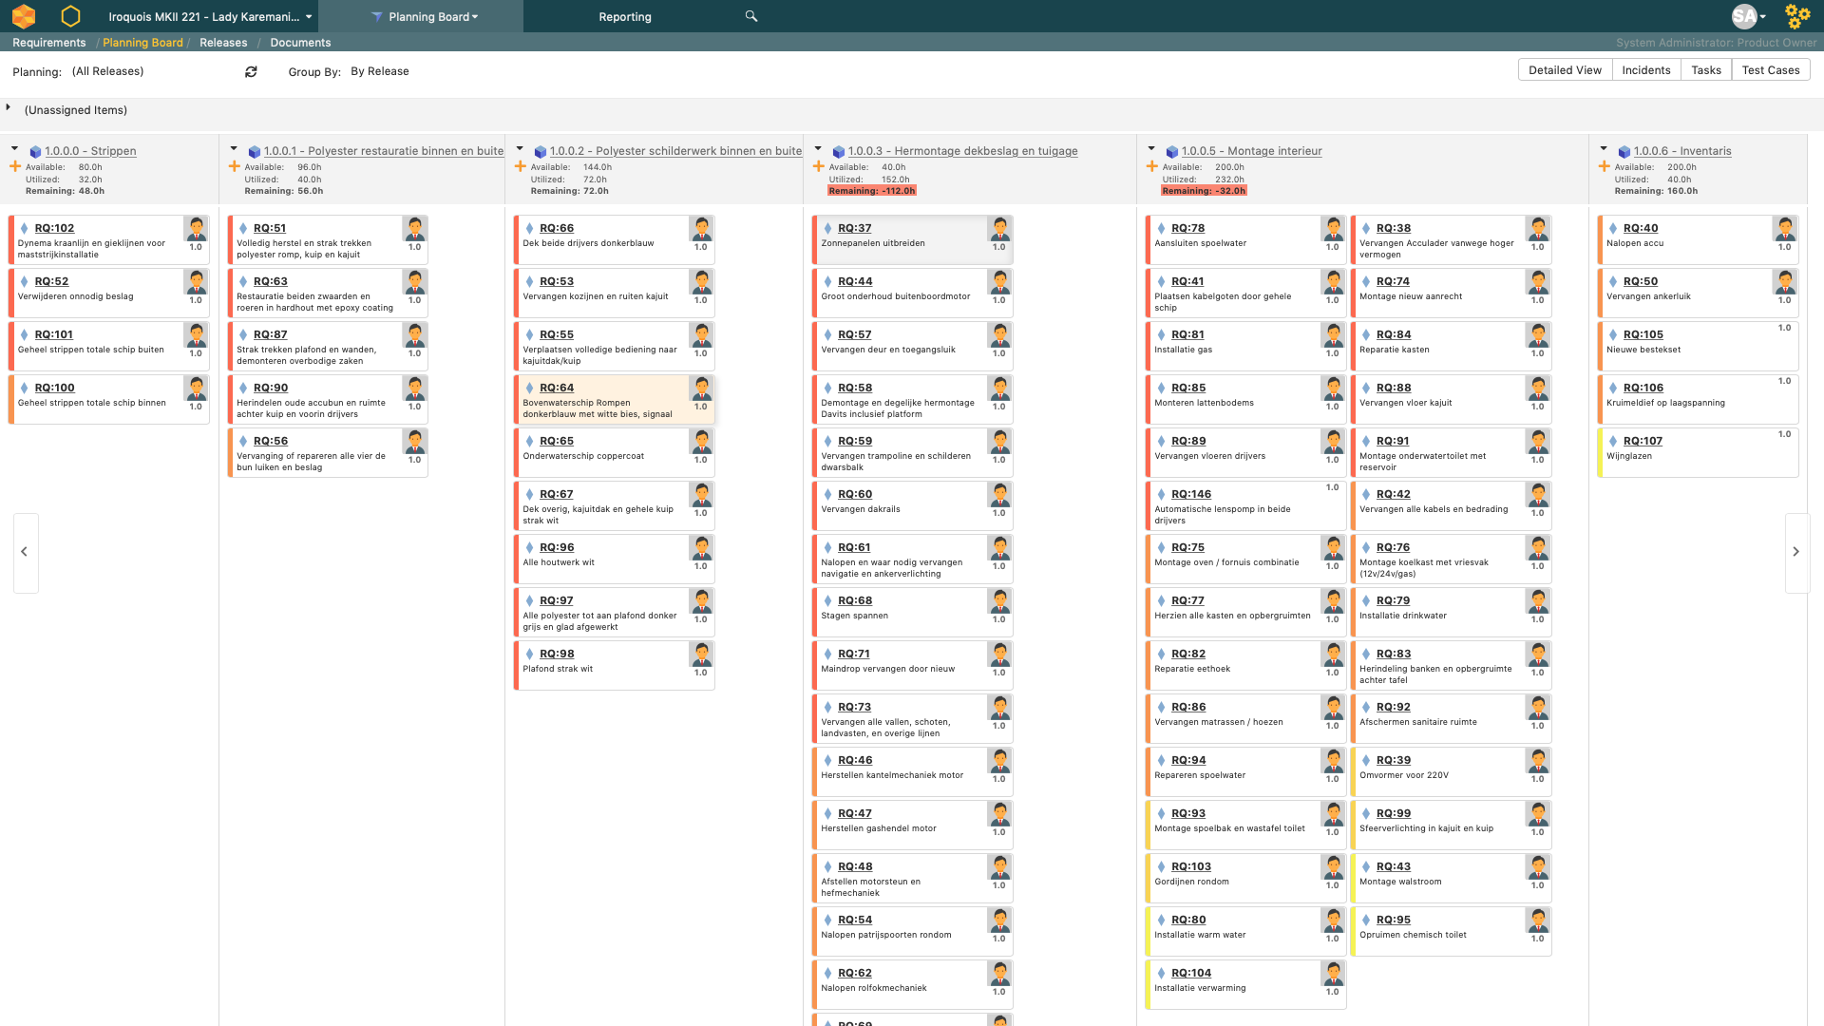
Iroquios MkII – Lady Karemaniya (2019 - ???)

Slide 34
Conclusions

Slide 35
Conclusions / lessons learned
Every customer, every project and every product is slightly different, think about that before configuring Spira
Spira is highly adaptable to changes in context, use this as an advantage, learn to properly use your tools
Constant involvement of Spira knowledge in a project is essential and can make or break the project and the commitment for using Spira products
“When configured with care, adapted to context and managed properly SpiraTest / SpiraTeam / SpiraPlan is the best ALM toolkit available on the market” (personal opinion)

