Slide 1
Goodbye to Old Tools
@Inflectra | #InflectraCon
Notes:
Building on ‘Spira admin 1’ you will learn more advanced administration topic including configuring artifact fields and workflows, modifying email notifications, changing the planning and testing settings, and the best practices for security and single-sign-on integration.

Slide 2
Peter Brackstone
Managing Director, Influence IT Consulting Pty Ltd
Sales Manager (ASPAC)
Inflectra Corporation
Brisbane. Australia
e peter.brackstone@Inflectra.com
e peter.brackstone@Influenceit.com.au
w www.influenceit.consulting
w www.inflectrasoftware.com.au

Slide 3
Objectives
We recently added a new risk management module to our Spira platform.
We will demonstrate the end-to-end workflow for using these new features.
We will cover the risk management lifecycle, from identifying and analysing risks, to evaluating and treating them with mitigations, and action items (tasks).
We will also discuss the methodologies used for ranking risks by probability and impact and how you can customise the exposure metrics used by Spira.

Slide 4
Risk Management
SpiraPlan now supports IT Risk Management out of the box
Supports the analysis and categorization of Risk based on Probability and Impact
Risk exposure is subsequently calculated and displayed as negative exposure
Both Risks and Mitigations are tracked and managed
Dynamic reporting tools included

Slide 5
Risk Overview
A Risk is something that could happen
Managing a Risk is about recognition, validation, evaluation and identifying mitigations to reduce or nullify the impact
SpiraPlan helps you to organise and manage Risks that you’ve identified for your project
Single tool solution for managing your IT project
Use the process out of the box or customise to your organisation

Slide 6
Creation
Create a Risk artefact

Slide 7
Phrasing a Risk
Risks are things that may happen
“Event that has an effect on the objective, caused by (something), resulting in consequences”
Example: ”Data Security: Data Security breach caused by insecure network resulting in $10M law suit.”
Use this standard format to make Risks clear and easier to assess

Slide 8
Risk Type
Use out of the box
Customise to your organisation

Slide 9
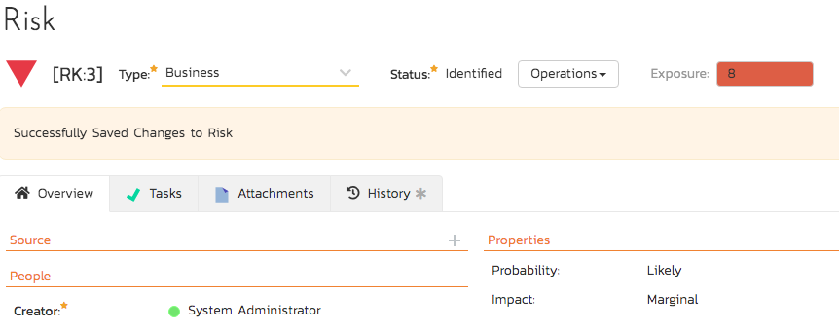
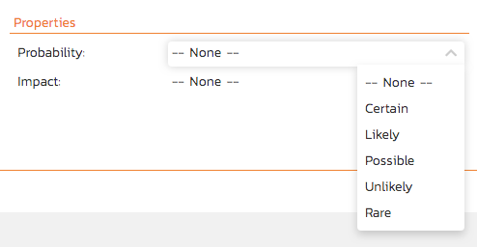
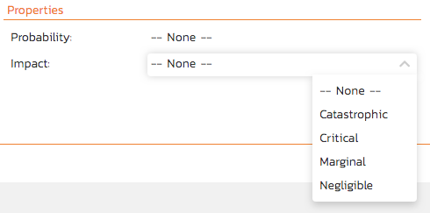
Probability & Impact
Out of the box
Customise to your organisation
Used to calculate Exposure
Displayed as a coloured bar on the Risk record
Displayed on the Dashboard as a Summary Chart

Slide 10
Risk Summary
Displayed on General Dashboard as a grid
Active entries (click on the item to view it)

Slide 11
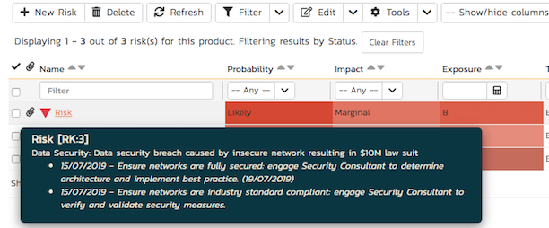
List View
Show/Hide Columns
Edit individually or in bulk
Hovering over the Name displays description and mitigations

Slide 12
Bulk Edit
Select at least one record
Edit/Save visible fields
Show/Hide columns to be edited

Slide 13
Side Bar
Quick access to saved filters
Useful charts to quickly view the risks for the Product

Slide 14
Mitigations
A mitigation is an action to be taken to minimise the impact of an identified Risk
Added at the record level
Sometimes referred to as “treatments”
Multiple Mitigations can be added and ordered

Slide 15
Mitigation Edit
Edit Panel

Slide 16
Ordered Mitigations
Multiple mitigations for the same Risk
Can be ordered to effectively apply Mitigation outcomes
Review dates can be set against Mitigations
Tasks can be set against the Risk

Slide 17
Task
Risk/Mitigation may require Tasks to be performed
Create Task from the Risk
Automatically associated

Slide 18
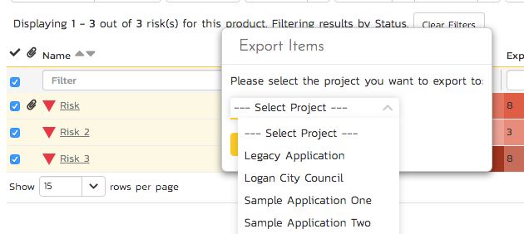
Export
To an application (Excel, Word, PDF)
To another Product

Slide 19
Default Workflow
Default Workflow
Or Customise

Slide 20
Operations
Defined by Workflow and User’s Role
Only eligible Operations are displayed for the current status of the artefact
Digitally Signed Operations are indicated with a padlock

Slide 21
Digital Signature
Provides electronic sign-off for Operations that require it

Slide 22
Risks to Issues
Risks which eventuate are Issues
Currently processed as Incident Type of “Issue”
Go to Incidents and filer for Issue
Side Bar Quick Filer
Quick View Charts
Issue Management to be Updated Soon

Slide 23
Questions?

