Slide 1
From Single Test to Test Framework With Rapise
@Inflectra | #InflectraCon

Slide 2
Alexey Grinevich
Rapise Engineer, Inflectra
@AlexeyGrinevich

Slide 3
From Test to Test Framework
Single Test
Scenario
Objects
Libraries

Slide 4
From Test to Test Framework
Test 1
Test 2
Test 3
Test 4
Test 5
Test 6
Test 7
Test 8
Test 9
…
…

Slide 5
From Test to Test Framework
Shared Code
Shared Objects
Shared Libraries
Shared Object Types
Re-use Same Scenarios for Different Purposes
Maintenance
Group Work

Slide 6
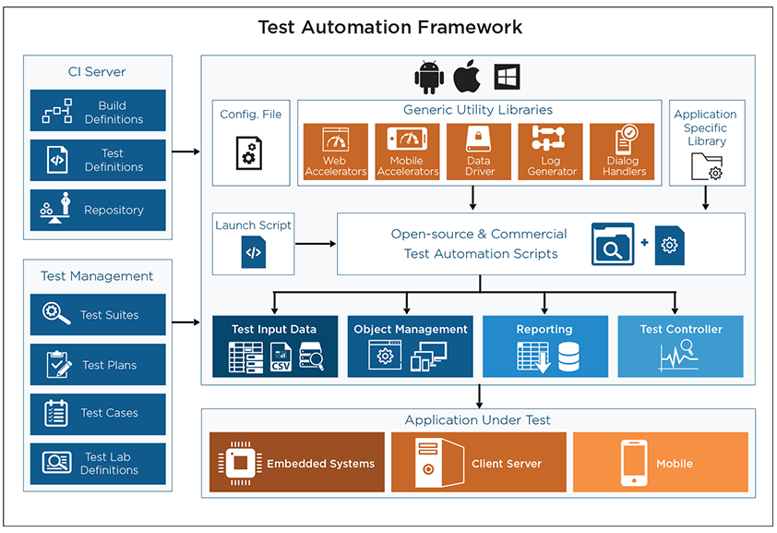
From Test to Test Framework

Slide 7
From Test to Test Framework
Ease of scripting
Scalability
Modularity
Understand-ability
Re-usability
Cost & Maintenance
Maximum coverage
Better error handling
Minimal manual intervention
Easy Reporting
Segregation
Test Configuration
Continuous integration
Debugging

Slide 9
Framework in Rapise + Spira
Key Features
Maintainability
Clarity (Understand-ability)
Re-usability

Slide 11
Create Framework In Rapise

Slide 12
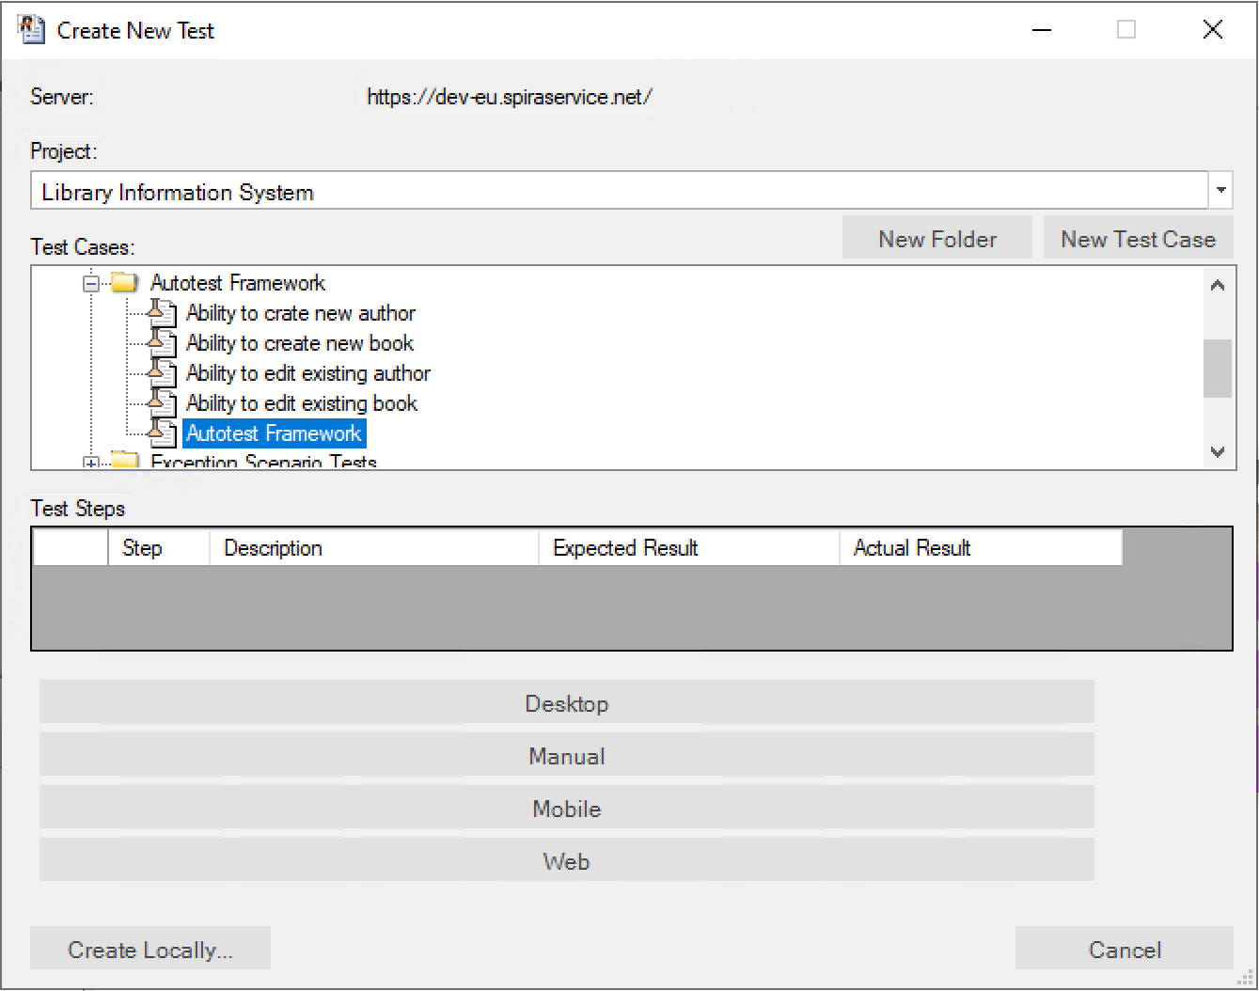

Slide 13
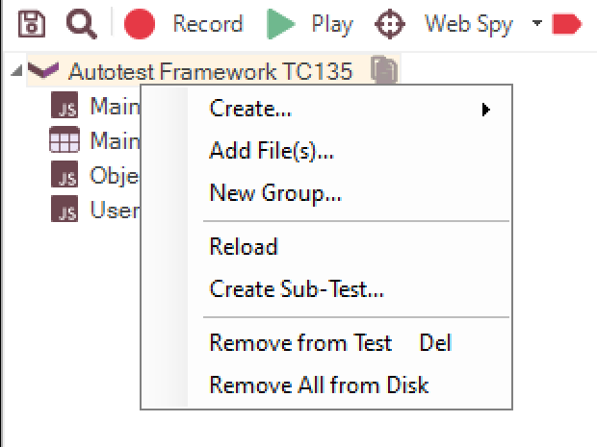
Adding Sub-Tests

Slide 14
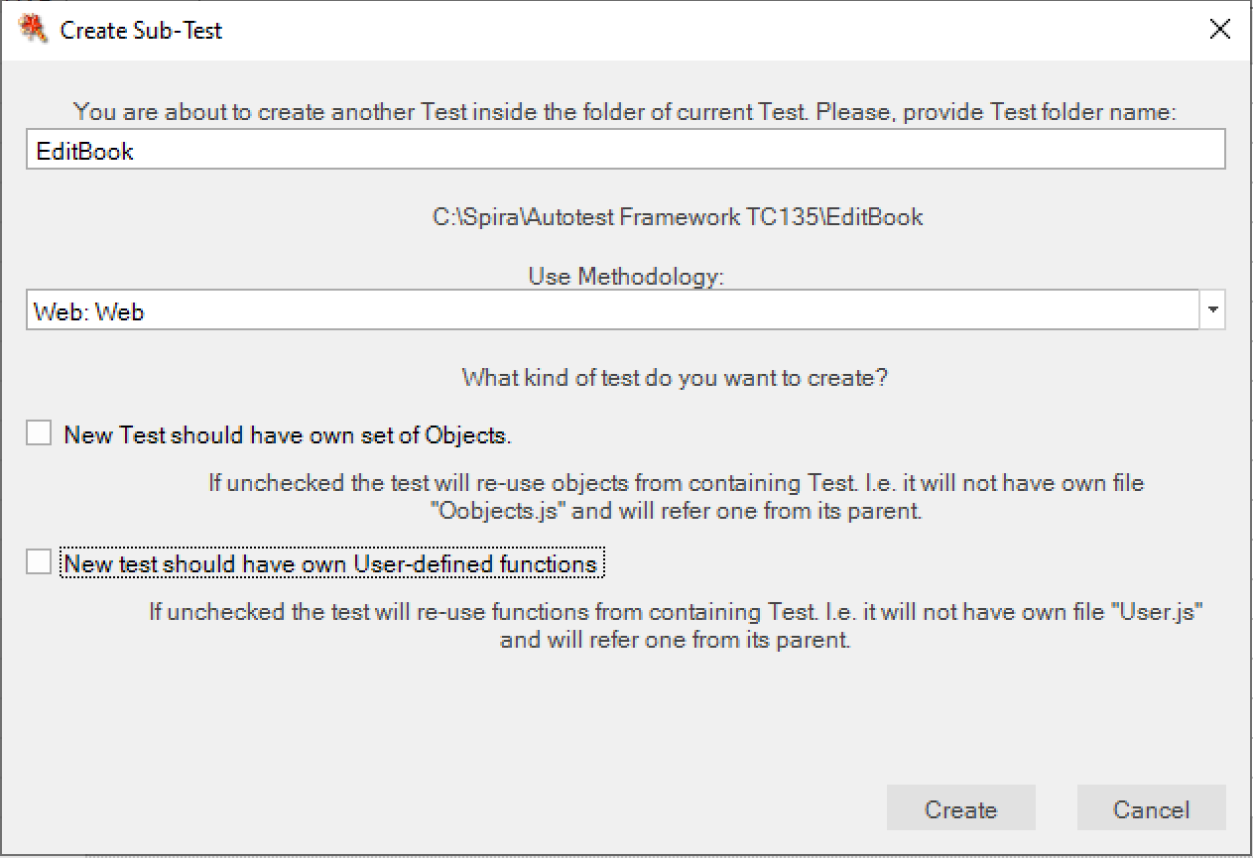
Making it a part of the Framework

Slide 15
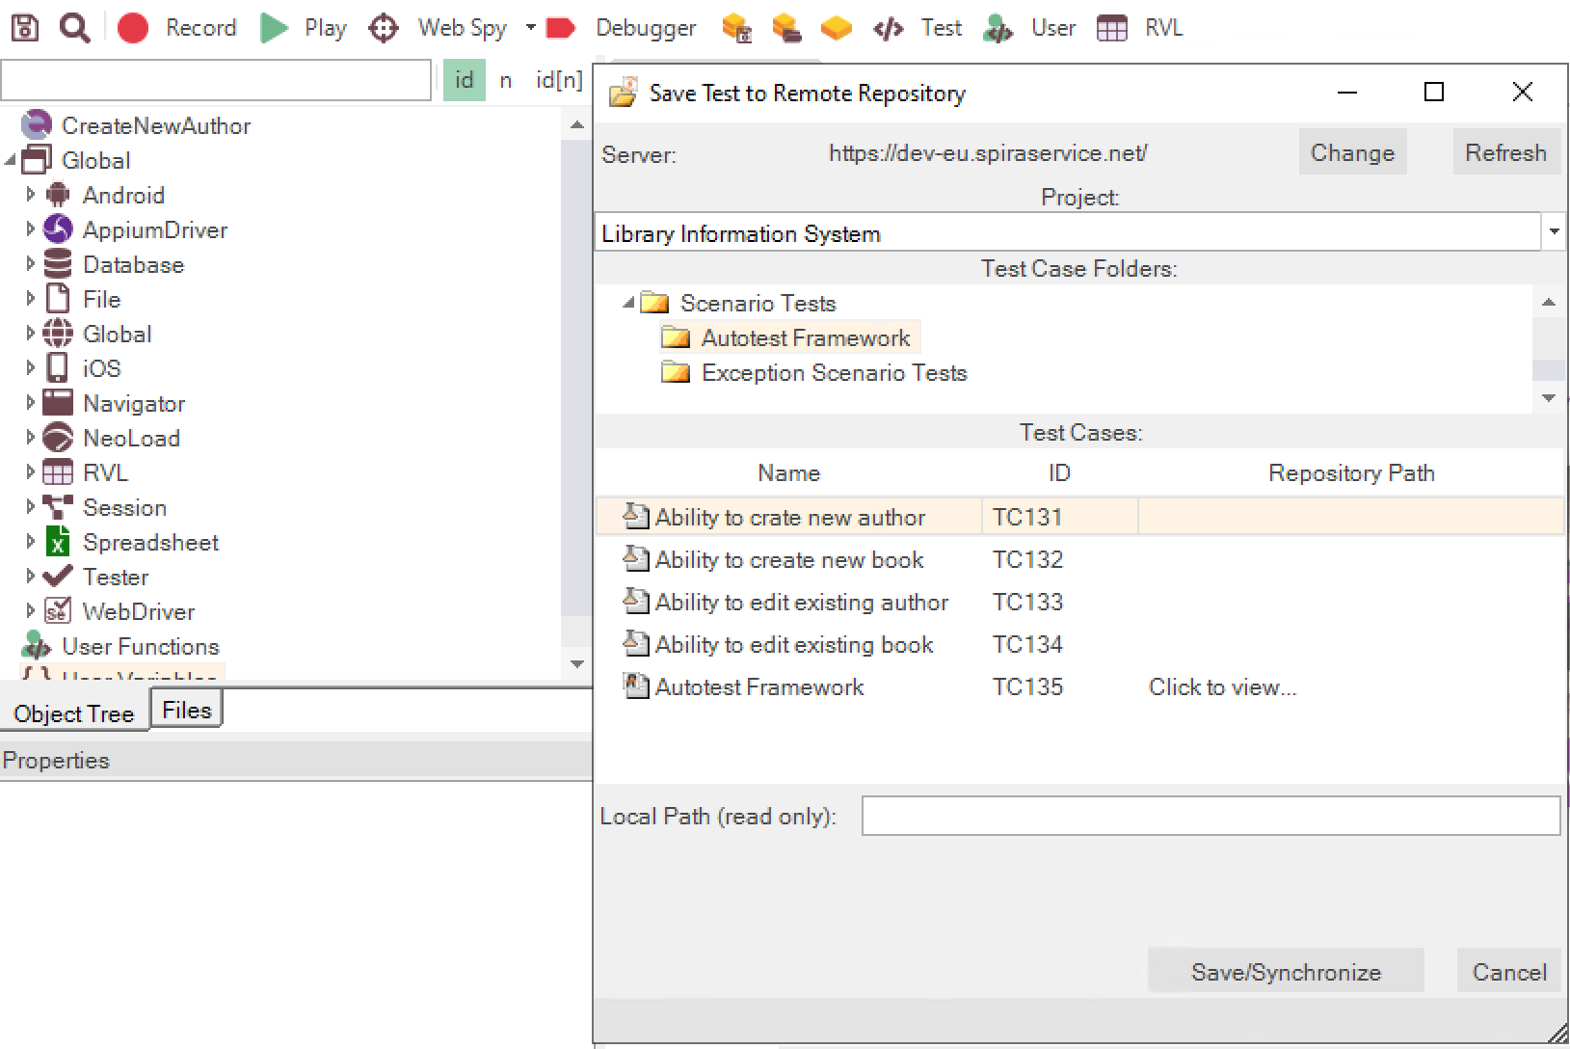
Saving to Spira

Slide 16
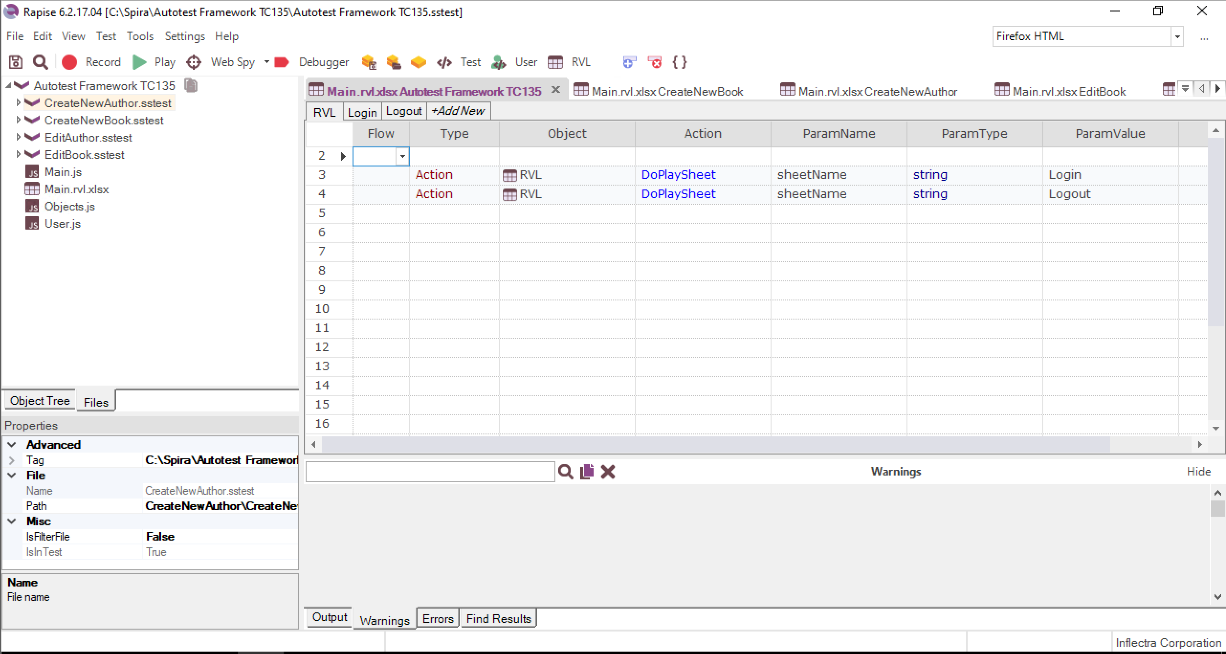
Test Set Cases in Rapise

Slide 17
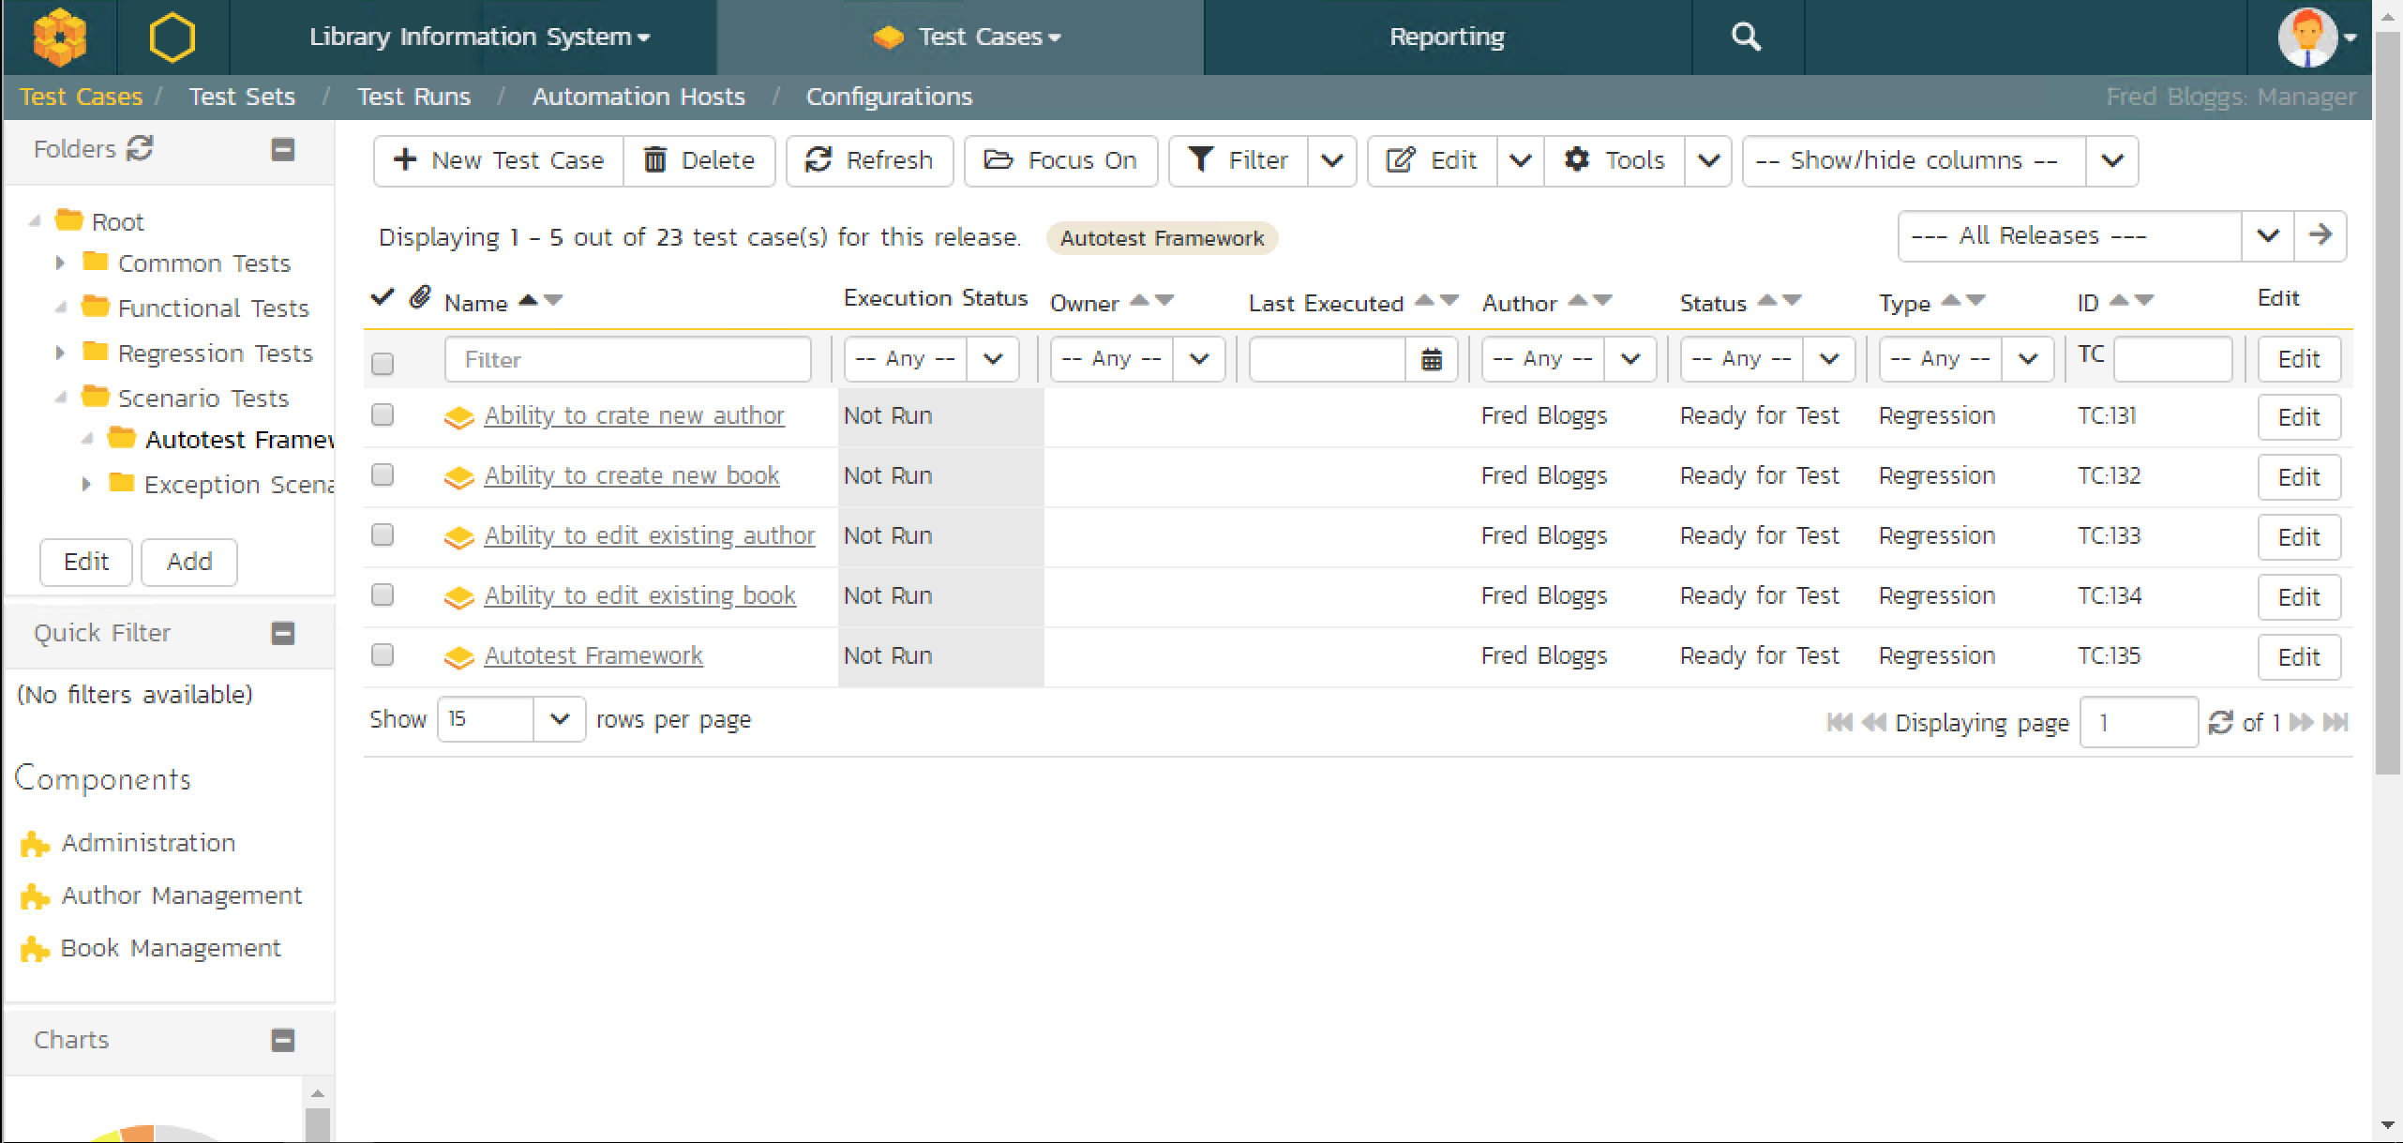
Test Cases in Spira

Slide 18
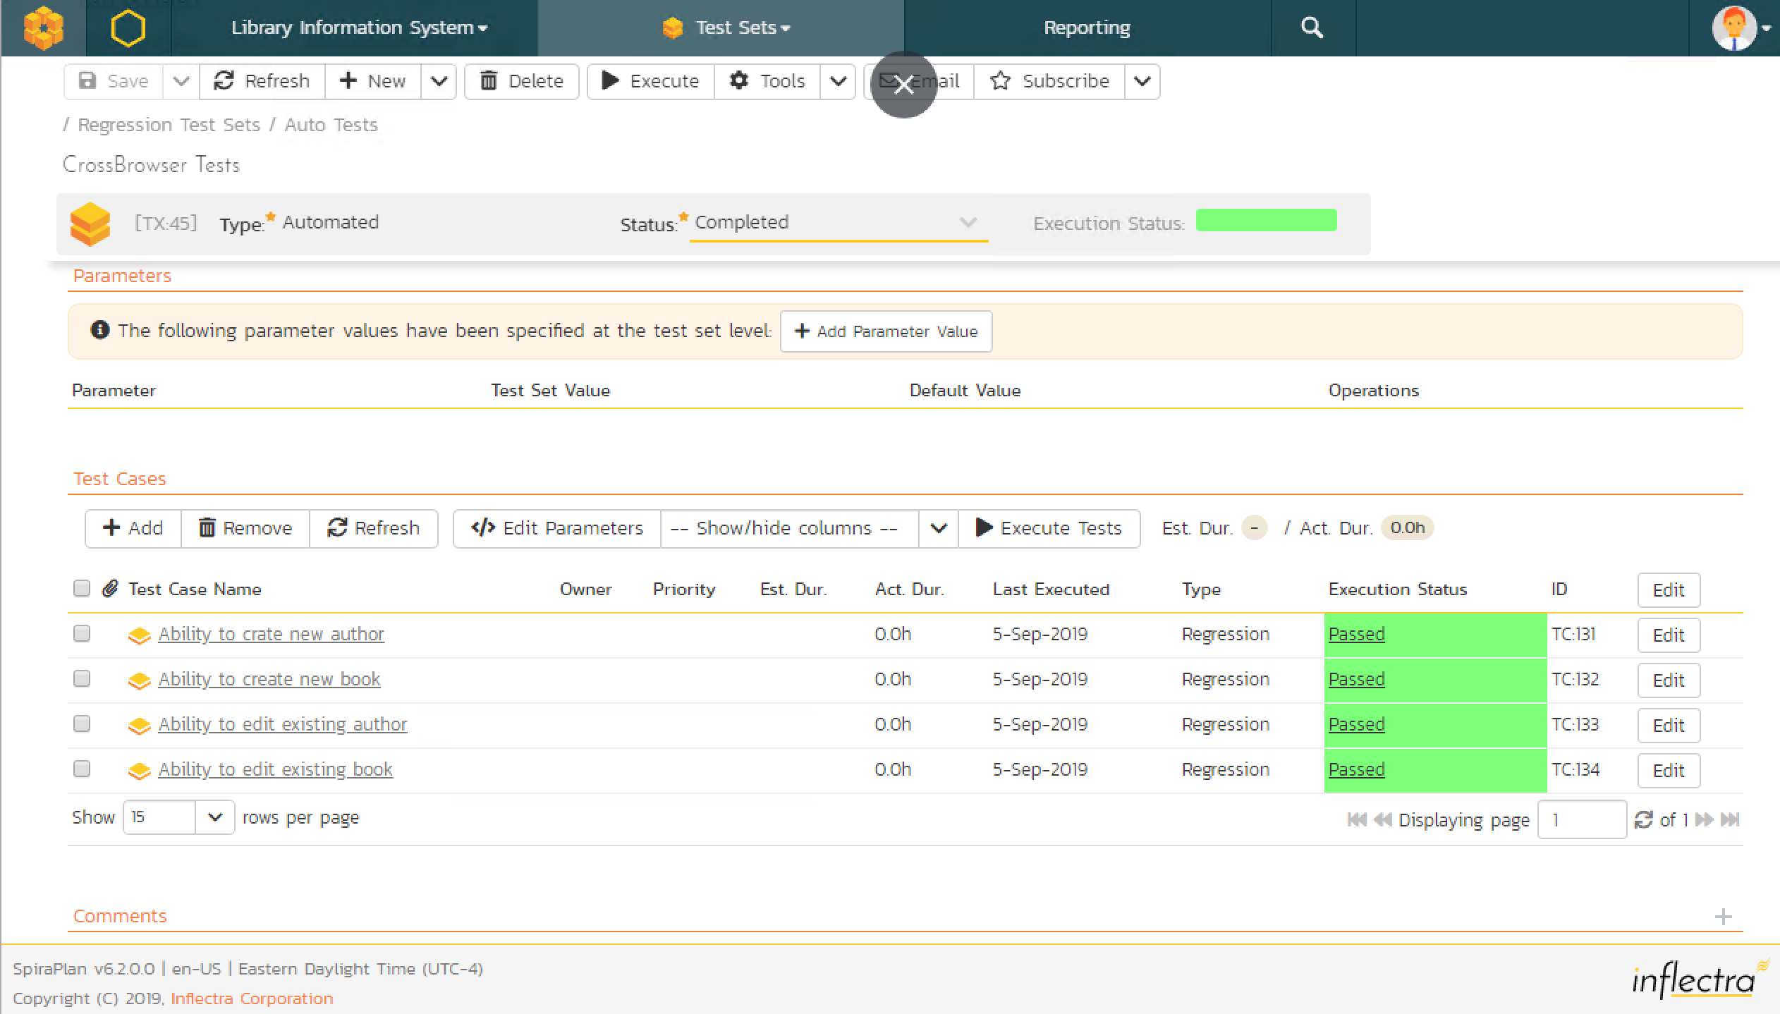
Combine Test Set

Slide 19
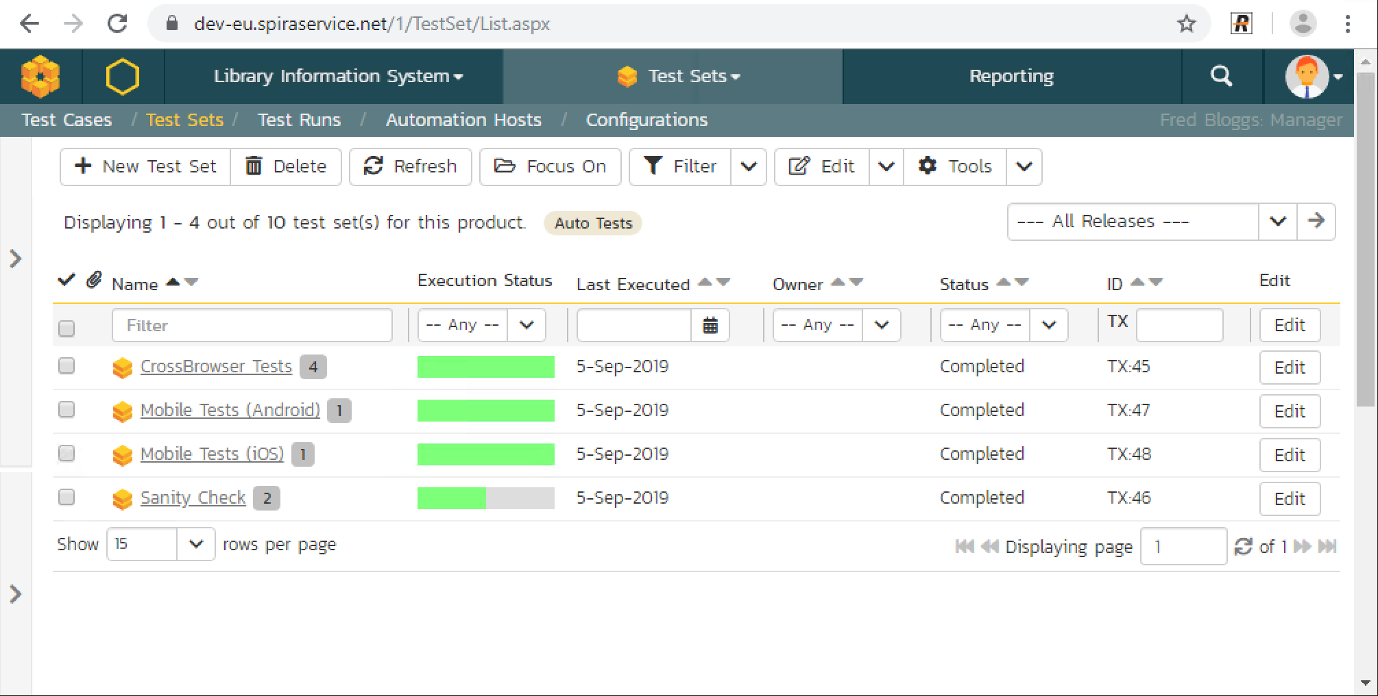
Several Test Sets

Slide 20
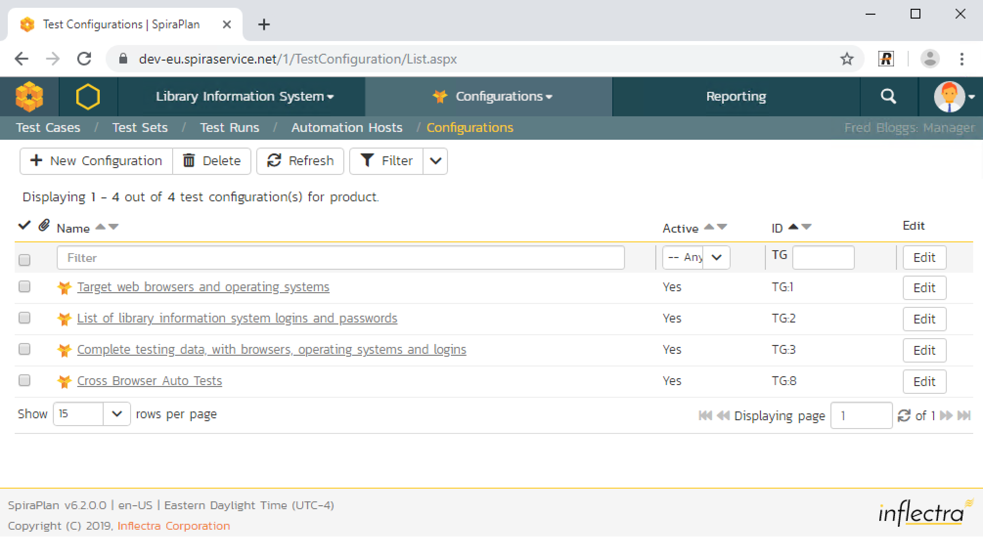

Slide 21
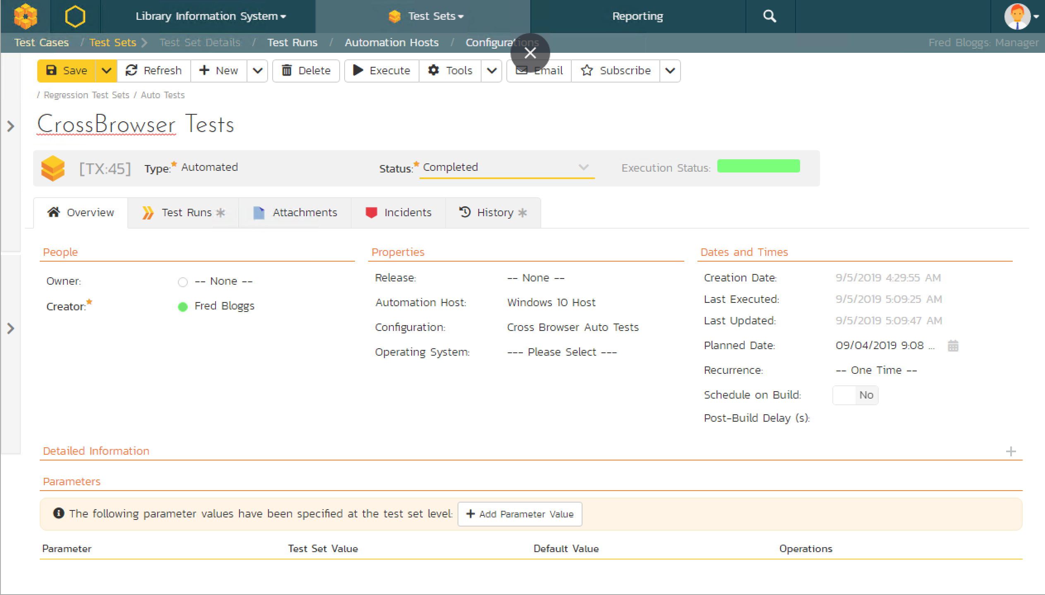

Slide 22
Test Set Level
One framework – many test sets
Test Set Configurations

Slide 23
Configuring
Single Test - Parameters
Test Set – Configuration
Product - Configurations

Slide 24
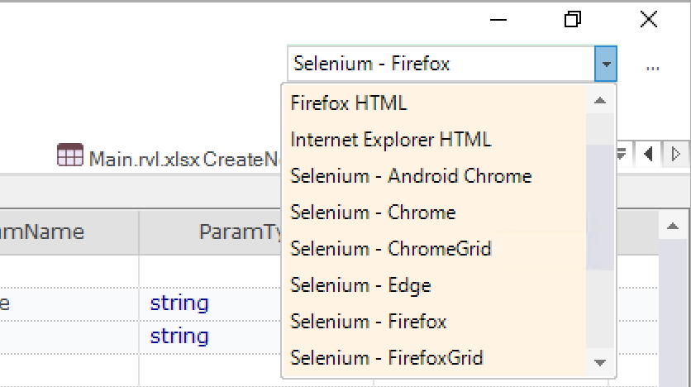
Change Test Purpose
Change Browser
Run on Mobile Device

Slide 25
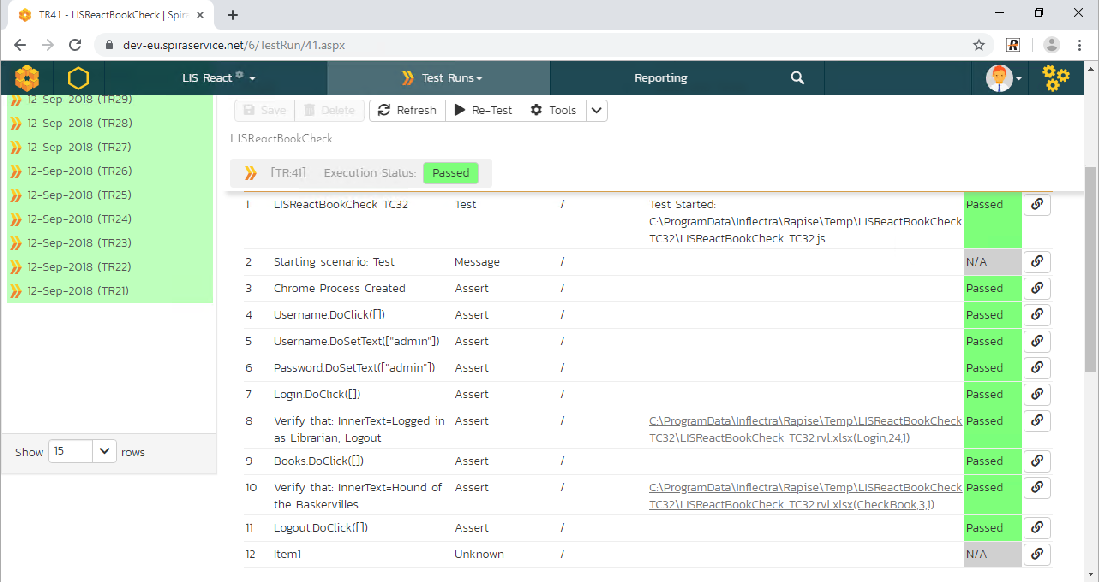
View Execution Steps

Slide 26
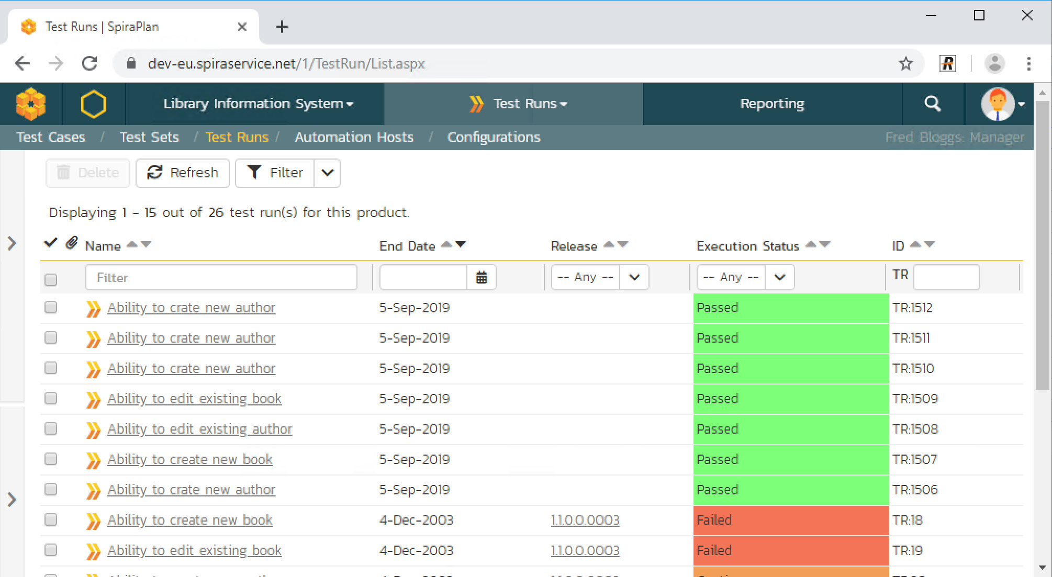
View Execution History

Slide 27
Rapise + Spira is a Framework
Pre-configured (Decisions are made)
You may change them
Pre-Defined Path From Test to Test Set
Selected Key Features
Maintainability
Clarity (Understand-ability)
Re-usability

Slide 28
Q&A
Contact me:
@AlexeyGrinevich
alexey@inflectra.com

